Slide 1

Islamic Civilisations and its influence
Name a famous:
Mathematician
Scientist
Writer
MARÍA SANZ

Slide 2
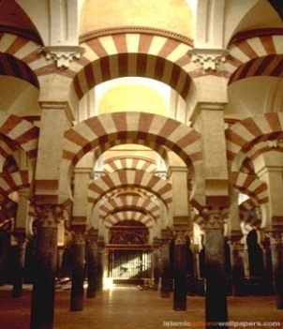
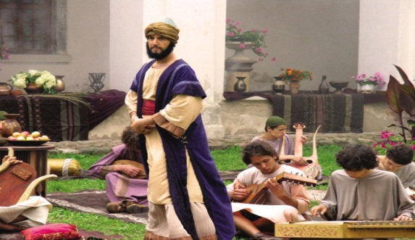
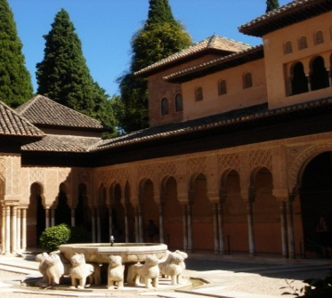
Islamic Civilisations and its influence
WHAT
…are we learning?
To understand Muslim contributions to science and art
To be able to describe some of the most important contributions
Explain why these contributions were significant
Students will be able to explain why these contributions are a significant part of History
Students will be able to describe the contributions in two or three sentences
Students will be able to show understanding about some of the most important influences
Key Words: astronomers , astrolabe, influences
Activate

Slide 3
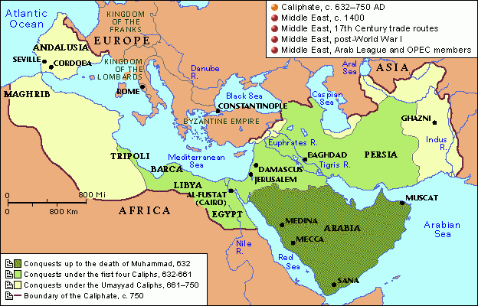
Cordoba is a town in Spain. Samarkand is in Central Asia. They are thousands of km apart, but they have one thing in common. They once shared in the Islamic Empires

Slide 4
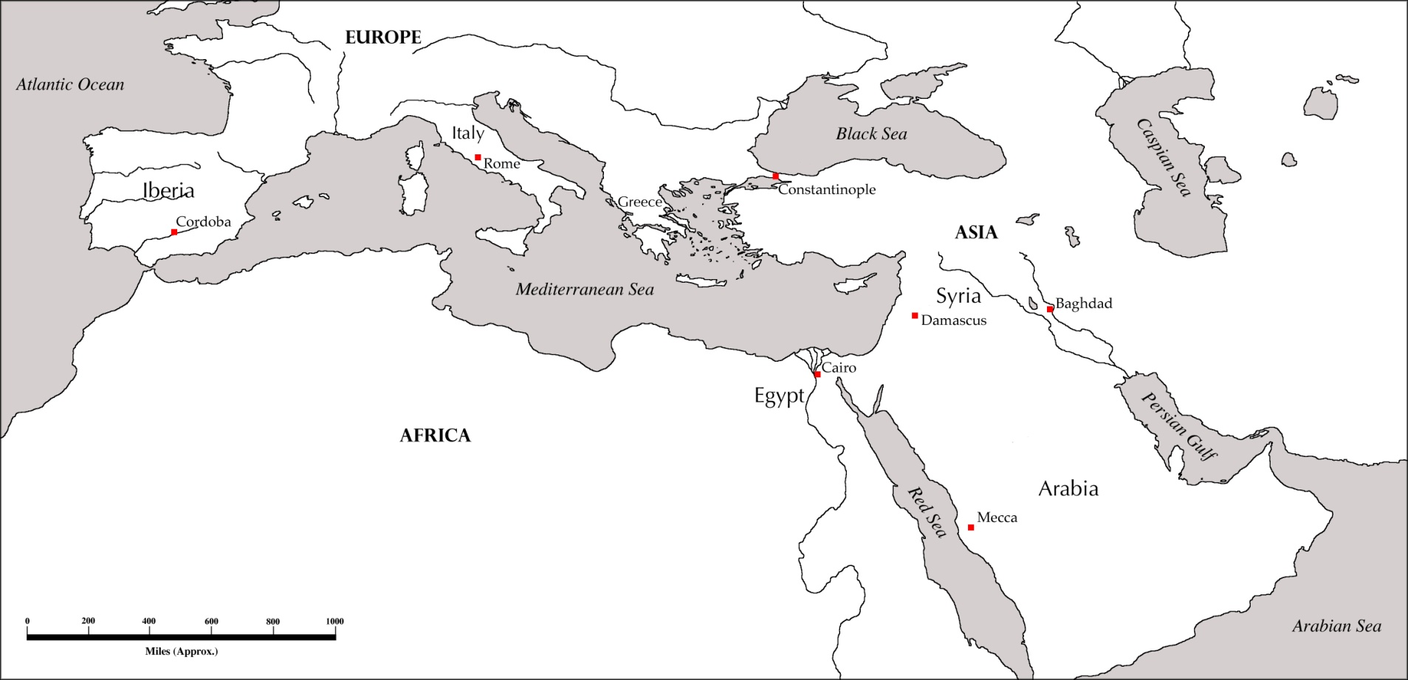
Demonstrate
Use the coloured map to help you identify and colour in the different stages of the Islamic Empires.
The Spread of Islam

Slide 5
So why did the Muslims have Empires?
Swords, slaves, spices, ivory and teak from India
Weapons from Afghanistan
Furs from Europe
Horses, pottery, silk and paper from China
Slaves from Europe
Horses from Arabia
Papyrus and linen from Egypt
Slaves from East Africa
Now find the countries and add these goods to your map

Slide 6

Consolidate
The Islamic Empires were only a part of Arabia. They only covered one country and didn’t last very long, they didn't take any thing from other countries!
Do you agree with this statement?
If not, why?

