Slide 1
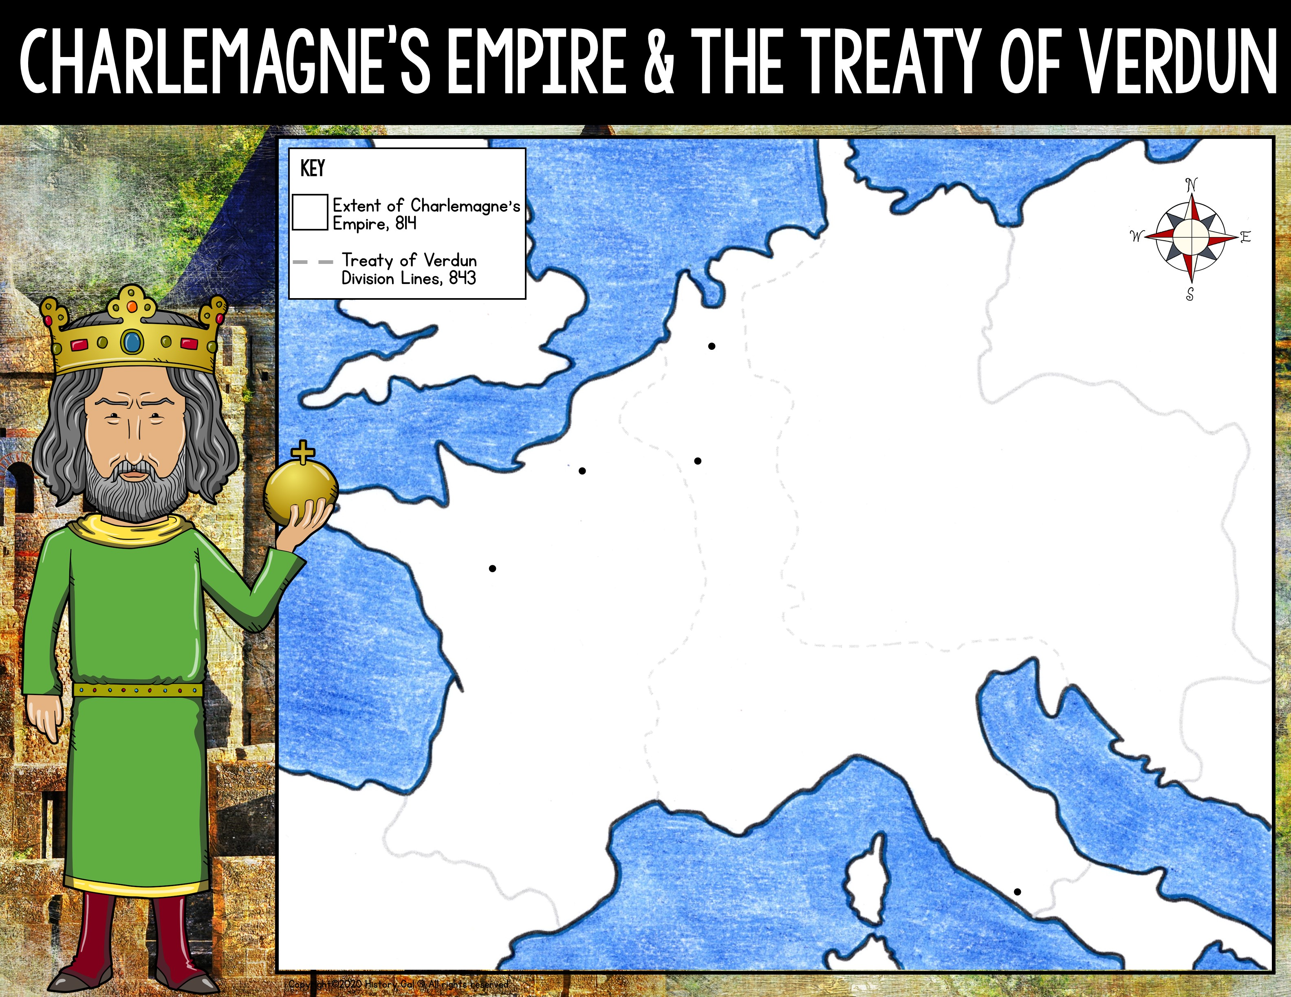
BALTIC SEA
NORTH SEA
ATLANTIC OCEAN
MEDITERRANEAN SEA
Notes:
Background Image ©@ Maugli (Deposit Photos), used with permission
Clip Art ©Prince Padania, used with permission
Clip Art ©Artventurous Life, used with permission
Map ©History Gal®

Slide 2
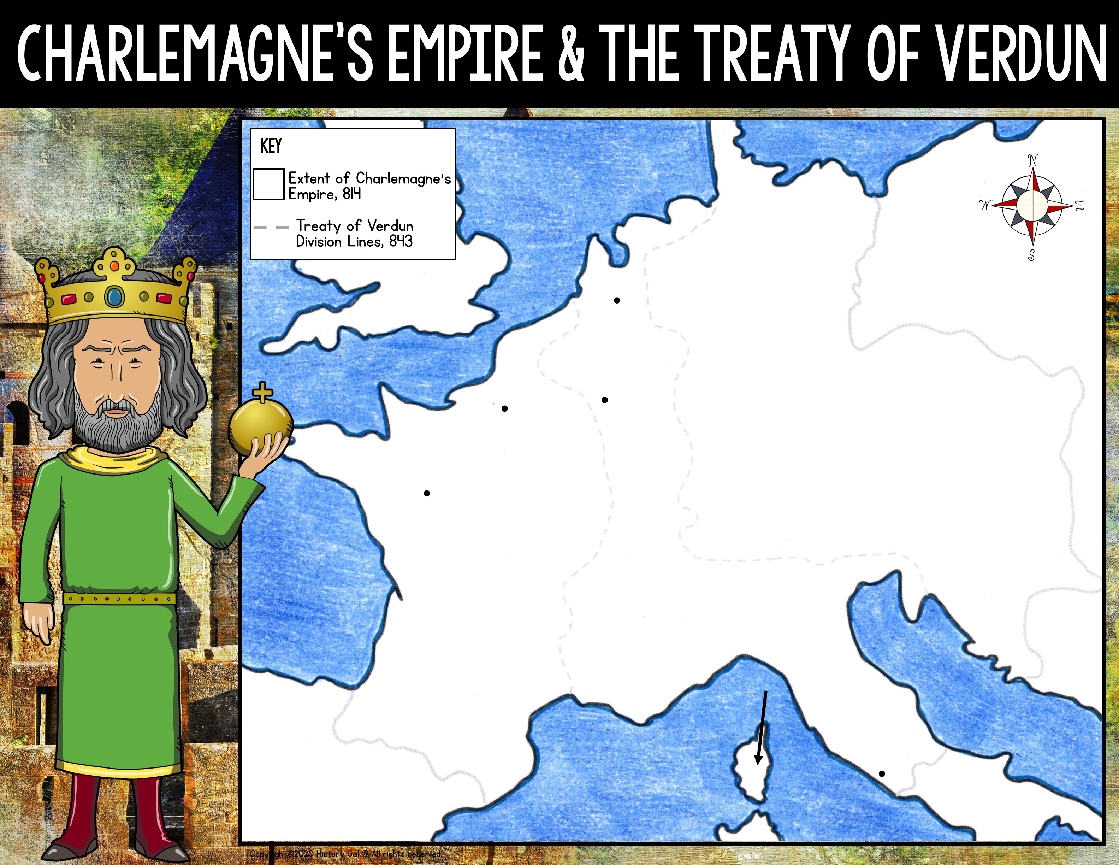
Baltic Sea
North Sea
Aachen
Paris
Verdun
Tours
Atlantic Ocean
Corsica
Rome
Spain
Mediterranean Sea
Notes:
Background Image ©@ Maugli (Deposit Photos), used with permission
Clip Art ©Prince Padania, used with permission
Clip Art ©Artventurous Life, used with permission
Map ©History Gal®

Slide 3
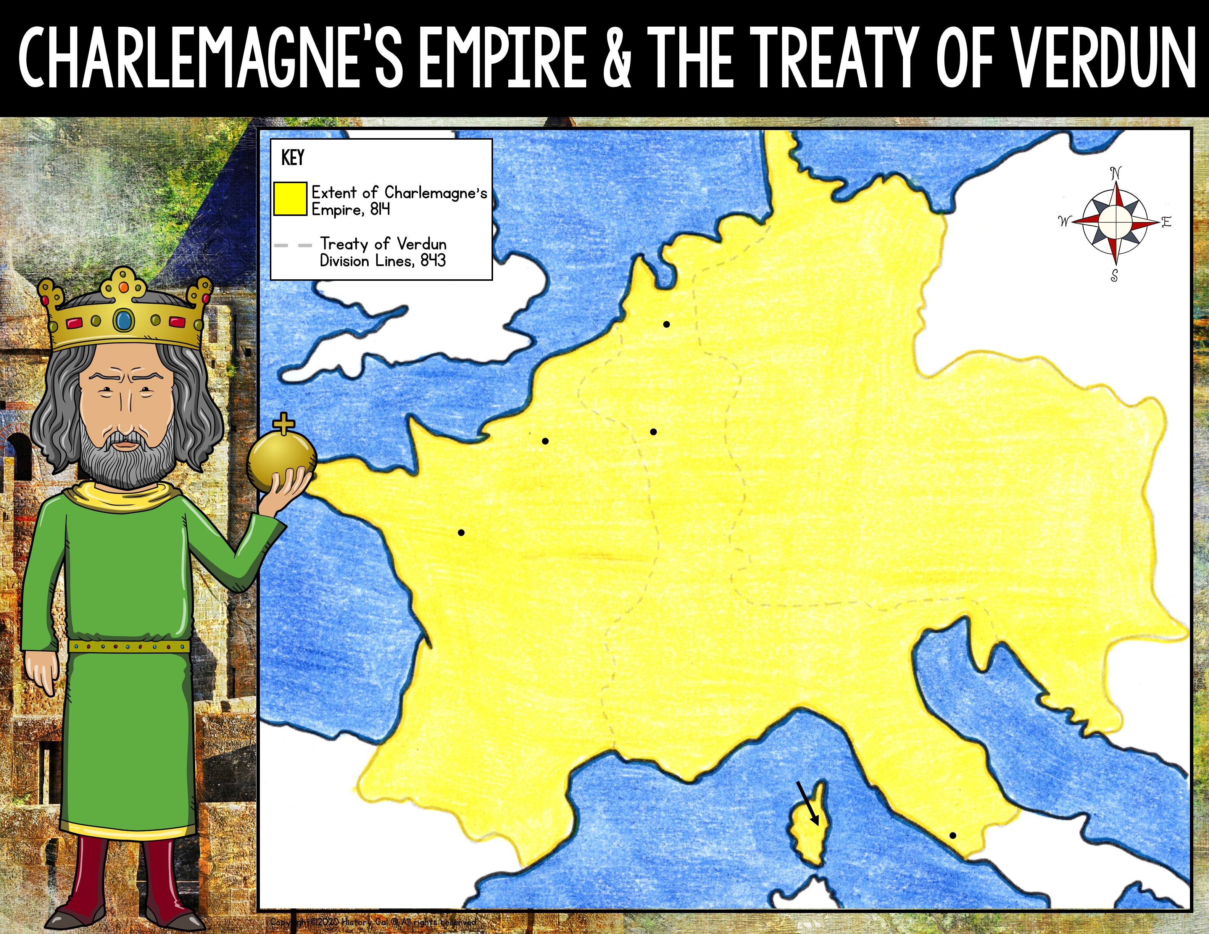
Baltic Sea
North Sea
Aachen
Verdun
Paris
Tours
Atlantic Ocean
Corsica
Rome
Spain
Mediterranean Sea
Notes:
Background Image ©@ Maugli (Deposit Photos), used with permission
Clip Art ©Prince Padania, used with permission
Clip Art ©Artventurous Life, used with permission
Map ©History Gal®

Slide 4

Baltic Sea
North Sea
Aachen
Verdun
Paris
Tours
Atlantic Ocean
Corsica
Rome
Spain
Mediterranean Sea
Notes:
Background Image ©@ Maugli (Deposit Photos), used with permission
Clip Art ©Prince Padania, used with permission
Clip Art ©Artventurous Life, used with permission
Map ©History Gal®

Slide 5
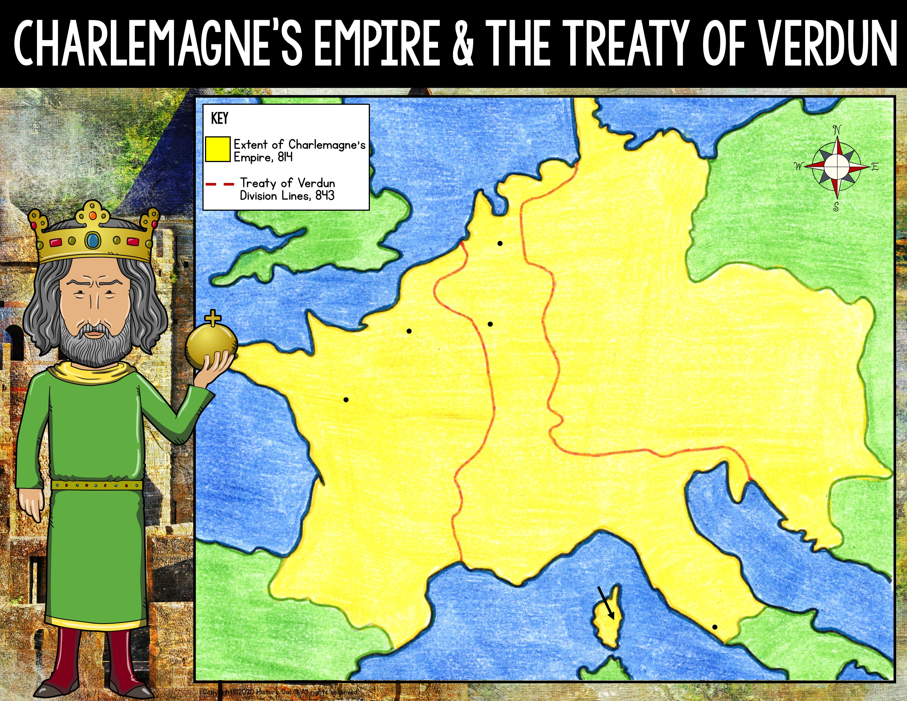
Baltic Sea
North Sea
Aachen
Verdun
Paris
Tours
Atlantic Ocean
Corsica
Rome
Spain
Mediterranean Sea
Notes:
Background Image ©@ Maugli (Deposit Photos), used with permission
Clip Art ©Prince Padania, used with permission
Clip Art ©Artventurous Life, used with permission
Map ©History Gal®

