Slide 1
*Bellringer: 3/8 and 3/9*
1. Pick up the papers by the door.
2. Update your ToC:
  114: Activity: Life of Charlemagne Chart
  115: Notes – Feudalism in the Middle Ages
3. Write down your HW:
  None! Enjoy your evening off from reading! ☺

Slide 2
*AGENDA: 3/8 + 3/9*
1. Bellringer
2. Reading Check
3. Activity: Life of Charlemagne Reading/Chart
4. Quick Notes: Feudalism
5. Start “Dark Ages” documentary (time-permitting)

Slide 3
Pre-Notes Activity: Charlemagne Reading and Review
Life of Charlemagne Activity
Read the Life of Charlemagne reading on your own. Then, either individually or with a person sitting next to you, complete your chart for the sections in the reading: Summarize the section. Draw a picture that represents your section. Write the Impact
Notes:
Goals of Feudalism
1. Read the Goals of Feudalism and based on whether or not they accomplished the goals, answer the question (Yes, No, Maybe So).
2. Then provide a reason for your answer, making sure to include specific examples. You will have to use the History Alive books!

Slide 4
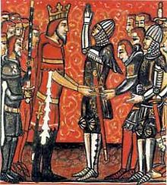
The Middle Ages:
Feudalism and the Manor System

Slide 5
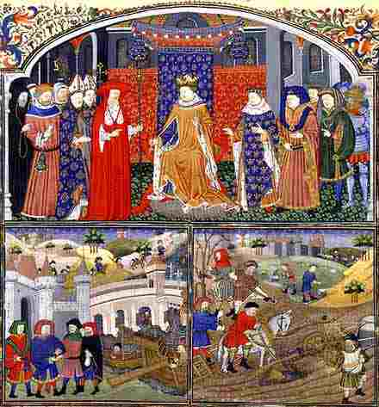
How is medieval society organized?
Kings & queens | Rulers
Nobles/lords | Controlled land in the name of the king Collect rent from serfs
Knights | Serve the lords Provide protection for manors
Serfs (peasants) | Majority of the population Worked the land in exchange for protection, place to live
Notes:
1. Kings and Queens
Rulers
2. Nobility
Lords and Knights
Controlled the land
3. Clergy
Church officials
4. Peasants
Majority of the population
Worked the land and served the nobles

Slide 6
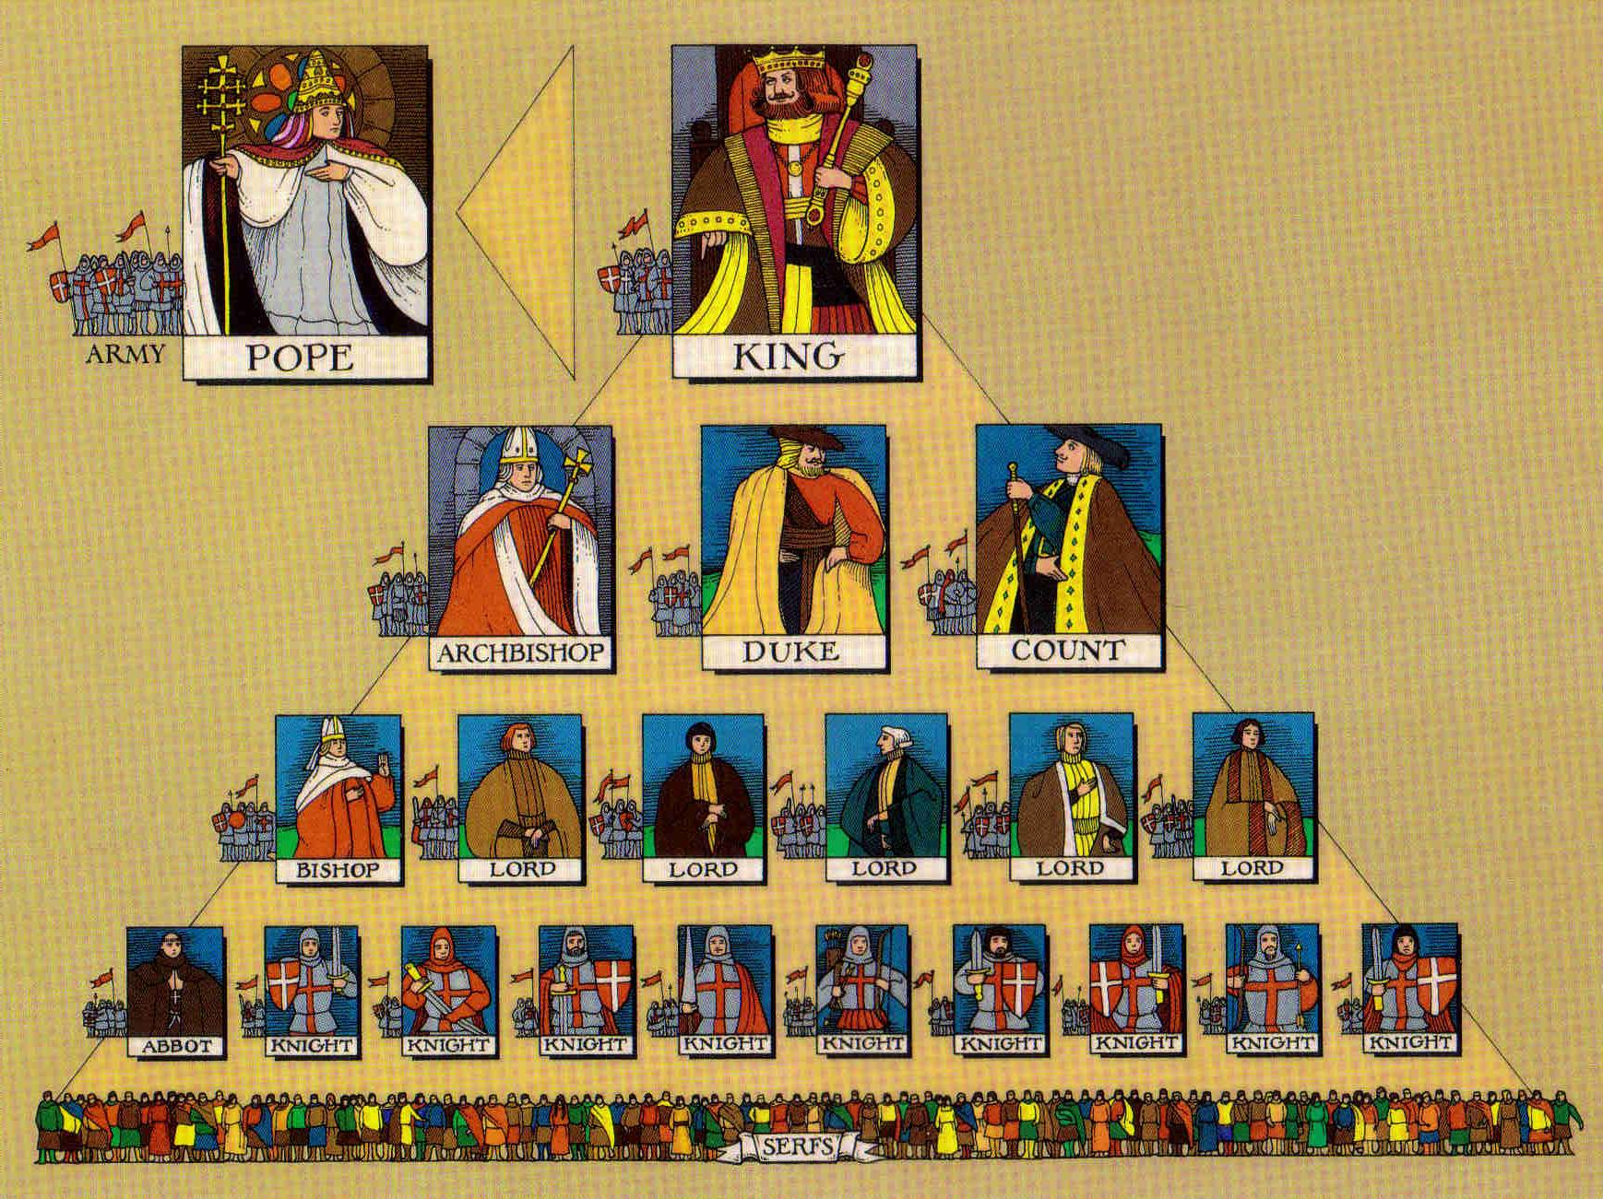
What is feudalism?
Political and social system based on the granting of land in exchange for loyalty, military assistance, working land, etc.

Slide 7


Slide 8
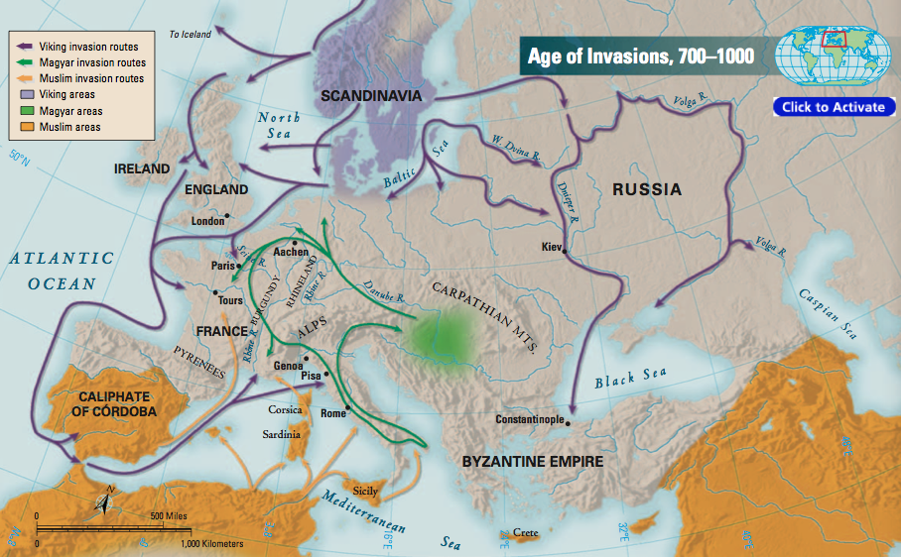
Why does feudalism develop?
1. Developed as a result of frequent invasions in western Europe
2. Kings and nobles needed to protect their lands

Slide 9
How does feudalism work?
SERFS AND FREEMEN

Slide 10
How does feudalism work?
LESSER NOBLES
(KNIGHTS)
LABOR
PROTECTION
SERFS AND FREEMEN

Slide 11
How does feudalism work?
POWERFUL
NOBLES
LOYALTY AND
MILITARY SERVICE
LAND AND
PROTECTION
LESSER NOBLES
(KNIGHTS)
LABOR
PROTECTION
SERFS AND FREEMEN

Slide 12
How does feudalism work?
KING
LOYALTY AND
SERVICE
LAND
POWERFUL
NOBLES
LOYALTY AND
MILITARY SERVICE
LAND AND
PROTECTION
LESSER NOBLES
(KNIGHTS)
LABOR
PROTECTION
SERFS AND FREEMEN

Slide 13
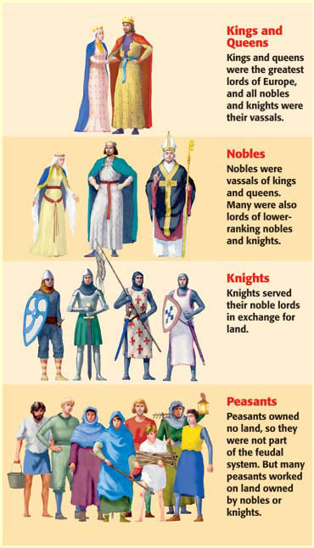
How does feudalism work?
Lords = divided their lands into sections called fiefs
Fiefs = (land) given to vassals
  Vassal: A person granted land for loyalty or military service
All nobles were vassals to the king
Knights = vassals to the lords, and so on…

Slide 14
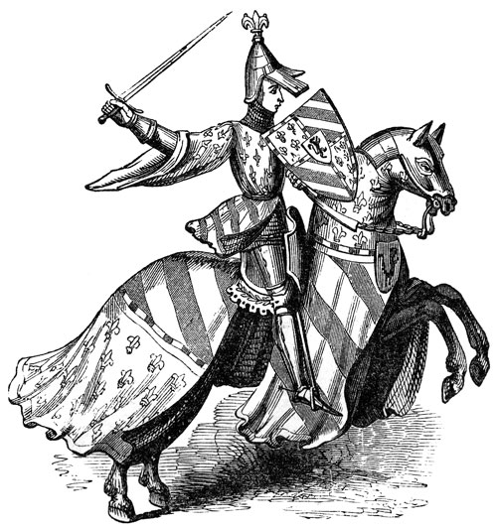
How does feudalism work?
Knights
  Mounted warriors who protected lord’s lands
  Given land for their services
  Followed code of chivalry
    Code of ethics followed by knights
    Honesty, fairness in battle, loyal, proper treatment of women

Slide 15
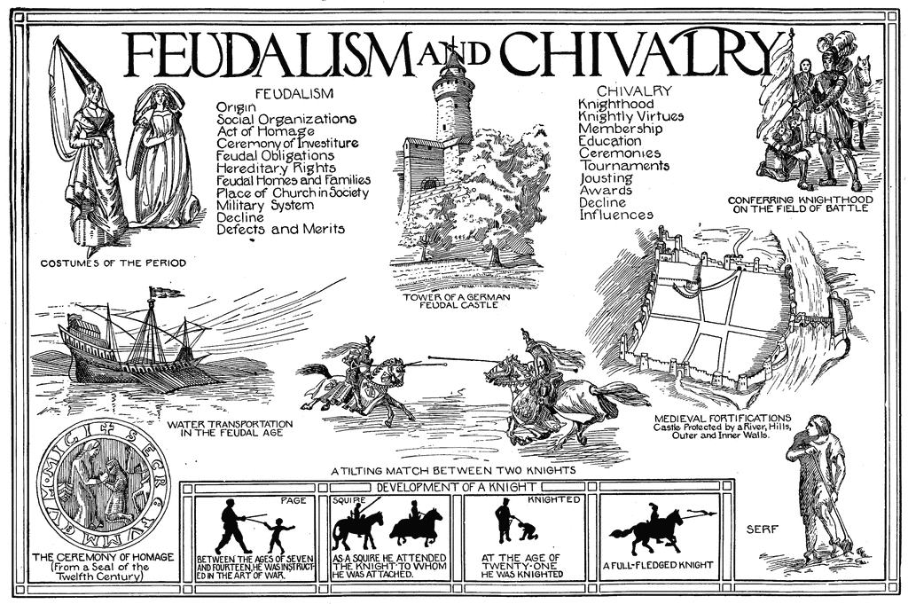

Slide 16
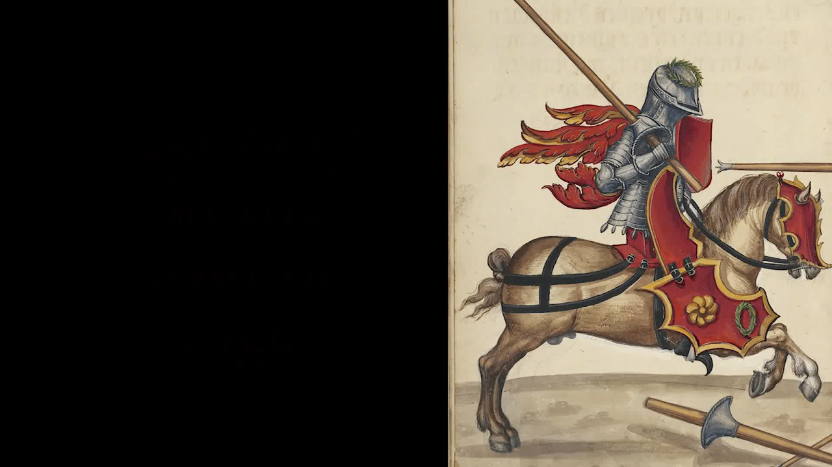

Slide 17
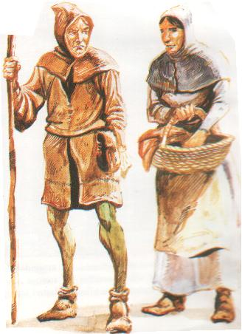
How does feudalism work?
Serfs
  Peasants = lowest class in feudal system
  Worked the land on manors in exchange for protection, place to live, etc.

Slide 18
Feudal Obligations
Knights Obligation to Lord
Lord’s Obligation to Knights
Provide military service
Remain loyal and faithful
Give money on special occasions
Give Land
Protect from attack
Resolve disputes between knights

Slide 19
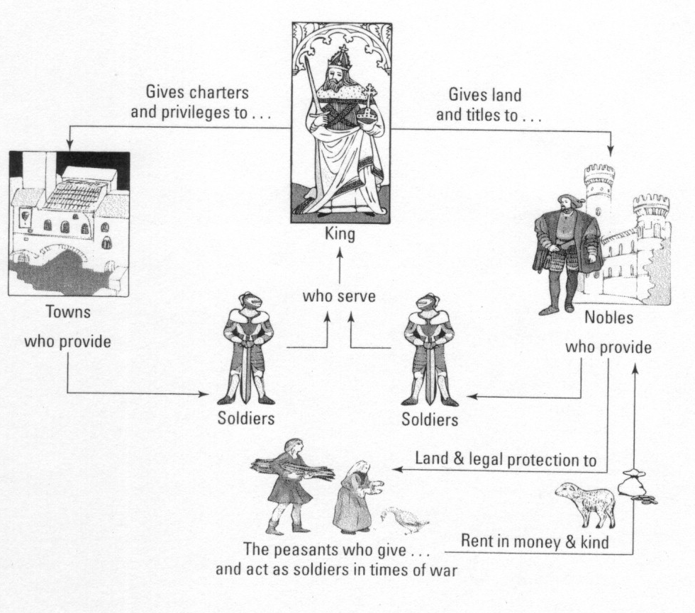

Slide 20
Feudalism has FOUR GOALS:
1. Political Order
2. Economic Stability
3. Prosperity
4. Opportunity

Slide 21
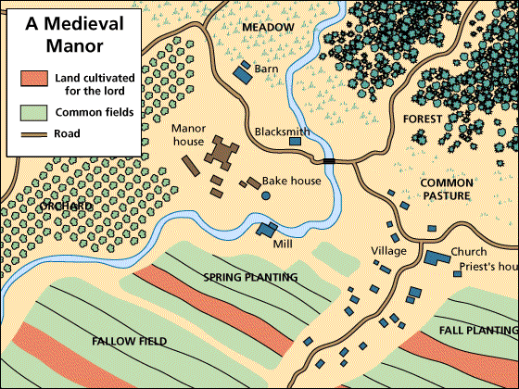
What is the manorial system?
An economic system in the Middle Ages built around large estates called manors
Included a village and the land surrounding it

Slide 22
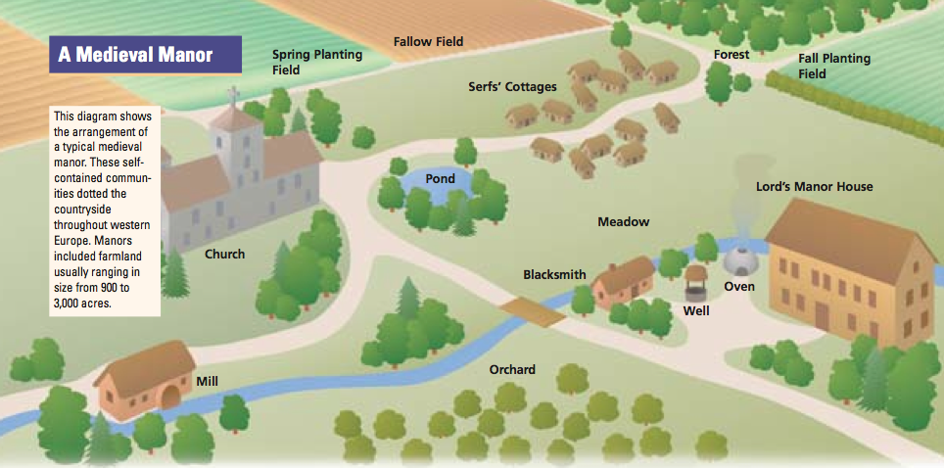
What is the manorial system?
Manors were self sufficient
  Most things needed for daily life were produced on the manor

Slide 23
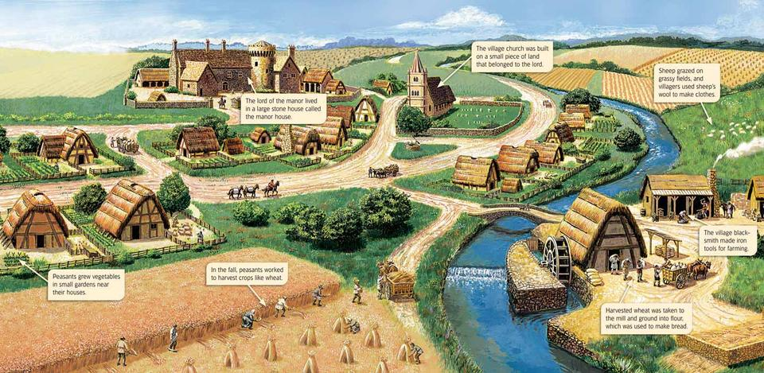

Slide 24
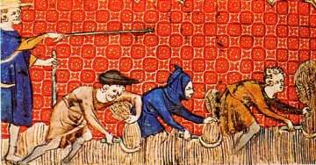
What was life like for the serfs?
  Were not allowed to leave or marry without the lord’s permission
  Were allowed to farm on the manor in return for work
  Lords were required to protect the serfs

Slide 25
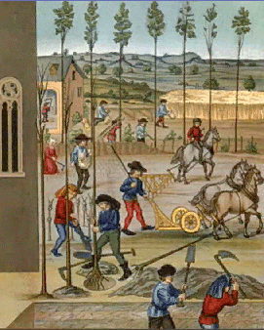
The life of a serf was harsh
  Worked long hours
  Few lived past 35 years old
  Based on heredity
    You were a serf if you parents were

Slide 26
  Peasants pay taxes to use mill and bakery; pay a tithe to priest
    Tithe = church tax = 1/10th of peasant’s income
  Serfs live in crowded cottages with dirt floors, straw for beds
  Serfs generally accept their lives as part of God’s plan

Slide 27
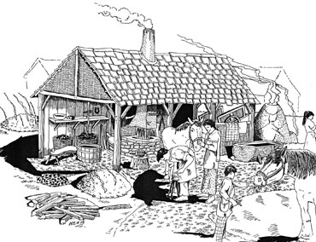
What about the freemen?
Freemen
  skilled workers (artisans) who paid rent to nobles and could leave the manor
    Ex. Blacksmith and millers

Slide 28
Goals | Yes/No/Maybe | Reasons/Examples
Political
Economic Stability
Prosperity
Opportunity

Slide 29
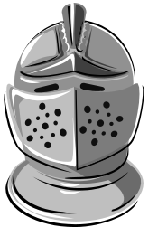
Manorial System
Everyone owed loyalty to the ________
Nobles were near the top of the social hierarchy . They got _______ from the king.
Lesser nobles (knights) gave _________ _________ in return for land
_______ were bound to the land. They worked in return for ____________.
__________ were skilled workers. They paid rent to the ______ and were free to move if they wanted to.

Slide 30
Check your answers
Everyone owed loyalty to the king.
Nobles were near the top of the social hierarchy. They got land from the king.
Lesser nobles (knights) gave military service in return for land.
Serfs were bound to the land. They worked in return for protection.
Freemen were skilled workers. They paid rent to the nobles and were free to move if they wanted to.

Slide 31
Closure
What was the Manorial System
How were manors self sufficient?
Explain why feudalism developed in western Europe.

