Slide 1

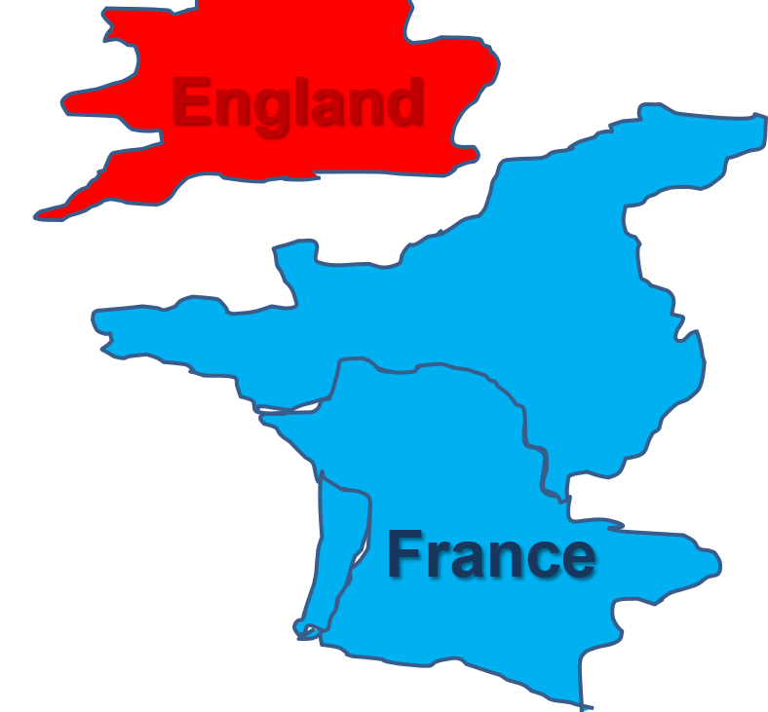

Slide 2
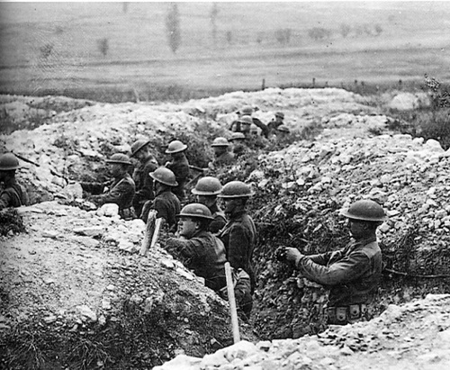
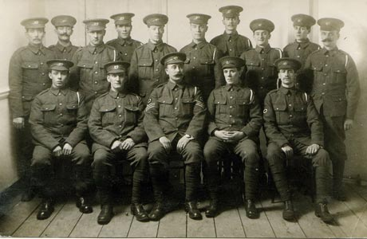
Hundred Years’ War
Dating back to the 1500s, there were at least a handful of times that the French and the English were allies in war. In recent history, the two countries were on the same side for World War I and World War II, as well as several conflicts since then, such as the Korean War, the Vietnam War and the Afghan War. As members of the United Nations, N.A.T.O. and the League of Nations over the last century, there has been relative peace between England and France.
World War I
World War II

Slide 3
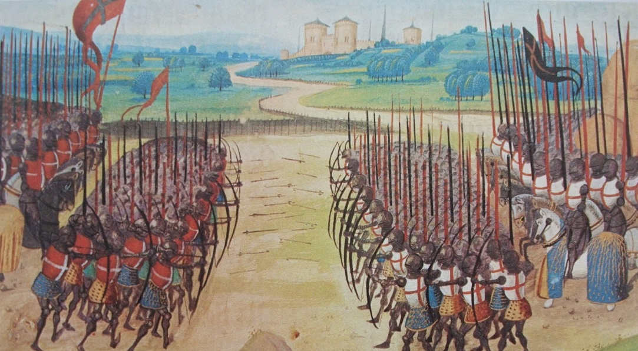
Hundred Years’ War
Despite the recent friendship, England and France have been bitter enemies throughout most of their history. They fought so often, in fact, that many of the wars were simply known by the duration of the conflict (e.g. ‘Hundred Years’ War’, ‘Nine Years’ War’ or ‘Seven Years’ War’).

Slide 4
Hundred Years’ War
Since the Norman Invasion almost 1,000 years ago, at least twenty major conflicts have occurred between the two nations, as seen on the timeline below. After the Reformation of the 1500s, several of the conflicts were driven by religious motives as France was predominantly Catholic and England predominantly Protestant.
Norman Conquest (1066)
Hundred Years’ War (1337-1453)
Italian Wars (1511-59)
Napoleonic Wars (1792-15)
Breton War (1076-77)
War of St. Sardos (1324)
Anglo-French War (1627-29)
American Revolution (1775-83)
Vexin War (1087-98)
Saintonge War (1242)
Anglo-Dutch War (1666-67)
Seven Years’ War (1754-63)
Rebellion of 1088
Henry II vs. Philip II 1208-13
Nine Years’ War (1688-97)
War of Austrian Succession (1740-48)
Anglo-Norman War (1101)
Stephen/Matilda Civil War 1135-54
War of Spanish Succession (1702-13)
Anglo-Norman War (1105-06)
Anglo-French War (1117-20)
1000 1100 1200 1300 1400 1500 1600 1700 1800 1900

Slide 5
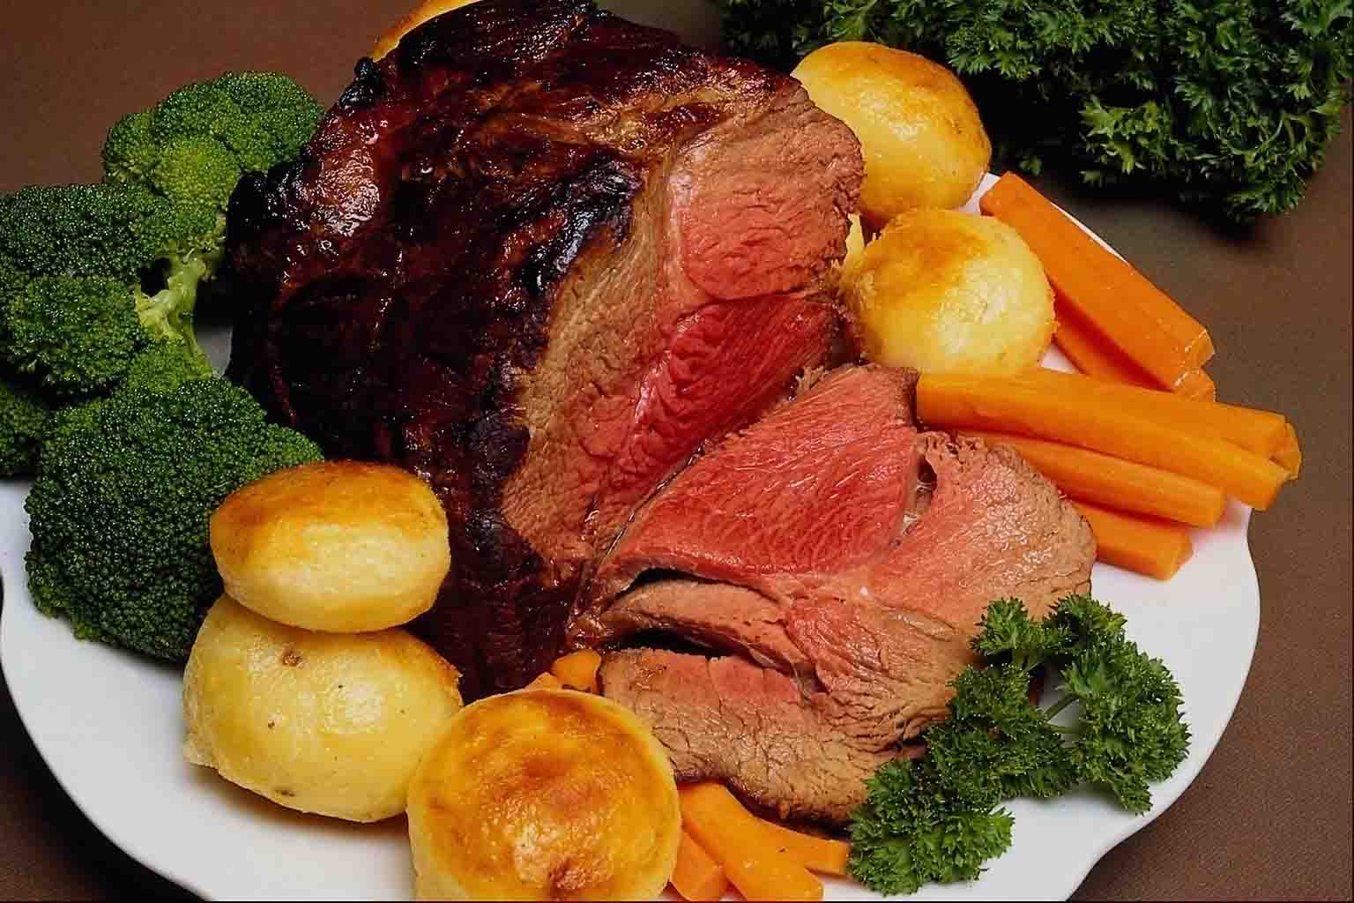
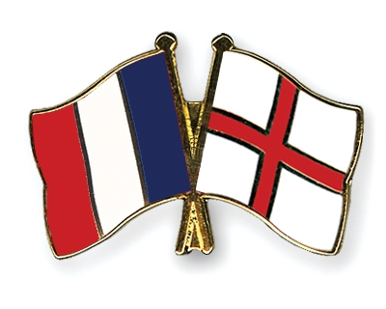
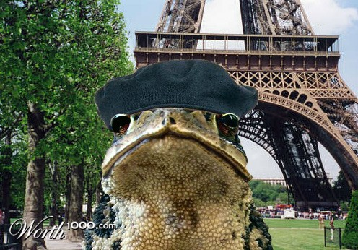
Hundred Years’ War
Get the names straight!!!
Throughout the slides, many different names are used to mean the same thing. Familiarize yourself with these lists so that you can tell the difference between the names of the two countries and the people who live there.
English
England
Anglo
British
Brits
Britain
‘Roast Beef’
French
France
Frank
Franco
Gauls
Norman
‘Frog’

Slide 6
Hundred Years’ War
The so-called Hundred Years’ War was actually a series of several conflicts between England and France that took over one hundred years and included many other European allies. The conflict forever changed military strategy and gave rise to French and English national pride.
Edwardian Era War (1337-1360) +
Caroline War (1369-1389) +
Lancastrian War (1415-1453) +
Breton War of Succession (1341-1364) +
Castilian Civil War (1366-1369) +
War of the Two Peters (1356-1375) +
1383-1385 Crisis (1383-1385)
= Hundred Years’ War
Three main stages of the Hundred Years’ War
Other wars related to the Hundred Years’ War

Slide 7
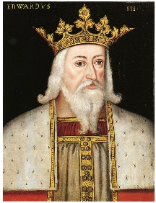
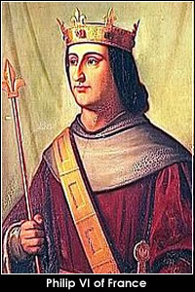
Hundred Years’ War: Edwardian War
1
The Edwardian War was the first stage of the Hundred Years’ War and began when England’s King Edward III inherited the *Duchy of Aquitaine. France’s King Philip VI considered Edward a duke who was to acknowledge allegiance to France. Edward refused, so Philip claimed Aquitaine as his own. In response, the English King Edward also declared himself to be the King of France and led an army across parts of France. Edward won victories at Auberoche (1345), Crecy (1346), Calais (1347) and La Roche-Derrien (1347)..
England
King Edward
Calais
Crecy
La Roche-Derrien
France
King Philip
Duchy of Aquitaine
Auberoche
*Duchy = region governed by a duke or duchess

Slide 8
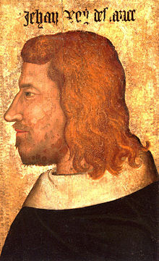
Hundred Years’ War: Edwardian War
1
The war was put on hold in 1353 due to the outbreak of the Bubonic Plague. When the war picked up again, French King John II had replaced King Philip VI after his death in 1350. Edward captured John at the Battle of Poitiers (1356). Truces and treaties followed. Edward was given many lands in France in exchange for taking back his claims to the French Throne. Peace followed for nine years.
England
King Edward
France
King John

Slide 9
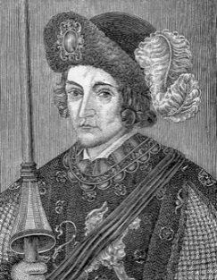
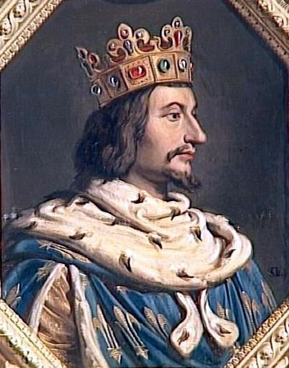
Hundred Years’ War: Caroline War
2
After almost a decade of peace, the second phase of the Hundred Years’ War erupted. The Caroline War was named after French King Charles V, who declared war on England after Edward’s son, Edward IV, refused demands to come to Paris. Charles wanted to take back the territories that were lost to England years earlier and gained back much territory before his death.
England
King Edward IV
France
King Charles V

Slide 10
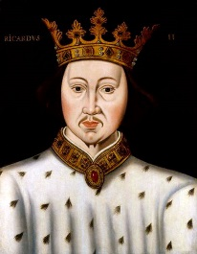
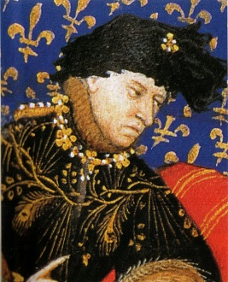
Hundred Years’ War: Caroline War
2
The successor of Charles V was Charles VI, who made peace with Edward IV’s son, the English King Richard II, in 1389. Peace treaties were upheld for the next twenty-five years which maintained the territories regained by the French.
England
King Richard
Peace?
France
King Charles VI

Slide 11
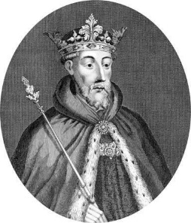
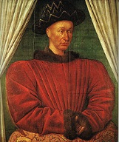
Hundred Years’ War: Lancastrian War
3
The third phase of the Hundred Years’ War was called the Lancastrian War, starting when England’s Henry V (of the House of Lancaster) invaded Normandy in 1415. When Henry died, his brother John led invasions deep into France in the name of the young English king Henry VI. After an English King was crowned in Paris, the French crowned Charles VII in Notre Dame. The English were later pushed out of France with the help of charismatic leaders like Joan of Arc.
England
Duke John
France
King Charles VII

Slide 12
Hundred Years’ War: Lancastrian War
3
England
Holy Roman Empire
1415A.D.
English-controlled territories and allies
France
French-controlled territories

Slide 13
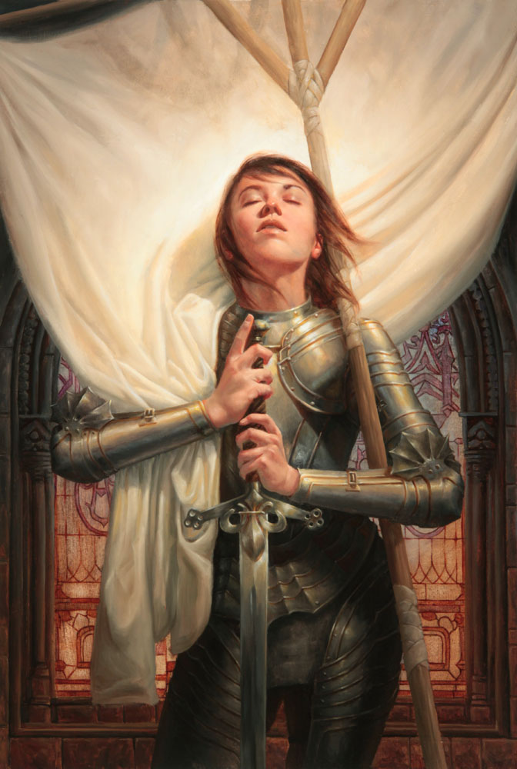
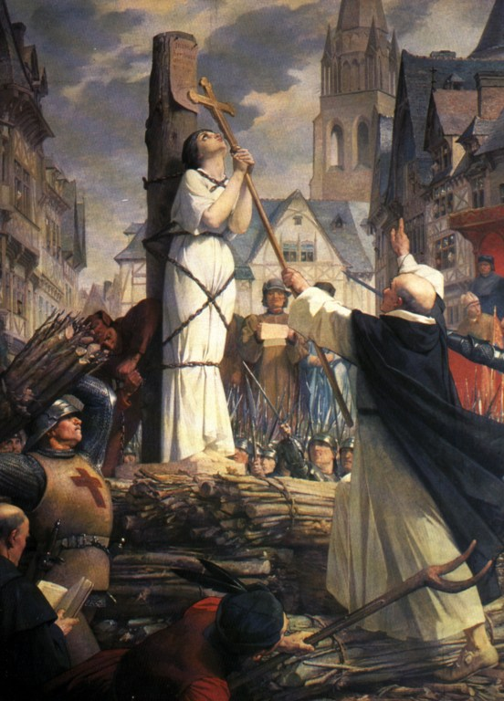
Hundred Years’ War: Lancastrian War
4
Joan of Arc is a something of a legendary French hero. She was born a peasant, but claimed to be following God’s calling as she led the French in numerous victories during the end of the Hundred Years’ War. Joan was eventually sold out to the English, put on trial and burned at the stake at the age of 19. The Catholic Church has since declared her to be a *martyr and a saint.
http://www.youtube.com/watch?v=xcM8ilpHsfQ
Joan of Arc defeating the English Army
*martyr = a person who is innocent, yet is killed for a greater cause or purpose

Slide 14
Hundred Years’ War: Conflict Ends
By 1453, the Hundred Years’ War was coming to an end with England only controlling one small part of France in Calais. Although the fighting ended, England and France were still technically at war until a peace treaty in 1475. Some English monarchs still claimed to be sovereign over France until the 1800s.
England
King Richard
France
King Charles VI

Slide 15
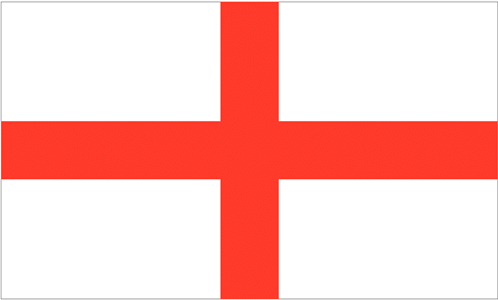
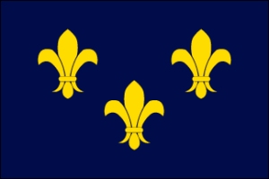
Hundred Years’ War: Outcomes
5
One development of the Hundred Years’ War is the increased sense of national pride among English and French people. Although the war was initially about family dynasties and rights to the French throne, nationalism played a major role in the conflict and has existed in a big way ever since.

Slide 16
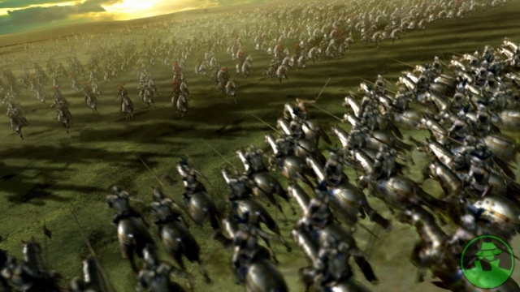
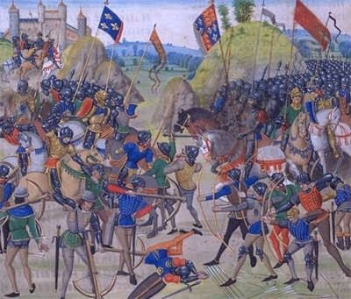
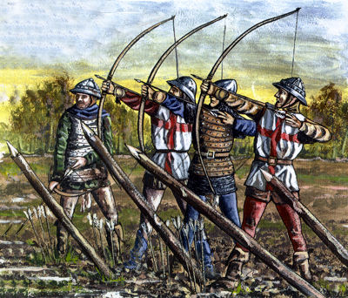
Hundred Years’ War: Outcomes
6
The Hundred Years’ War also led to foundational changes in warfare. The use of knights and cavalry was proving to be too expensive to sustain. English longbows could pierce most pieces of a knight’s armor. There was now a desire for standing armies in France and England made up mainly of peasants.

