Slide 1
FEUDALISM AND MANORIAL SYSTEM
IES FORTUNY
MARÍA SANZ

Slide 2

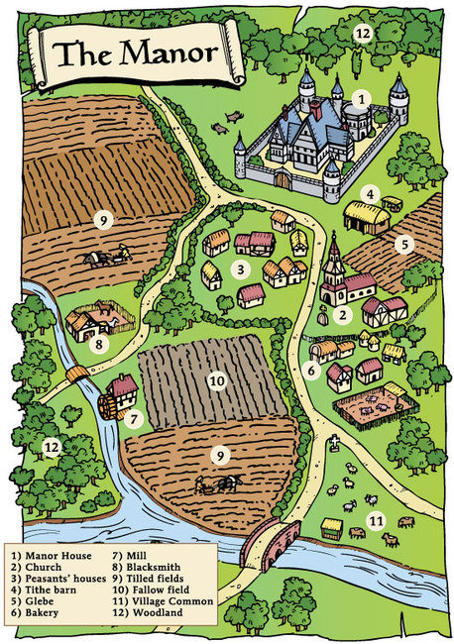
Economic system within feudalism
Based around the Manor – estate with farms, houses, a village, etc.
Lord collects taxes from serfs who work the land
Self-sufficient with the lord in charge

Slide 3
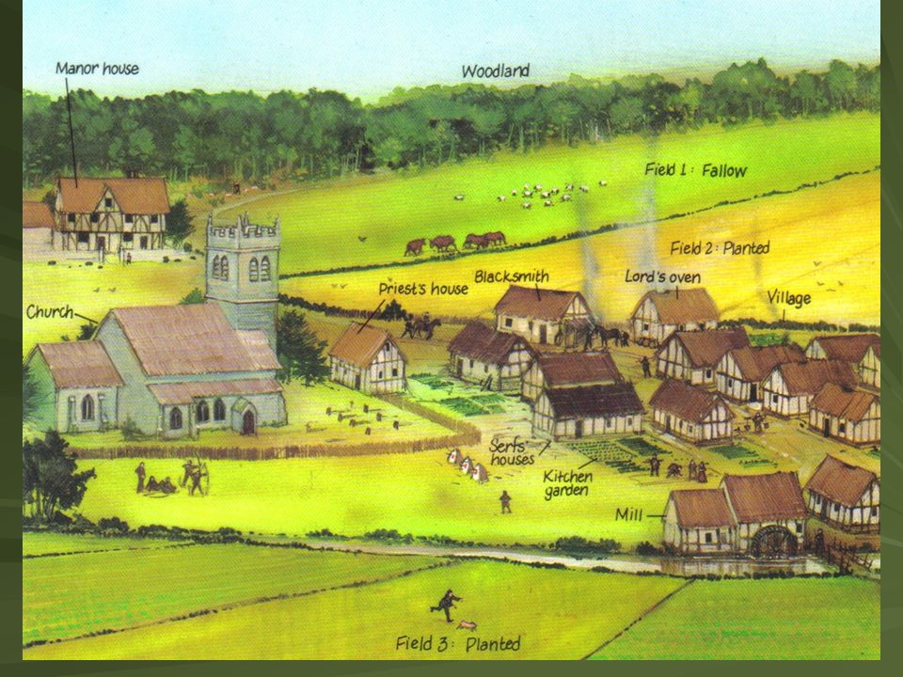

Slide 4
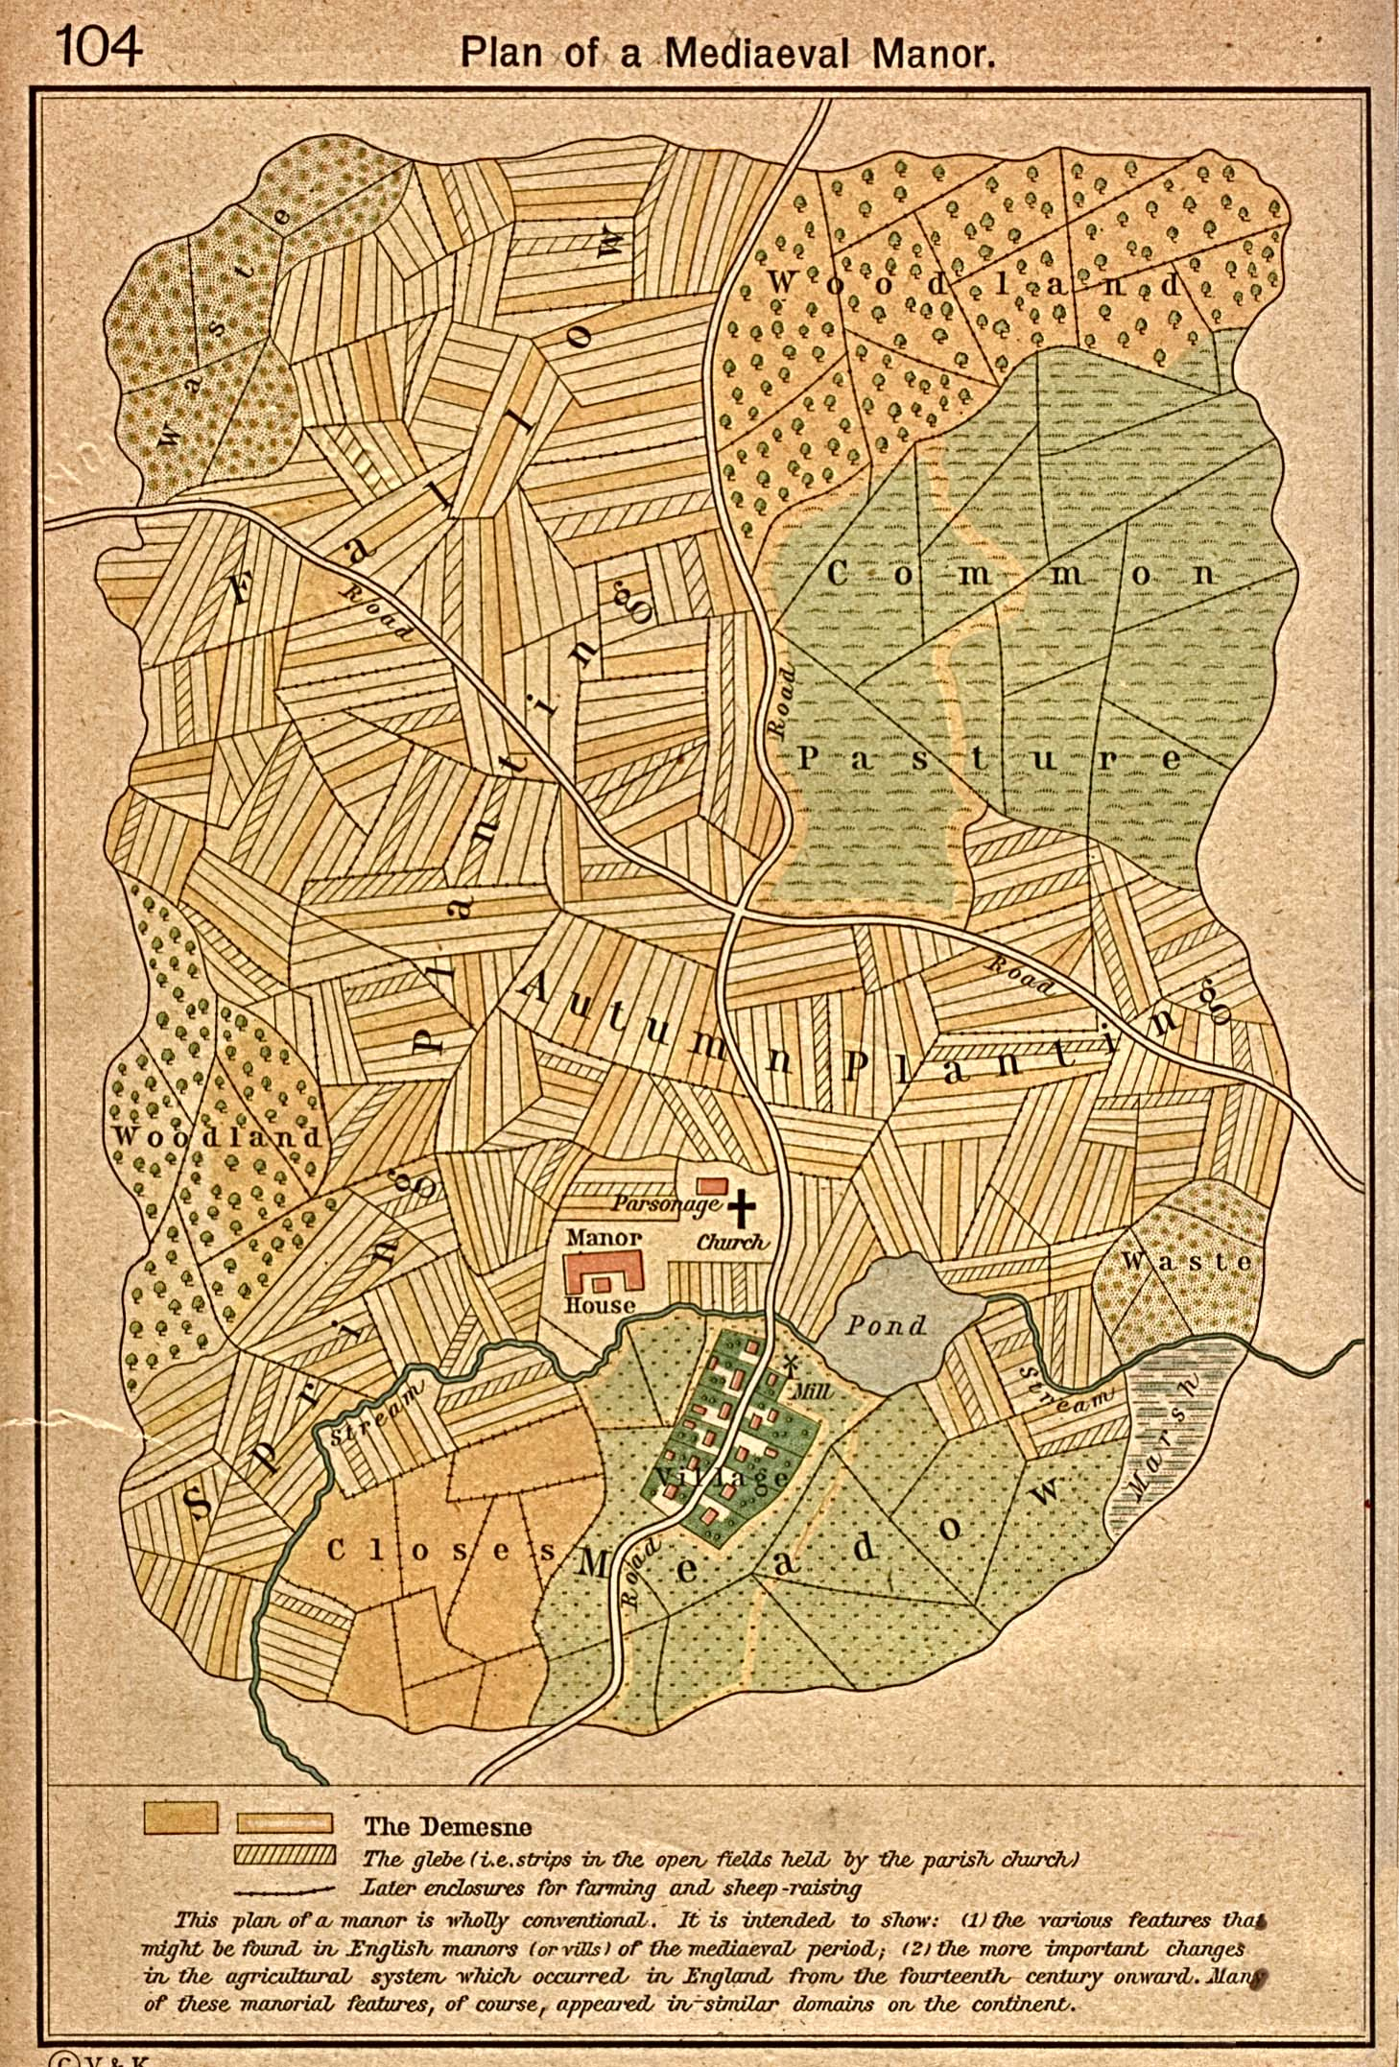
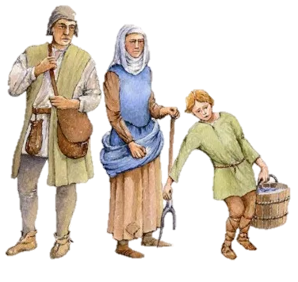
Serfs are tied to the manor
Given small strips of land to farm after working the lord’s fields

Slide 5
This picture shows a later manor, where people learn to leave fields fallow and rotate crops.
Serfs could earn enough money to buy a plot of land and become a free peasant.
They could also escape to the city and live for a year and a day and gain their freedom.
Most remained serfs on the manor all their lives.

Slide 6
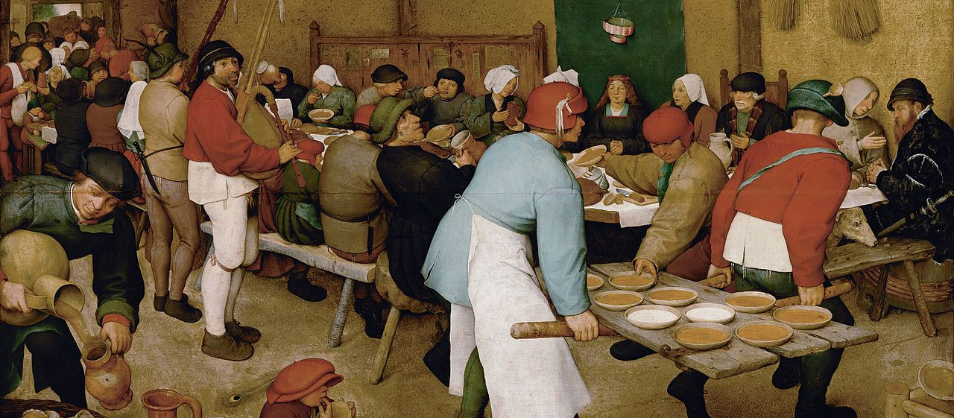
The Peasant Wedding - a 1567 painting by the Dutch Renaissance painter Pieter Bruegel the Elder, one of his many depicting peasant life. The bride is in front of the green textile wall-hanging, with a paper-crown hung above her head. She is also wearing a crown on her head, and she is sitting passively, not participating in the eating or drinking taking place around her. The feast is in a barn in the summertime; two sheaves of grain with a rake recalls the work that harvesting involves, and the hard life peasants have. The plates are carried on a door off its hinges. The main food was bread, porridge and soup.

Slide 7
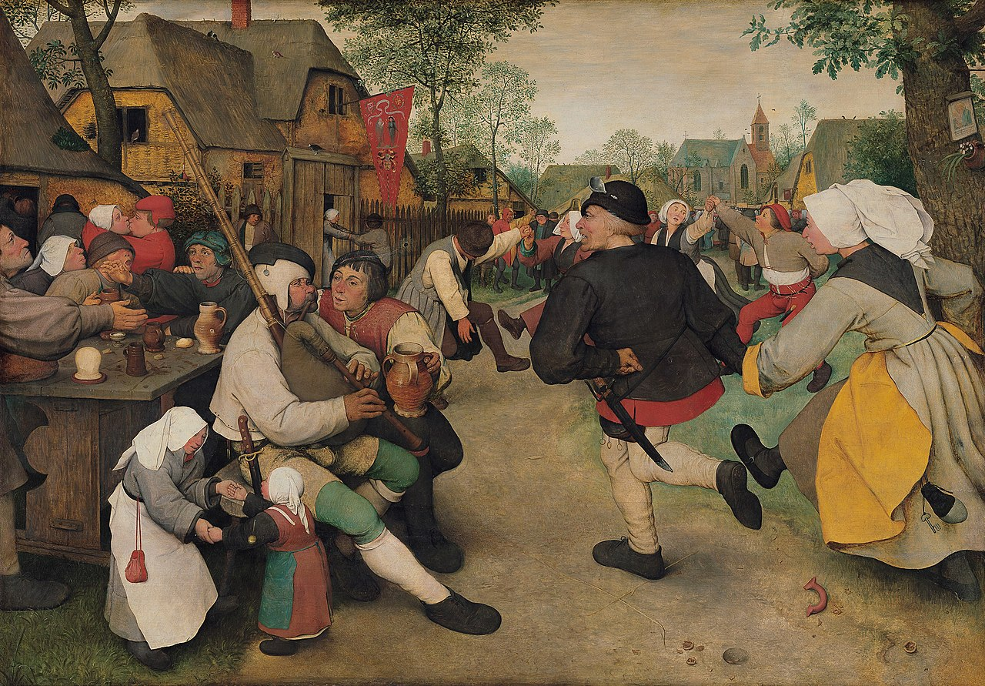
The Peasant Dance - an oil-on-panel by the Netherlandish Renaissance artist Pieter Bruegel the Elder, painted in c.1569.
It was looted by Napoleon Bonaparte and brought to Paris in 1808, being returned in 1815

Slide 8

Why did feudalism
and the Manor System develop
and how did they relate to each other?

