Slide 1
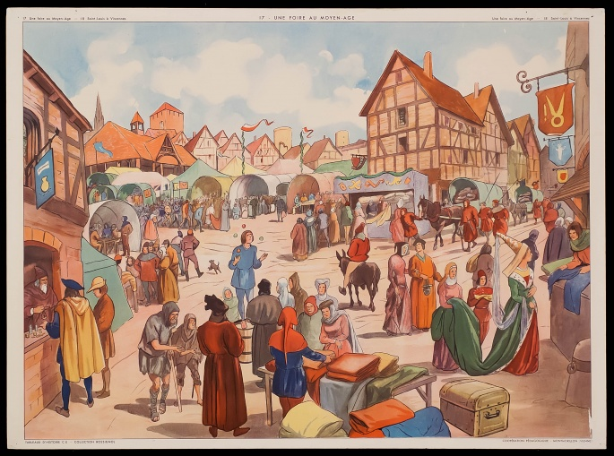
The Development of Medieval Guilds

Slide 2

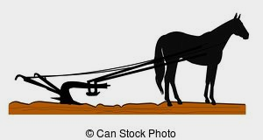
Starting in the 11th century, the population of Europe increased dramatically. This increase continued into the 14th century.
The introduction of the iron plow, a new harness that enabled
horses to be used for farming, and the three field system of crop
rotation allowed food production
to keep pace with this increase.
This population increase created
a rise in the demand for goods.
Notes:
The Iron Plow: could penetrate the soil faster and deeper than the wooden plow. This increased the size of crops because they were in contact with wetter soil and more nutrients. The New Harness: devised to have the horse pull a load with his chest instead of his neck. The Three Field System is explained in the next slide.

Slide 3

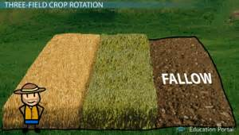
The Three-Field System of Crop Rotation
To meet the need for more food and to reduce the possibility
of starvation in medieval Europe, the three-field system of crop rotation was also developed. In this system, farmers changed the use of fields over time. Each of two fields would be planted with different crops each year, while a third field would lie fallow. Each time crops are
planted in a field, they use much of
the nutrients that the soil can provide.

Slide 4
Leaving a field unplanted for a year allowed the soil to replenish these nutrients naturally, making it ready to be planted the next year. These three fields would be rotated each year so a different field would remain unplanted. If one
of the two crops failed, the other would serve as a backup. And, a new field would be ready to plant the next year.
This system dramatically reduced medieval Europeans' risk
of starvation due to crop failure and increased Europe’s
supply of food.

Slide 5
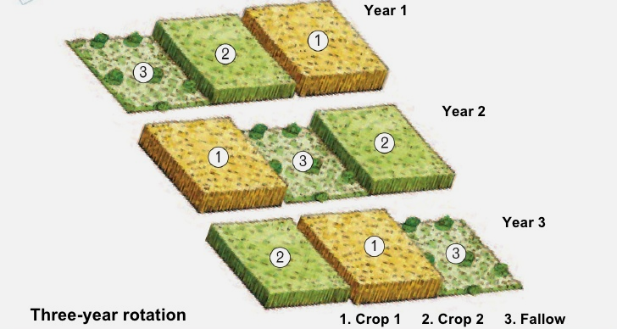

Slide 6
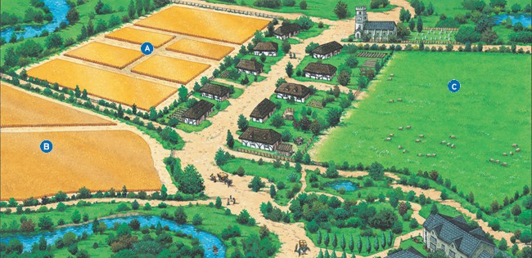
Wheat
Fallow (unplanted)
Barley
Notes:
Barley: makes a good - cereal grain, bread, animal feed, and a fermentable material for distilled beverages, mostly beer.

Slide 7
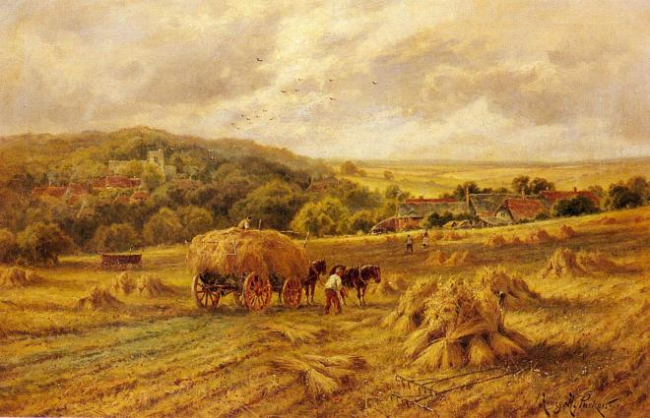

Slide 8

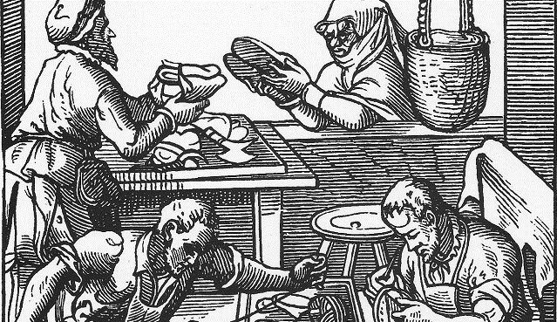
As trade increased, towns grew. The number of merchants, artisans, craftspeople, and workers living in towns increased. Beginning in the 12th century, many artisans and craftspeople joined together in what are called guilds: groups of people performing the same craft,
usually in the same city,
who joined together for
their common good.
“Cobbler” Guild Shop (shoemakers)

Slide 9
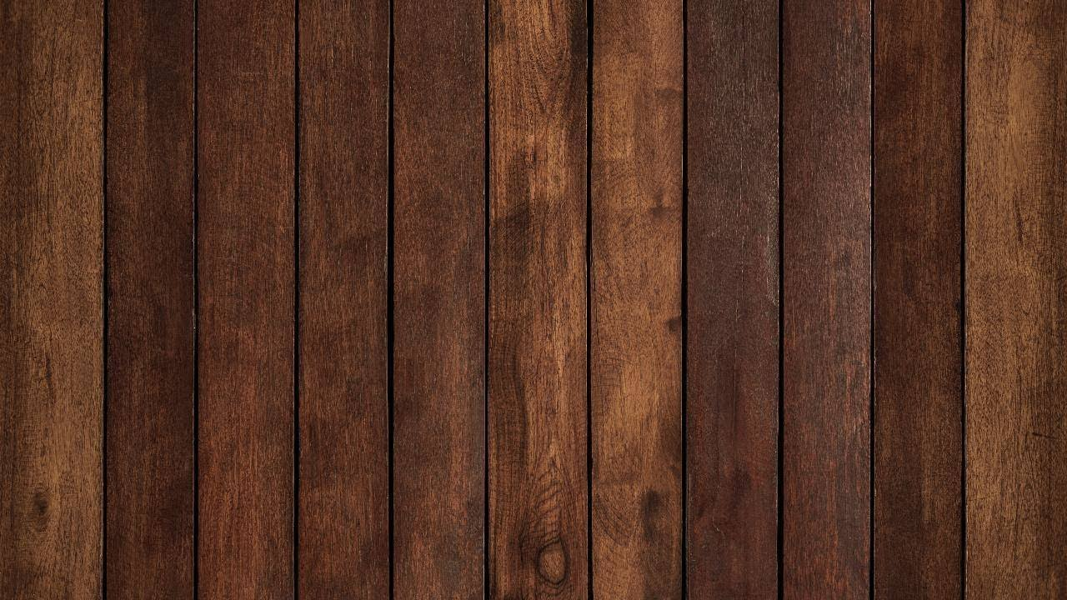
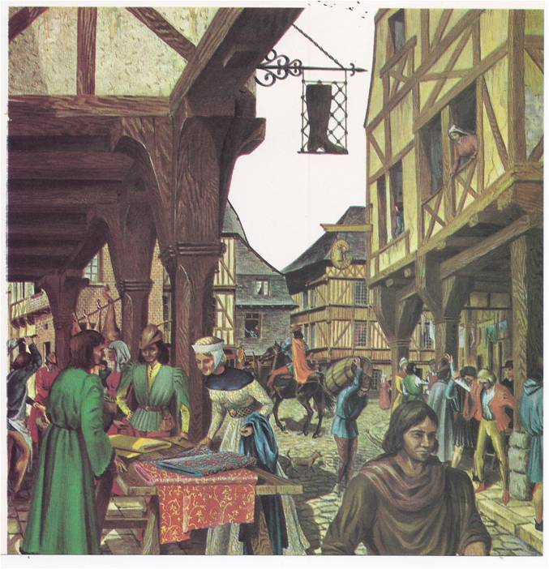

Slide 10

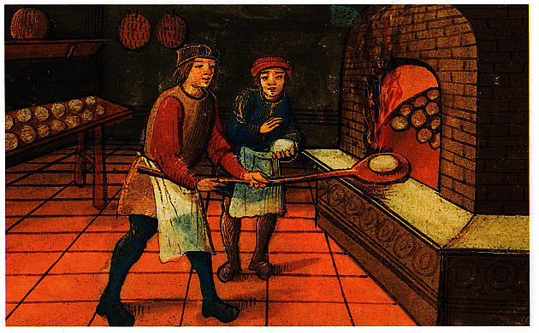
These guilds regulated the quality of goods produced, set prices, controlled the number of craftspeople, and also controlled where and to whom goods could be sold. Controlling the quality, the price, and the distribution worked out well for the guild members, as well as, their customers.
People could count on
goods of consistent quality
at fair prices. Guilds would
regulate trade in medieval
Europe for centuries.
.

Slide 11
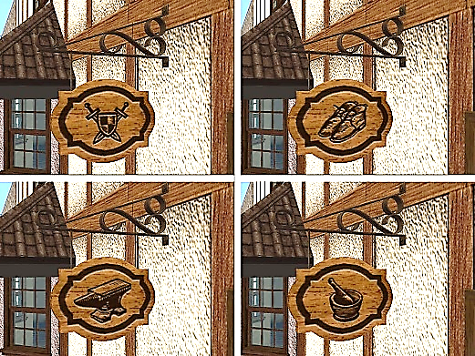
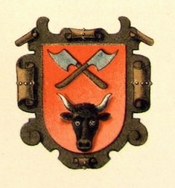
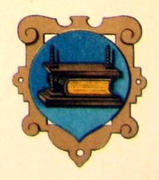
Because most medieval Europeans were illiterate, guild members would fashion a picture representing their business on their exterior sign instead of spelling out the name of the craft.

Slide 12
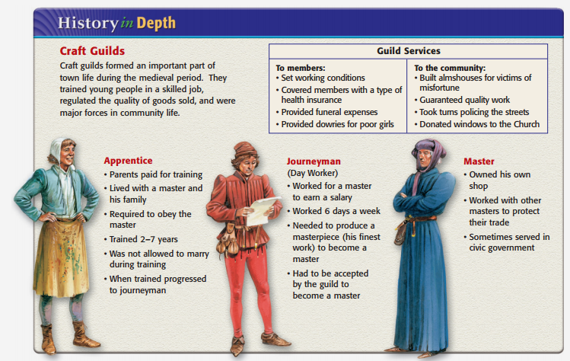
Workers in each guild shop were divided into three levels.
At the bottom level was the apprentice who usually worked for room and board. He was in the first stage of learning the craft.
He would usually perform the simplest tasks
of the craft, learning more and receiving more
responsibility as he gained experience.

Slide 13


At the mid-level came the journeyman. He was paid for
his skill in the craft but had not yet created a masterpiece.
A masterpiece was a piece of work, related
to his craft, fashioned by the journeyman,
to be submitted to the guild for their
approval before the journeyman
could be considered a master
of his craft.

Slide 14

At the highest level was the master, or master craftsman, who after years of learning the craft, had successfully created
a masterpiece, and usually, was either the owner of the craft shop or in charge of it for the owner.

Slide 16
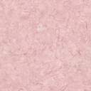
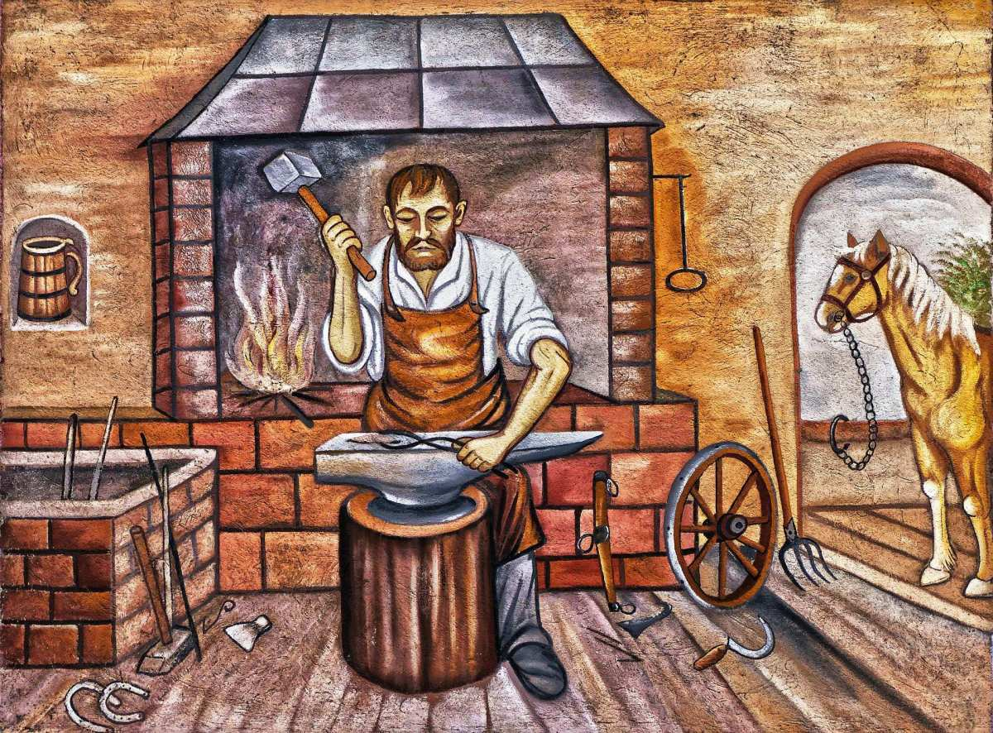
Guilds - Vocabulary
lie fallow: remain unplanted
nutrients: vitamins and minerals
craft - a product or service
illiterate - not able to read or write
room and board - a place to live and eat

Slide 17
Concepts for Consideration
Between the eleventh and fourteenth century food production increased in Europe. Give three reasons why this happened.
What were medieval guilds and why were they so important ?
Guild members fashioned pictures representing their businesses
on their exterior signs instead of spelling out the name of the craft. Why ?
Briefly describe the three levels of craft workers in a guild shop.

Slide 18
Extension

Slide 19
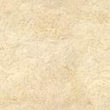
Medieval Guilds - Activity
Medieval Guilds consisted primarily of two types:
1. Merchant Guilds: made up of traders who bought and sold goods
in the form of raw materials and/or finished goods.
2. Craft Guilds: made up of artisans who created goods or services
for daily use.
It is said that guilds were made up of skilled people who joined together for their common good. So, what was that common good ?
Notes:
EXTENSION ACTIVITY

Slide 20
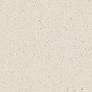
Generally speaking, both Merchant and Craft Guilds shared most practices in common. They regulated the price, the quality, and the volume of the products that could be sold. They offered protection for traveling guild members and their possessions against highwaymen. They agreed on charters with the noble,
who owned the land on which the town was located, to collect taxes on goods or services to pay that lord. They would donate some of their goods or services to the local church, and they supported and cared for guild members and their families.
Some guild masters would serve as town officials.

Slide 21

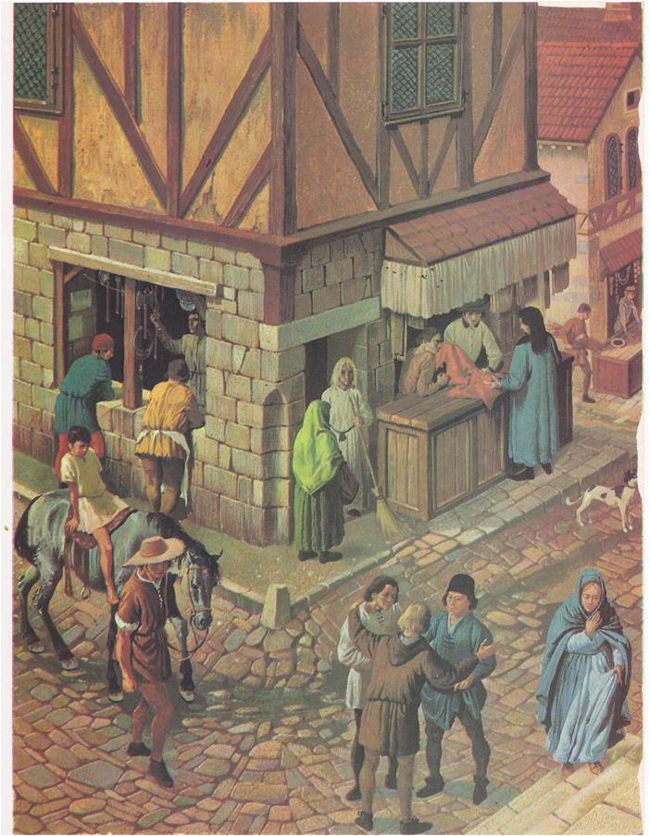
With that in mind, any shop that applied to a guild would be well aware that there were rules to follow, standards to which it must adhere, and financial commitments that it would be required to make. However, these practices ensured that each shop could thrive within its
community without worry of unfair competition.
The general public also benefited from these
arrangements because they could rely on
good quality at reasonable prices.

Slide 22

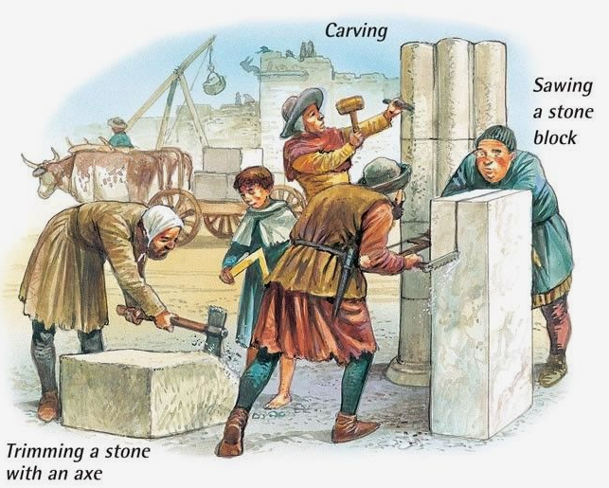
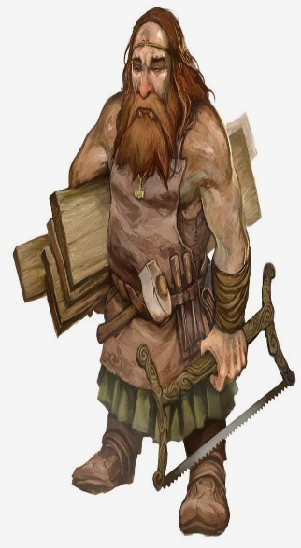
Merchant Guild Shops could sell a wide range of goods, whereas,
Craft Guild Shops usually produced a single product,
a line of associated products, or a service.
Some Craft Guilds:
Masons: Masons did mostly brick and stone construction,
usually churches, castles, and cathedrals. Their guild was
a universal guild. Because they traveled from town to town
where the work was necessary, having a guild located in
one city was not practical.
Carpenters: Carpenters worked with wood to make windows, doors,
wooden beams, fences, and furniture. In addition to woodworking skills,
it was necessary for a carpenter to understand mathematics.

Slide 23
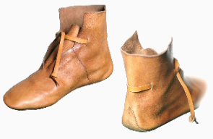
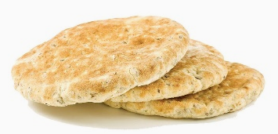
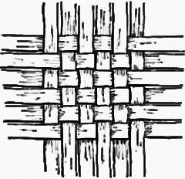
Cobblers: Cobblers made and repaired various kinds of shoes, mostly for commoners.
Nobles usually had a special cobbler to make their higher fashion shoes, as well as,
boots for knights. Cobblers had to be skilled in the use of leather and sewing (stitching).
Bakers: Bakers primarily needed to know the ingredients and exact quantities that were necessary to make bread, as well as, the time and temperature it took to bake it in a stone oven, as this was their main product. They would have knowledge of extra additives such
as almonds, honey, garlic, and to a lesser degree, cinnamon,
to vary the taste of the finished product.
Cloth Makers: Cloth makers worked primarily with wool, but cotton, linen, and leather were also used. A medieval cloth maker would need working knowledge of the process of converting wool into yarn, but the primary skill would require weaving wool.
Weaving involved the use of two sources of yarn and intertwining
them in a perpendicular pattern to create a garment or a blanket etc.

Slide 24
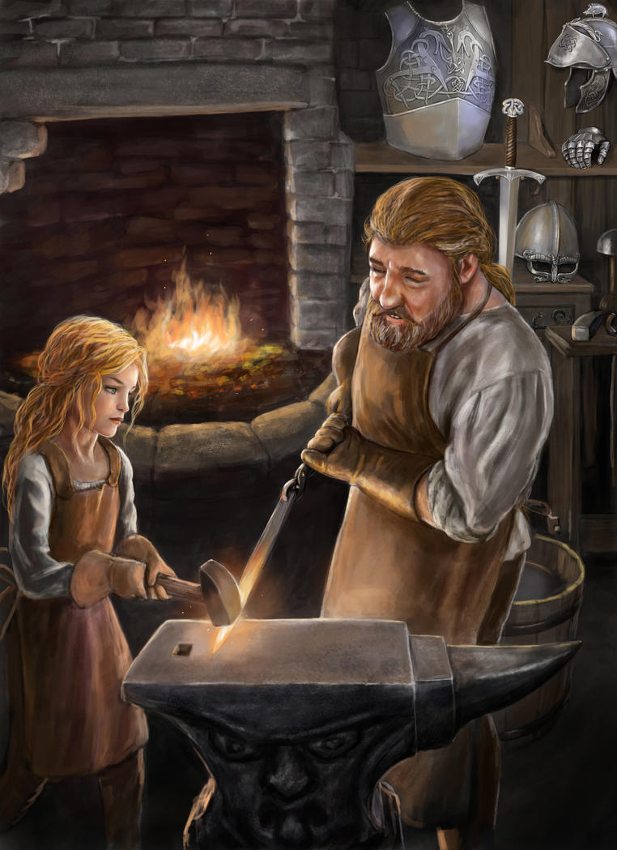
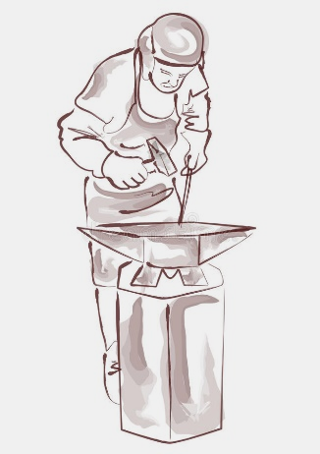
Metalsmiths: Called blacksmiths, these metal workers
crafted metal into a variety of products ... from weapons,
shields, and armor - to farming tools, horseshoes, and
nails. They would require a working knowledge of
smelting, tempering, and hardening in order to make
a quality piece strong and durable. Finally they would
be required to master the art of shaping
the piece with hammers (striking) and files.

Slide 25
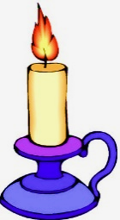
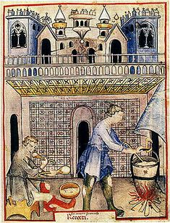
Chandlers: Candle Makers fashioned candles from tallow and bees wax, using flax,
hemp, or cotton for wicks. Tallow candles gave off an unpleasant odor when burned,
so they were used exclusively by peasants. Bees wax candles were used by the nobility because they could afford them. Chandlers would heat and fashion both types into a mold, add a wick, and let them dry. This simple process meant that peasants could make their own candles, so chandlers did not make a lot of money making tallow candles.
Their income came primarily from the manufacture of the more expensive
bees wax candles that smelled better. Chandlers would also augment
their income by keeping bees, as well as, manufacturing soap, which
included various combinations of ash, lime, oils, beer, flour, and animal fat.
Notes:
Bottom right: Chandlers making soap

Slide 26

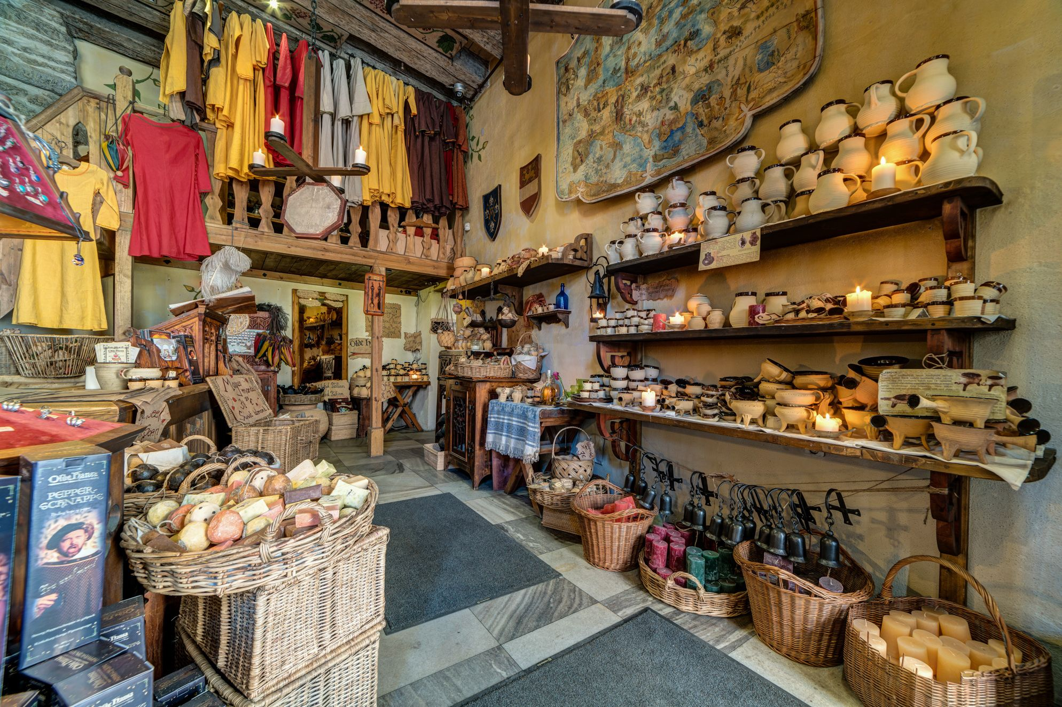
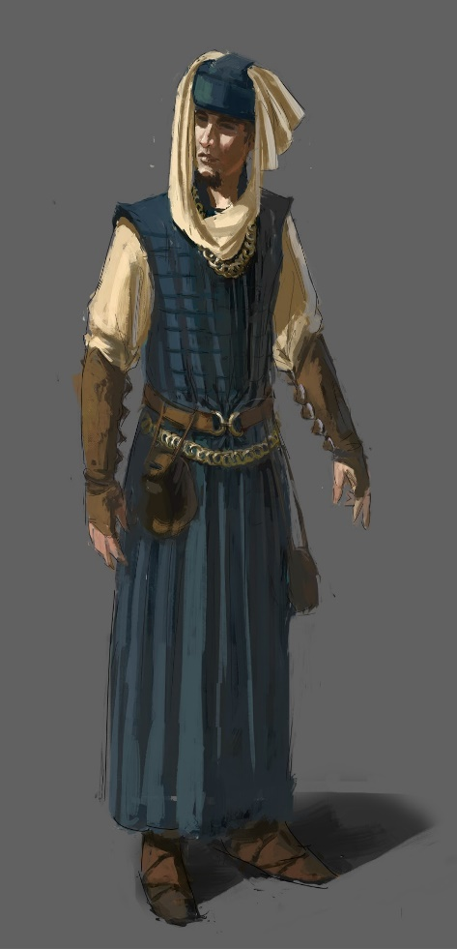
Merchant Guilds: In addition to the regulations and benefits they shared with craft guilds, merchant guilds regulated weights and measures and monitored business practices among the town's merchants.
Merchants: Merchants would
buy a variety of goods from
local or long-distance sources
and sell raw materials at
wholesale prices to craft guilds
or finished goods at retail to the
public. A shop owner would need
a working knowledge of mathematics,
as well as, marketing and accounting skills.

Slide 27
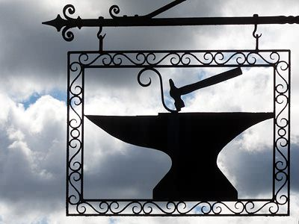
Medieval Guilds Activity - Vocabulary
raw materials: the basic materials with which a finished product is made
finished goods: goods that are ready to be consumed (used) by the public
artisans: artists and craft persons
blacksmith: "black" refers to the color of iron when it is heated.
"smith" refers to the striking required to shape the metal.
smelting: the process of removing metal from its ore by melting it in a charcoal-fueled fire
tempering and hardening: the process of alternating heating and cooling while shaping (striking) metal
tallow: animal fat
flax: a fibrous food plant used to make wicks and linen
hemp: a fibrous plant used to make rope and wicks
augment: increase, add to
wholesale: selling goods to those who use them to produce finished products and sell at retail prices
retail: the sale of goods for consumption (use) rather than for resale
marketing: activities involved in buying at wholesale, displaying it, and bringing about a sale at retail
accounting: keeping track of purchases, sales, and expenses

Slide 28
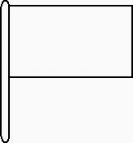
Medieval Guild Application
To complete your Craft Guild Application, you must demonstrate your knowledge of both the requirements and benefits of our Guild, as well as, the skills you must possess to become a member shoppe. Include a proposed exterior sign design
and masterpiece illustration.
The Guild: ____________________________________________________
Name of Applicant: ____________________________________________________
Proposed Name of Shoppe: ___________________________________________________
Acknowledgement of Guild Requirements and Benefits
List Requirements:
List Benefits:
List Skills Required of the Shoppe:
Shoppe Masterpiece Illustration:
Shoppe Sign Illustration:

Slide 29
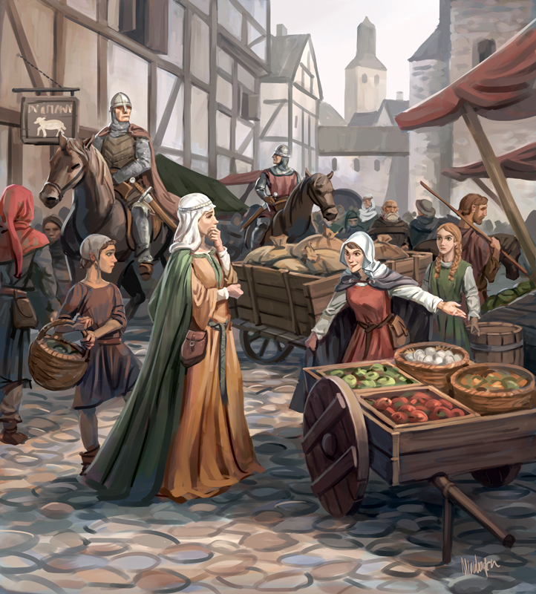

Slide 30
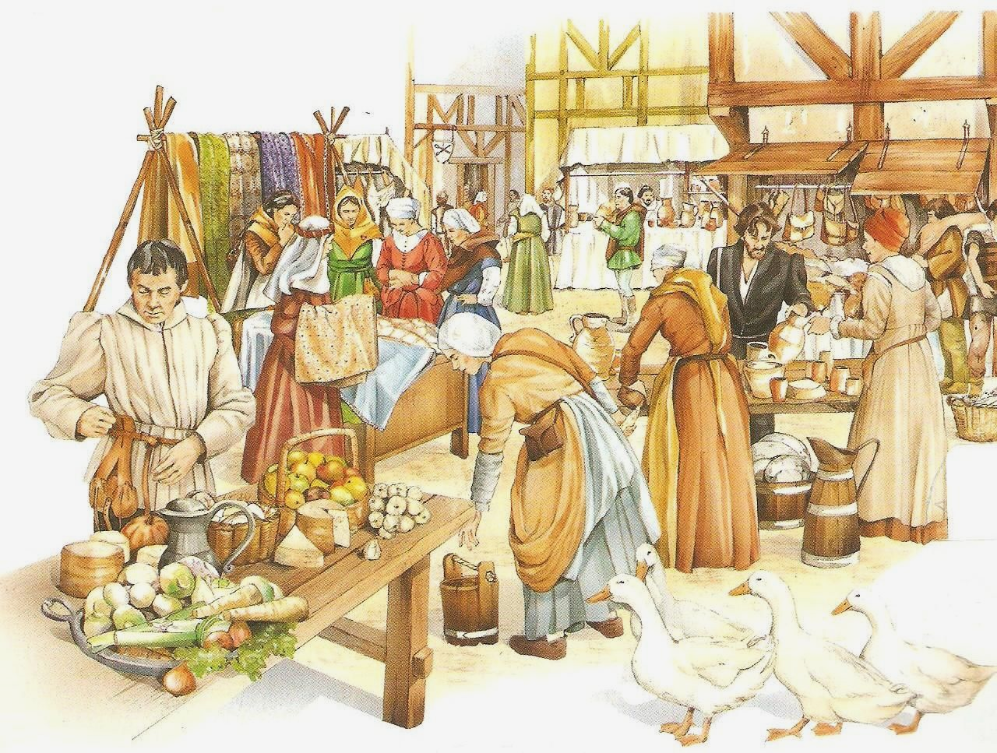

Slide 31
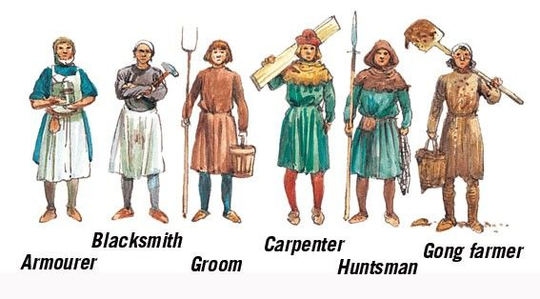
Notes:
Gong Farmer: Someone who digs out and removes human excrement from “bathrooms.”

Slide 32
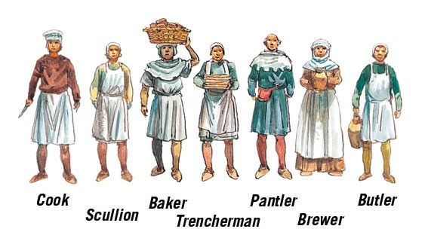
Notes:
Scullion: kitchen worker Trencherman: prepares the table for a meal. Pantler: in charge of the food supply Butler: chief servant of the household

Slide 33
