Slide 1

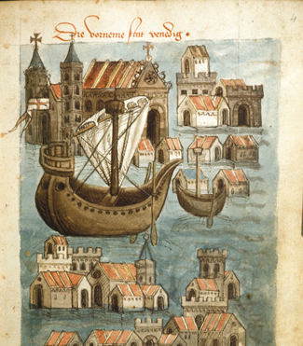

TRADE IN THE MIDDLE AGES
MARÍA SANZ

Slide 2
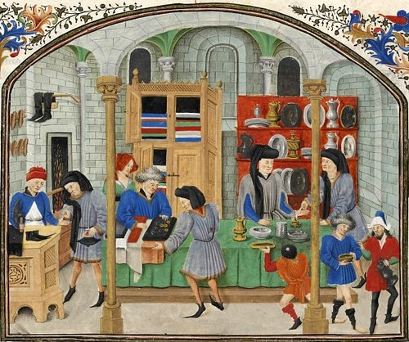
TRADE IN THE MIDDLE AGES
Main Idea
Towns and cities grew during the high Middle Ages as the amount of trade increased between Europe and other continents.
MAIN QUESTIONS TO ANSWER
Which cities saw the initial growth of trade in the Middle Ages?
What led to the growth of towns and cities in the Middle Ages?
What was daily life like in medieval cities?

Slide 3
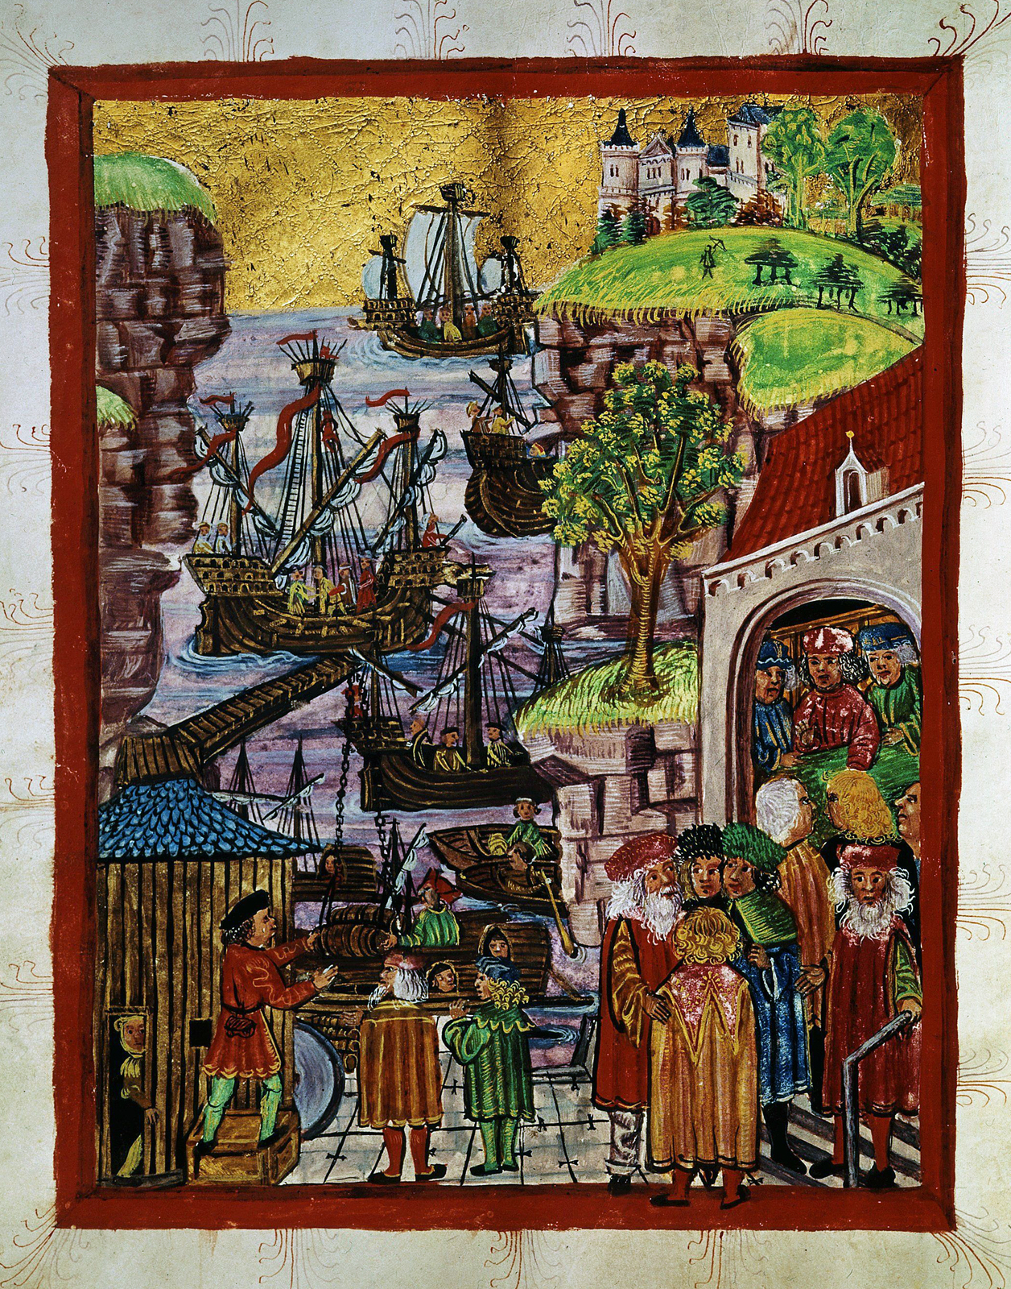
GROWTH OF TRADE
Most of this trade was controlled by merchants from Italy and Northern Europe.
ITALIAN TRADE CITIES
Italians among earliest to build thriving trade
Sailors set out to find valuable goods from distant lands
Venetian sailors traveled to Byzantine Empire, Muslim lands
Brought back silk and spices from China, India
Loaded onto Venetian wagons
SELLING GOODS
Venetian merchants went north to sell imported goods
Goods were expensive, very profitable
Other Italian cities created trade routes
Genoa, Florence, Pisa, Milan, all major trading cities
Italians controlled almost all southern European trade

Slide 4
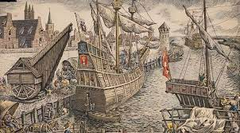
HANSEATIC LEAGUE
Italians dominated trade in south
Hanseatic League actively traded in northern Europe
Northern German towns, worked together to promote, protect trade
Controlled most trade between Europe, Russia, Baltic region

Slide 5
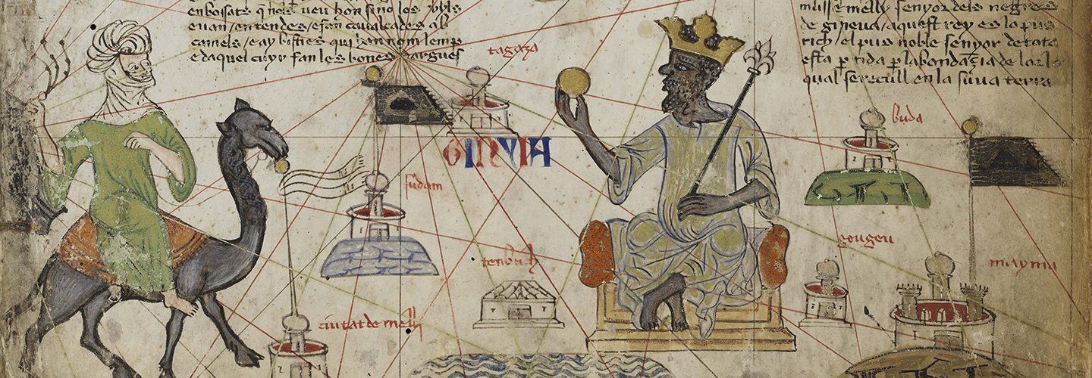
TRADE FAIRS AND MARKETS
Merchants needed to get goods to customers, traveled long distances to visit trade fairs.
Trade fairs held in towns, drew huge crowds, buyers and sellers met there.
Great variety of goods offered, rare fabrics, aromatic spices, animals.

Slide 6
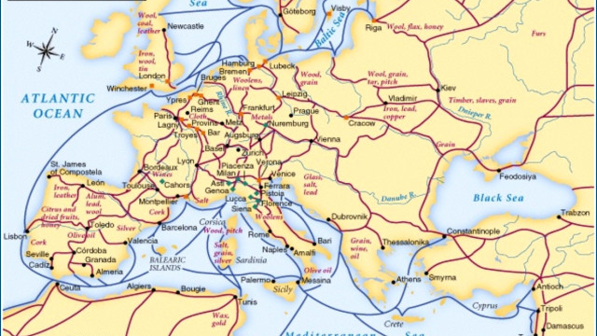
TRADE ROUTES

Slide 7
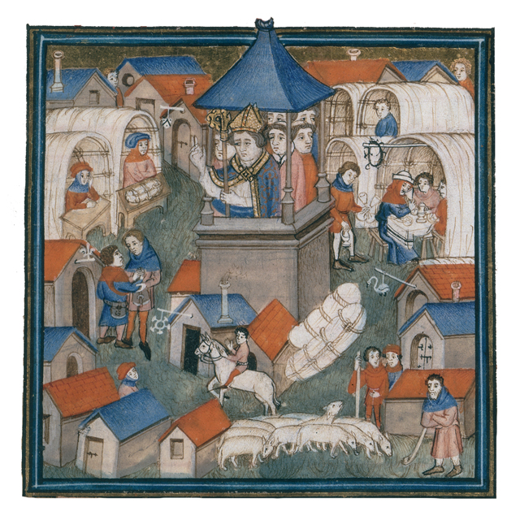
TIME AND LOCATION OF FAIRS
Trade fairs usually held once a year, specific locations
Some trade fairs lasted for months
Schedule staggered so merchants could travel from one to another
Some merchants spent most of time on road

Slide 8
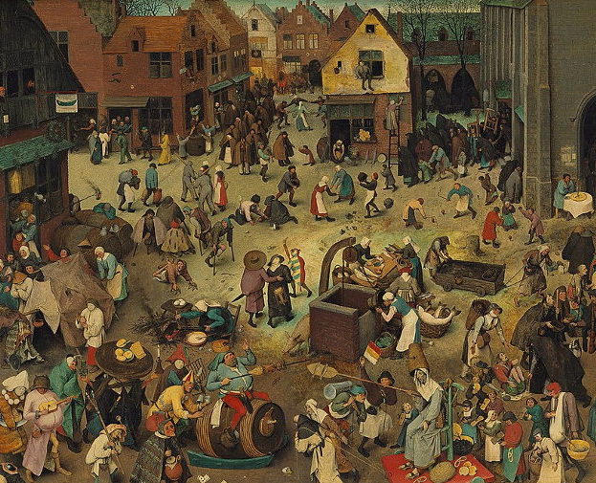
MARKETS
Trade fairs not attended by average person
Generally places for sales between merchants
For everyday needs, people visited local markets
Local markets sold locally-produced goods

Slide 9
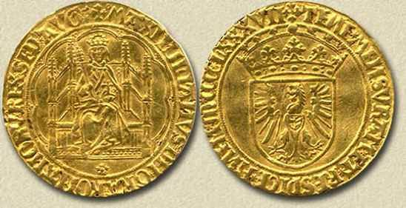
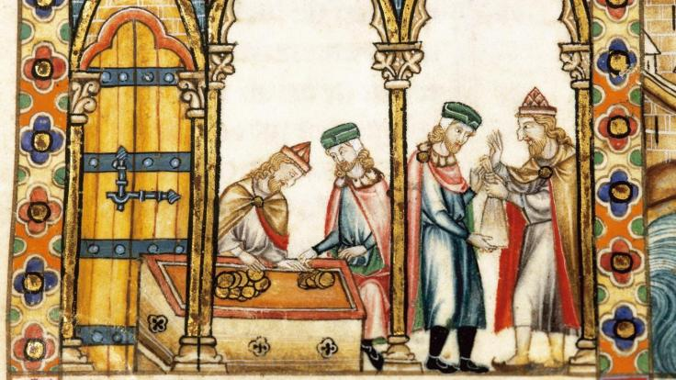
MONEY
Trade encouraged use of money, had not been common in Europe for years
Previously workers paid with goods.
Cities began minting coins, workers began demanding coins for payment.

Slide 10
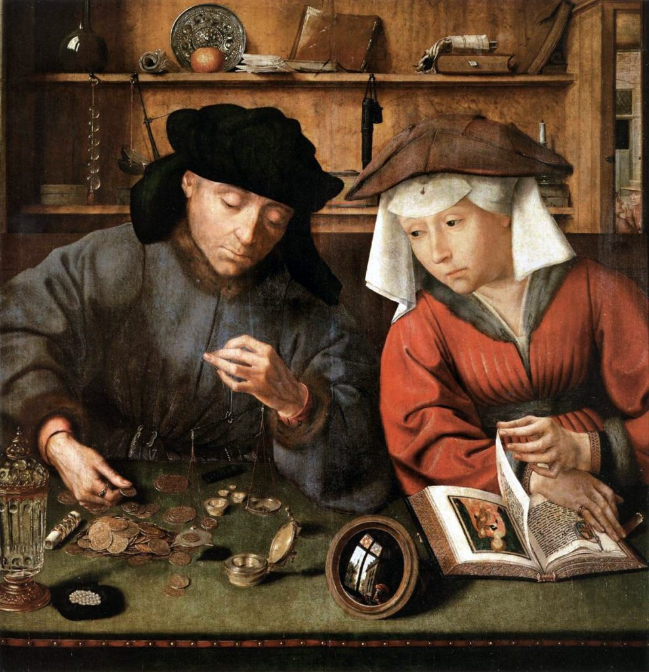
CREDIT
Some merchants allowed customers to buy goods on credit
In return for goods, customer signed document stating when, how payment would be made

Slide 11
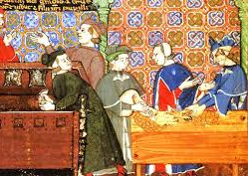
BANKS
Use of money, credit led to creation of Europe’s first banks
People could deposit money for safekeeping, request loans
Most money-lenders were Jews, barred from many other occupations

