Slide 1
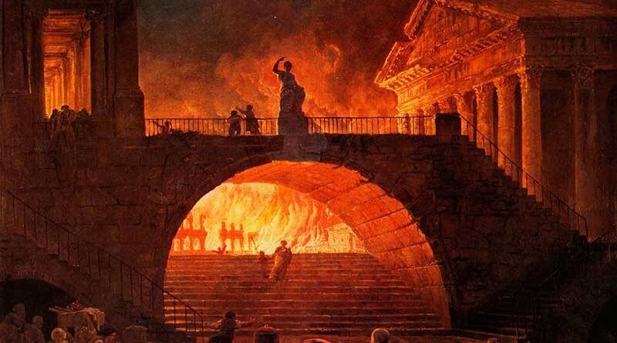
What happened in Western and Eastern Europe after the Fall of Rome?

Slide 2
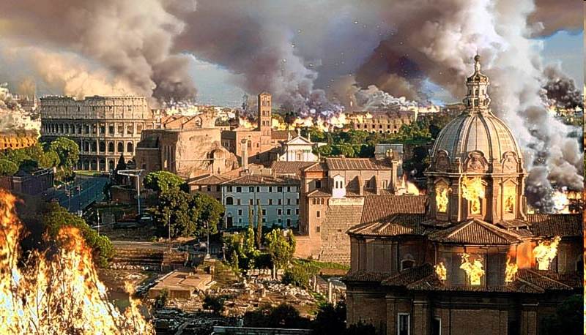
The division of the empire left the Western Roman Empire too weak and it eventually collapsed in 476.

Slide 3
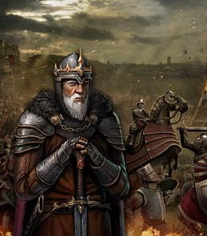
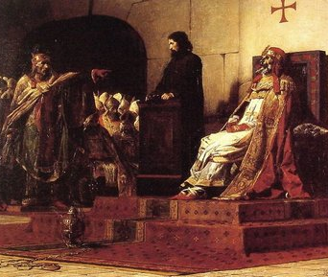
As a result of the Roman Empire’s decline, Western Europe entered a period of chaos and disorder.
“Dark Ages” or “Middle Ages”

Slide 4
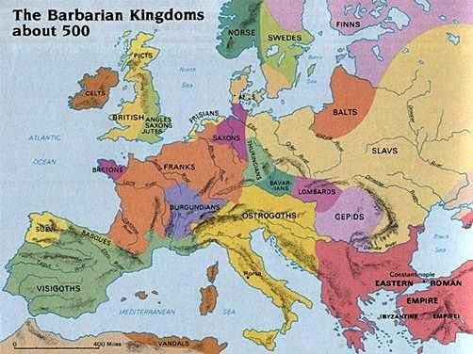
New Monarchies appeared in Western Europe

Slide 5
1. FRANKISH KINGDOM IN FRANCE.
2. OSTROGOTH KINGDOM IN ITALY.
3. SAXON KINDOM IN GERMANY.
4. ANGLO-SAXON KINGDOM IN BRITAIN.
5. BURGUNDIAN KINGDOM IN SWITZERLAND.
6. VISIGOTHIC KINGDOM IN SPAIN
MAIN KINGDOMS WERE:

Slide 6
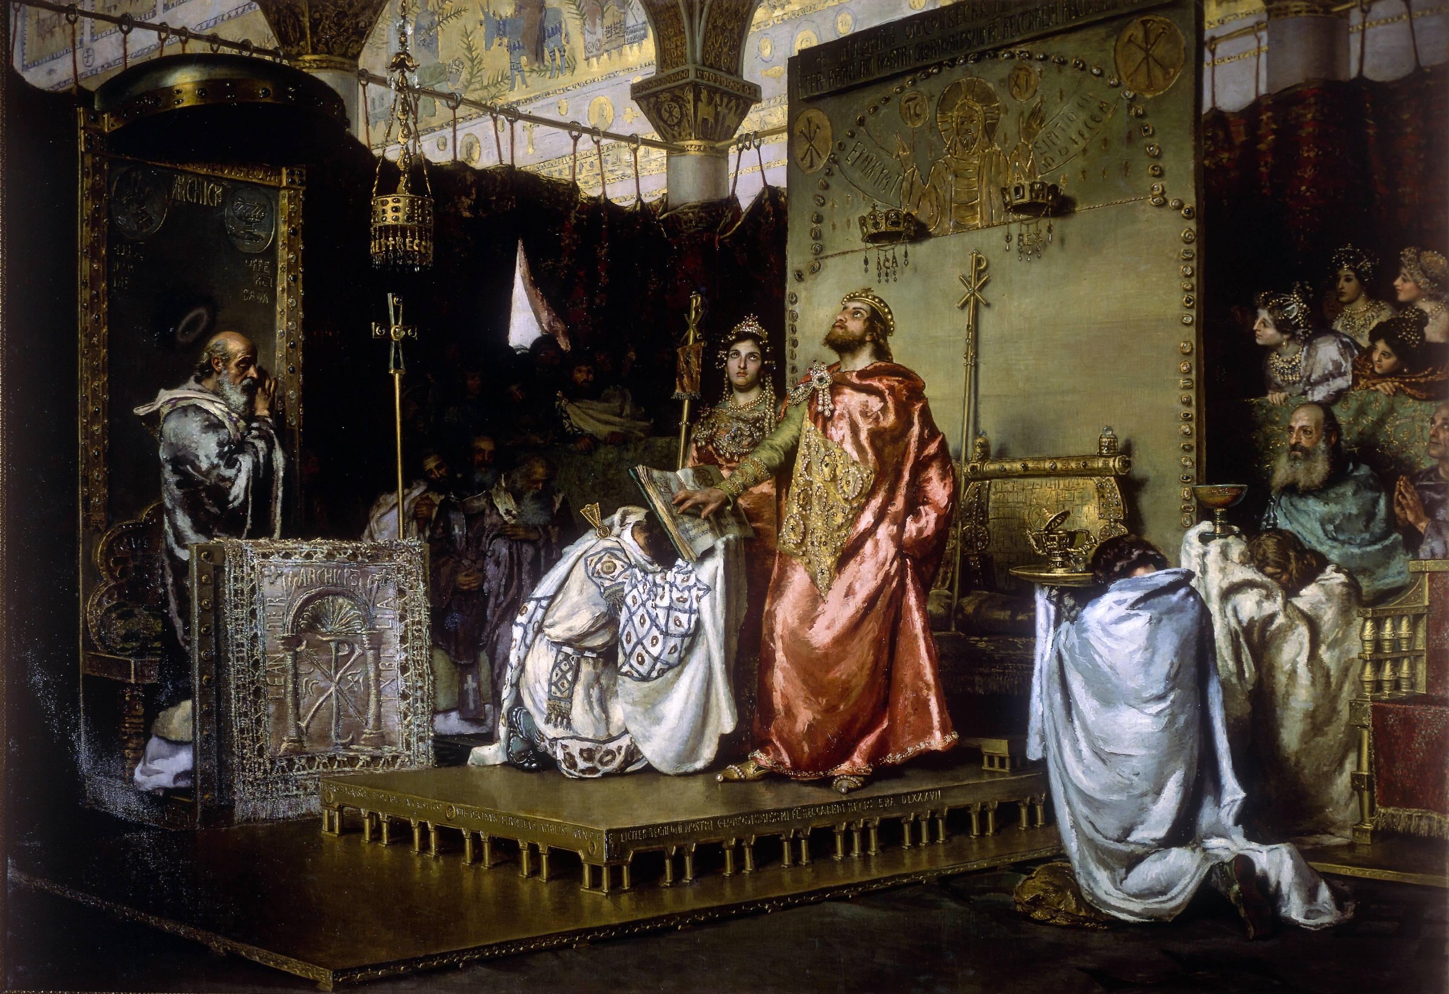
CHARACTERISTICS OF THESE MONARCHIES
At the beginning maintained their traditions.
Later adopted Latin as their official language.
Kings converted to Christianity

Slide 7
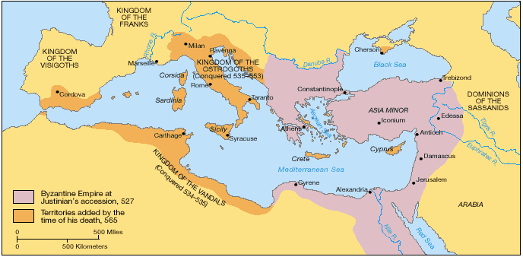
Meanwhile, the Eastern Roman Empire was able to continue to exist and became known as the Byzantine Empire.

