Slide 1

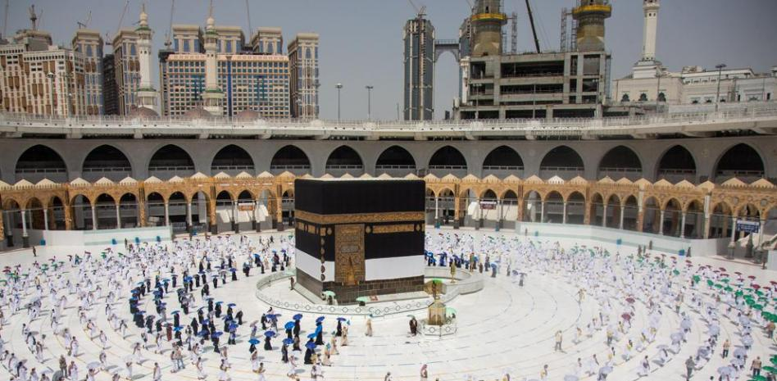

5 Pillars of Islam
FIVE PILLARS OF ISLAM

Slide 2



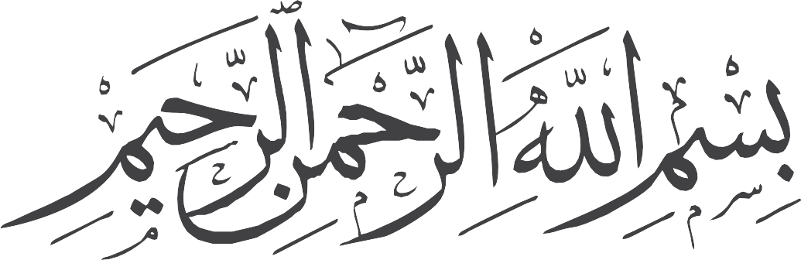


Slide 3
The 5 Pillars of Islam
01

Slide 4
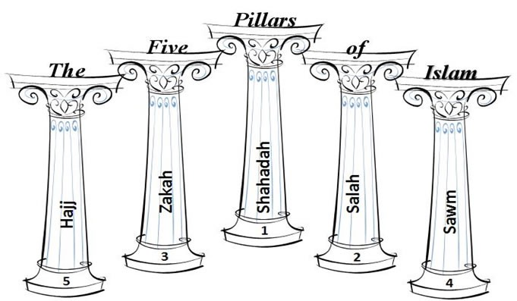


There are 5 Pillars of Islam which are the most important Islamic practices.

Slide 5







1
2
3
4
5

Slide 6

Faith (Shahadah)

Slide 7
1. Faith (Shahadah)
A Muslim should testify that Allah is one and Muhammad is His Messenger
This statement of faith must be declared publicly.
It should be a genuine belief which includes all the above articles of faith.
✓
Publicly

Slide 8
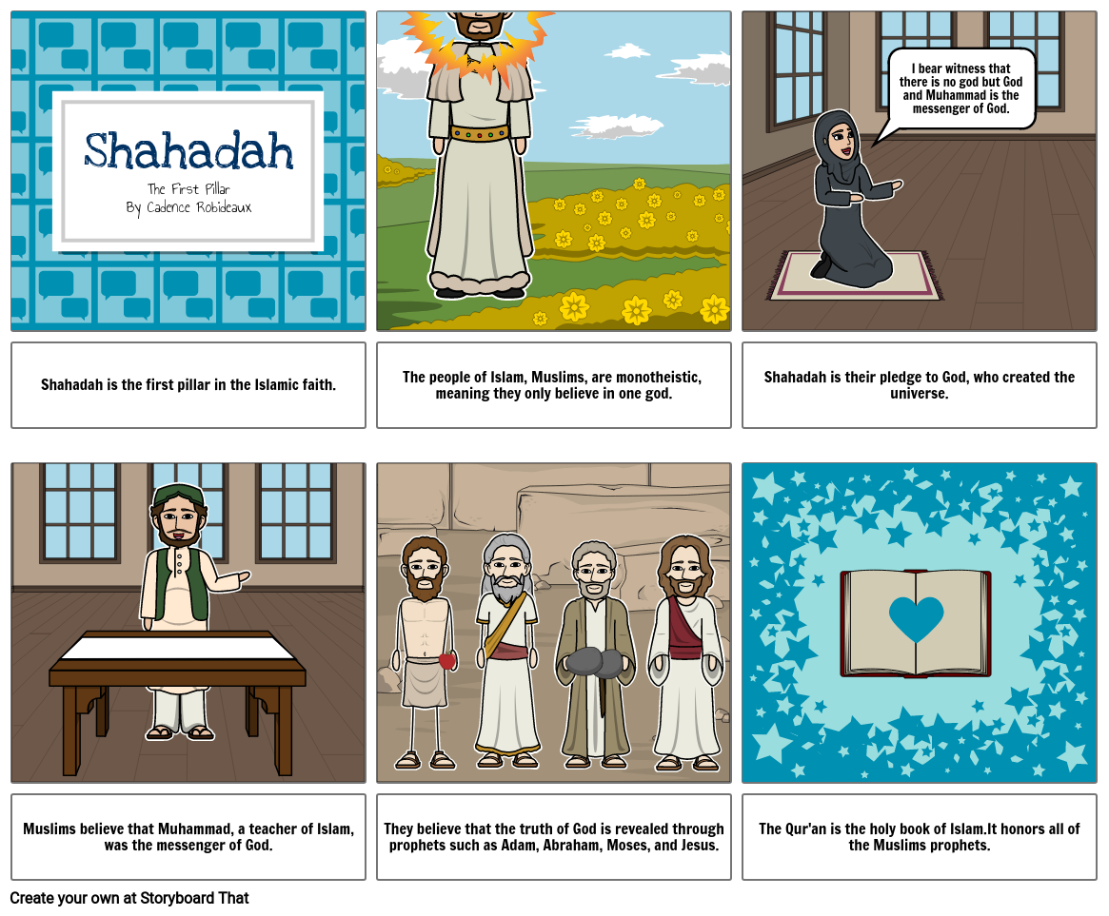

Slide 9


Prayer (salah)

Slide 10

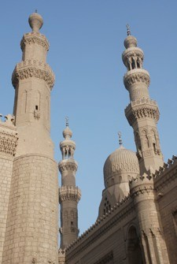
2. Prayer (salah)
Praying to the Creator (Allah) on a daily basis is the best way to cultivate in a man a sound personality and to actualize his aspiration.

Slide 11
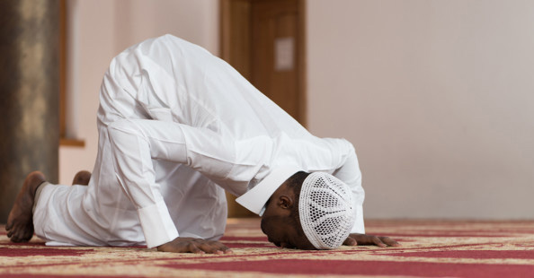
2. Prayer (salah)

Slide 12



Part of Requirements
✔ | Ablution (Wudu)
✔ | Purity. Cloth & Place
✔ | Intention (Niah)
✔ | Facing Mecca (Qiblah)

Slide 13
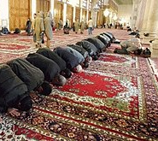
2. Prayer (salah)
Muslims should pray five times a day

Slide 14




3. Charity (Zakah)

Slide 15
3. Charity (Zakah)
Obligatory charity giving is an act of worship and spiritual investment.
The literal meaning of Zakah is purity and it refers to the annual amount in kind which a Muslim with means must distribute among the rightful beneficiaries.

Slide 16
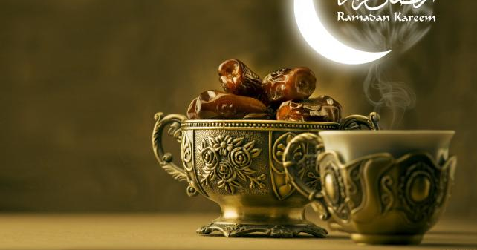
4. Fasting (sawm)

Slide 17
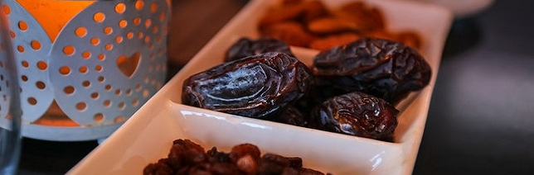
4. Fasting (sawm)
Fasting is abstaining completely from eating, drinking, intimate sexual contacts and smoking from the break of dawn till sunset.

Slide 18
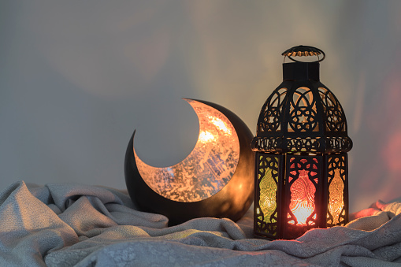
4. Fasting (sawm)
Ramadan
Obligatory fasting is done once a year for the period of the month of Ramadan, the ninth month of the Islamic year.

Slide 19
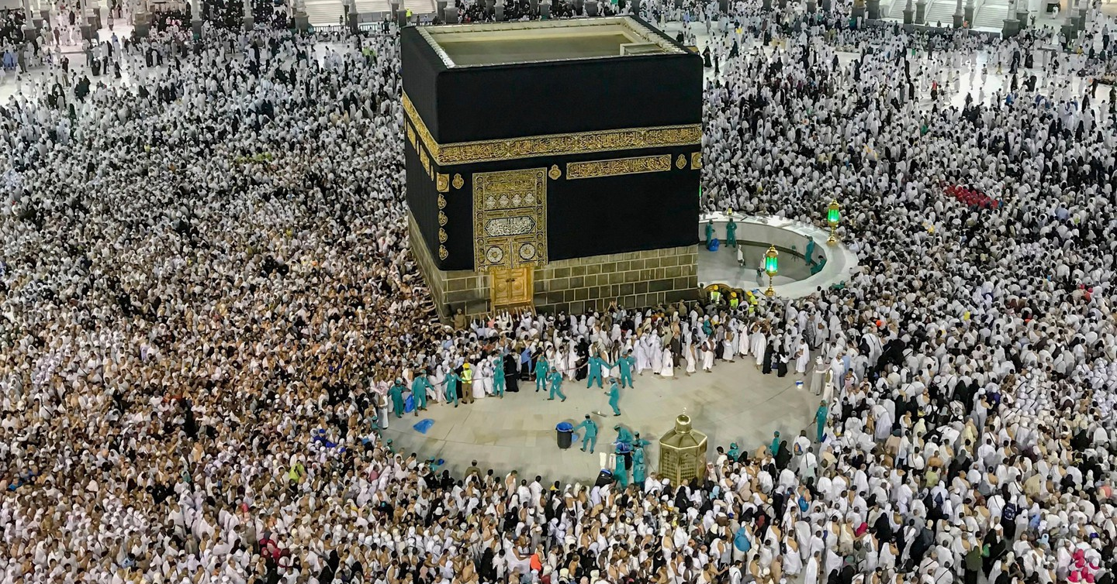
5. The Pilgrimage (hajj)

Slide 20

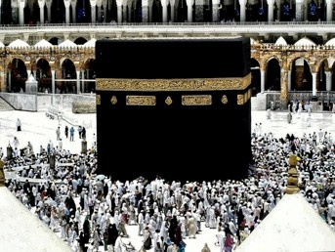
5. The Pilgrimage (hajj)
It is a pilgrimage to Mecca, at least once in a lifetime and it is obligatory upon every Muslim male and female who is mentally, physically and financially fit.

Slide 21


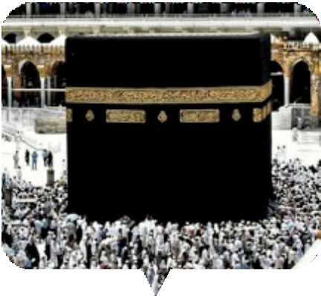

Slide 22

It is the largest annual convention of faith on earth.

Slide 23

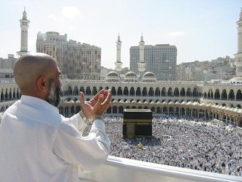
5. The Pilgrimage (hajj)
Peace is the dominant theme. Peace with Allah, with one's soul, with one another, with all living creatures.
To disturb the peace of anyone or any creature in any shape or form is strictly prohibited.
Supplicating Pilgrim at Masjid Al Haram. Mecca, Saudi Arabia.
Credit to Ali Mansuri.

