Slide 1
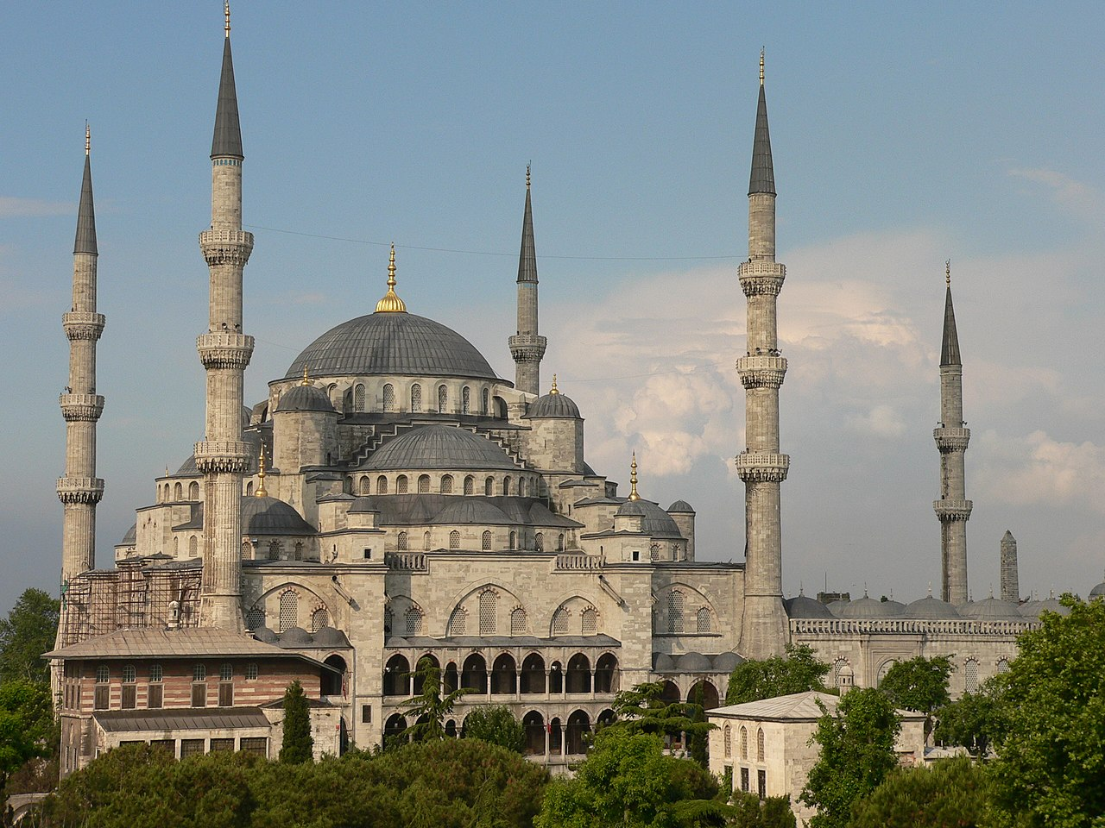
THE ISLAMIC EMPIRES

Slide 2

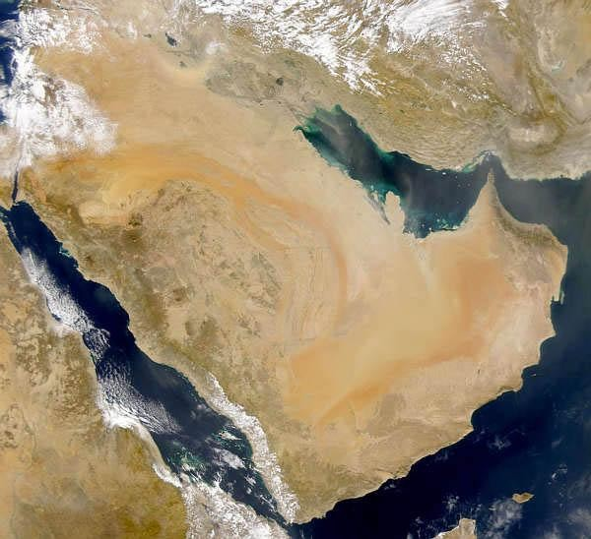
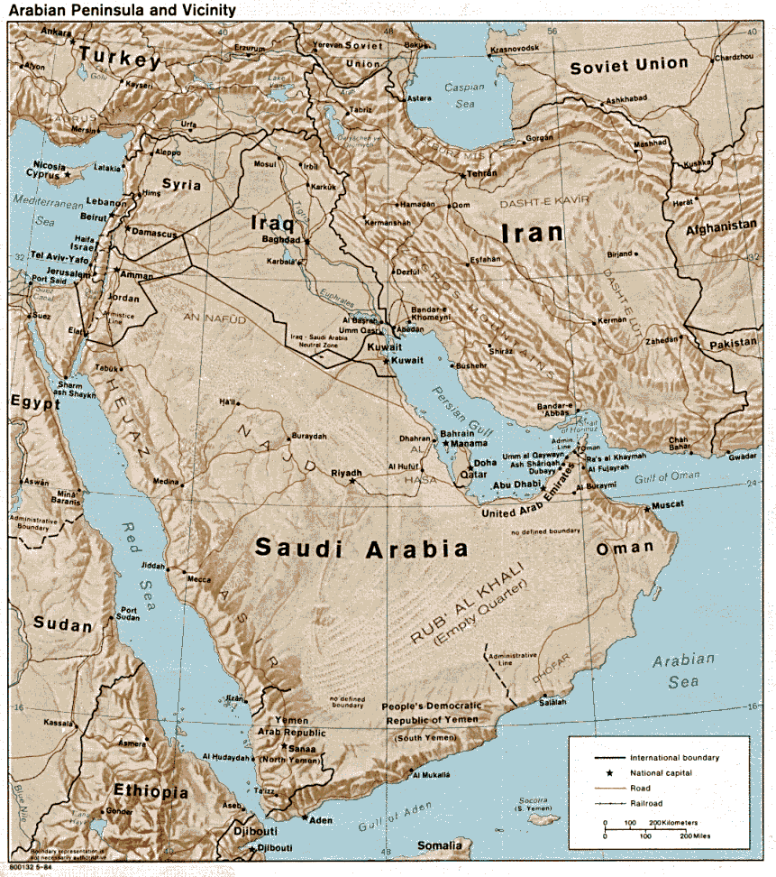
ISLAM AROSE IN THE ARABIAN PENINSULA IN THE EARLY 600’S

Slide 3
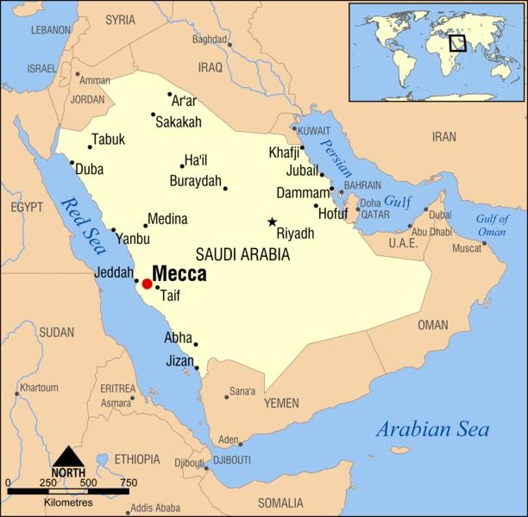
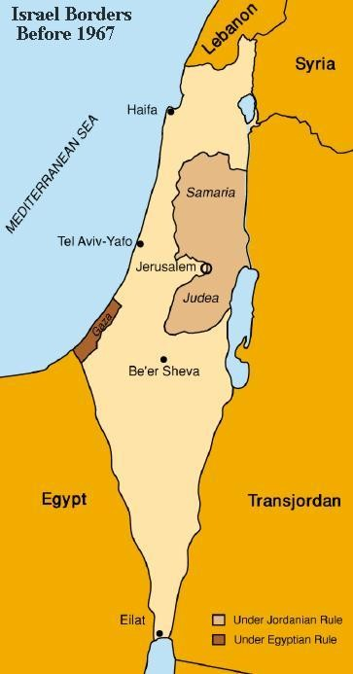
MECCA –MEDINA- JERUSALEM

Slide 4
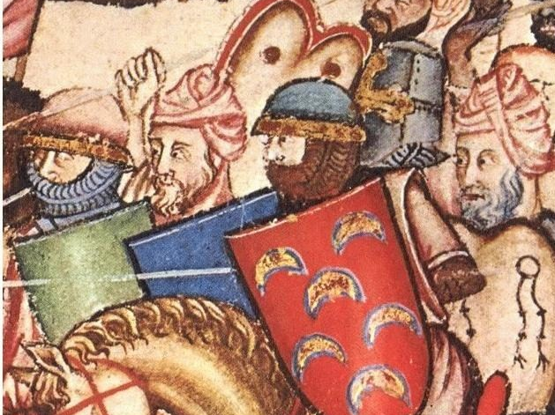
CA L I P H -SUCCESSOR TO MUHAMMAD WITH RELIGIOUS AND POLITICAL POWER

Slide 5
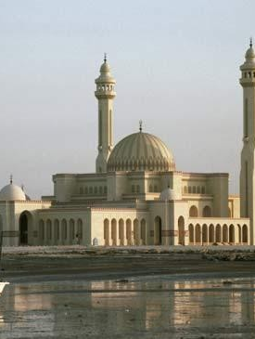
DIVISIONS GROW -->WHO SHOULD RULE AFTER MUHAMMAD'S DEATH?

Slide 6
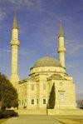
SUNNI
CALIPH SHOULD BE CHOSEN BY MUSLIM LEADERS
DO NOT VIEW THE CALIPH AS DIVINE

Slide 7
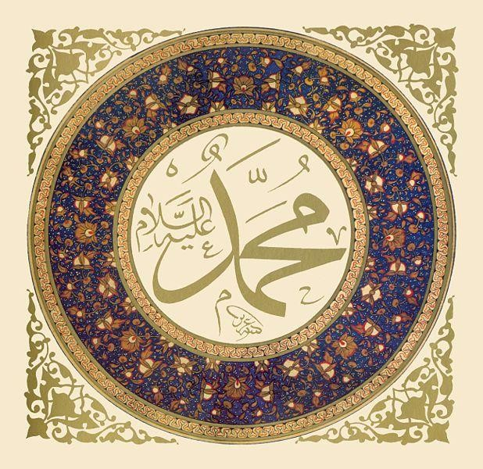
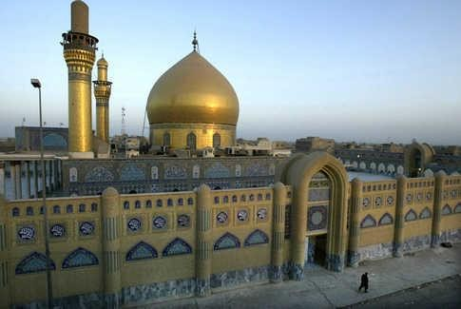
SHIITES
BELIEVED THAT ONLY THE DESCENDANTS OF THE PROPHET MUHAMMAD SHOULD BE HIS SUCCESSORS
BELIEVED THAT THE DESCENDANTS OF THE PROPHET WERE DIVINELY INSPIRED

Slide 8
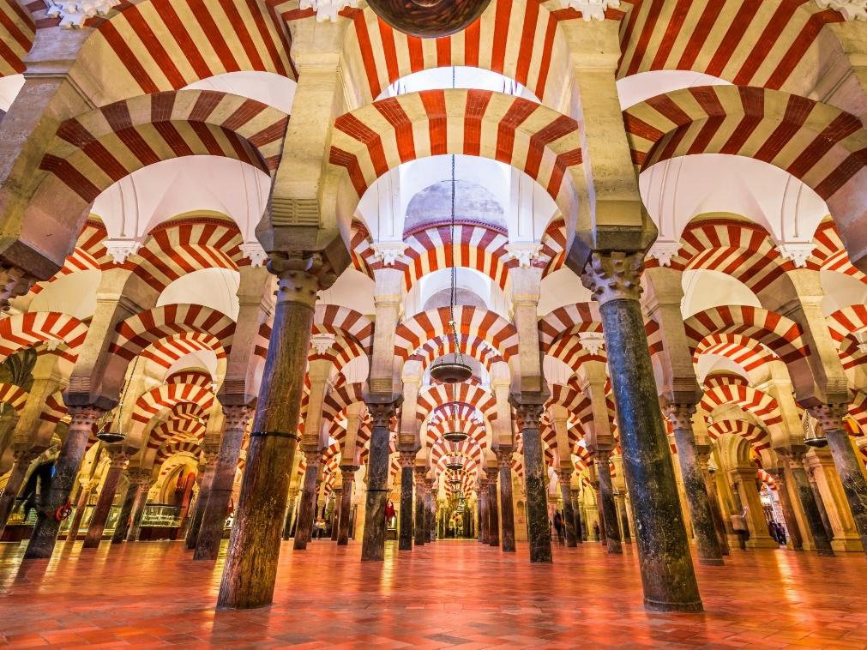
Caliphate
After the death of Muhammad, Abu Bakr was elected the first caliph.
The period when the Muslims were ruled by caliphs (600s to 900s) was known as the caliphate.

Slide 9

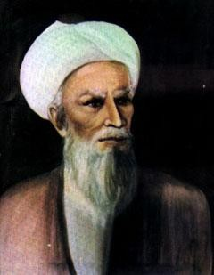
THE SPREAD OF ISLAM
UNDER ABU BAKR
  SPREADS QUICKLY TO PARTS OF THE BYZANTINE EMPIRE, THE PERSIAN EMPIRE, EGYPT, AND NORTH OF AFRICA
  CONQUEST & CONVERSION
ABU BAKR

Slide 10
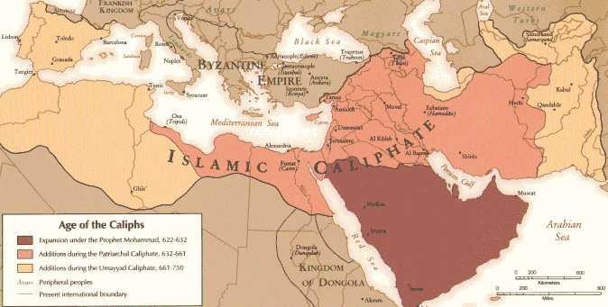

Slide 11

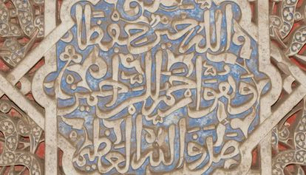
REASONS FOR THE SPREAD OF ISLAM
GOOD TREATMENT OF DEFEATED PEOPLE
( FAIR AND TOLERANT)

Slide 12

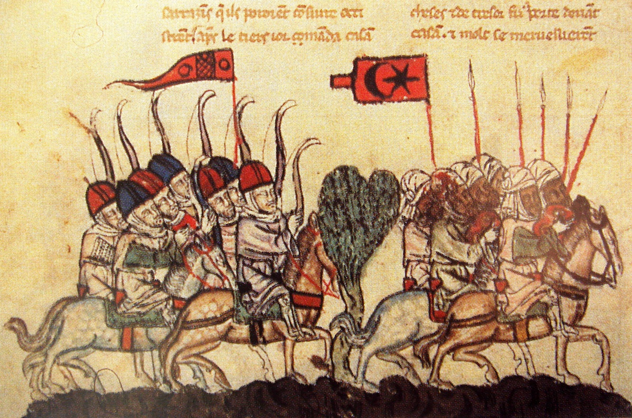
STRONG ARMY

Slide 13
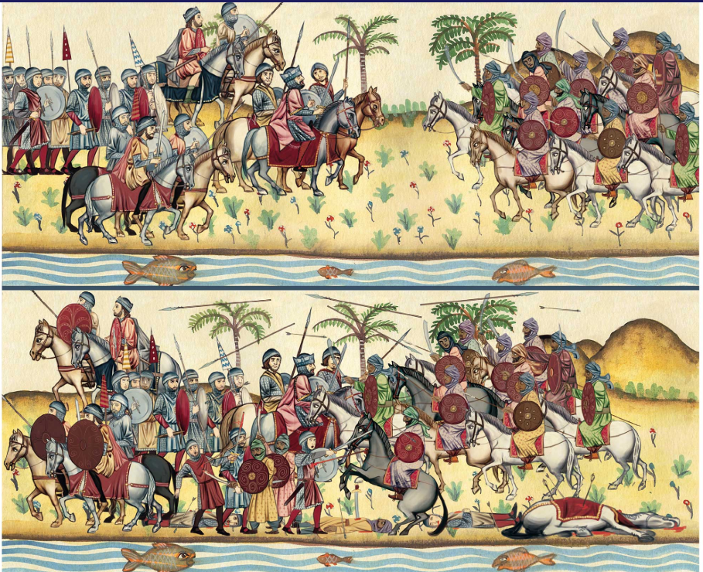
WEAK OPPONENTS
(PERSIA AND BYZANTINE EMPIRES, SPAIN, NORTH AFRICA, INDIA, SOUTHEAST ASIA)

Slide 14

SOCIAL PATTERNS
“SOCIAL MOBILITY”
IT BECAME POSSIBLE TO MOVE UP IN THE SOCIAL ORDER, ESPECIALLY THROUGH RELIGIOUS, SCHOLARLY, OR MILITARY ACHIEVEMENTS.

Slide 15
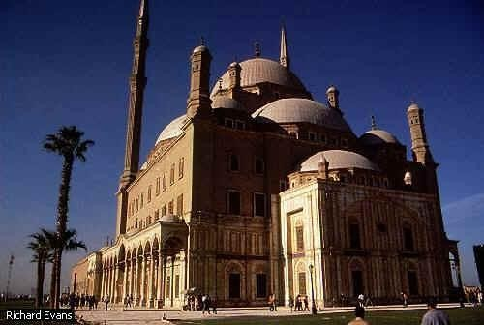
AS IN GREECE AND RO M E S L A V E R Y WAS C O M M O N N OT IN I T HE I S L A M I C
E M P I R E S
RELIGIOUSLY TOLERANT
-TAX ON NON- MUSLIMS

Slide 16
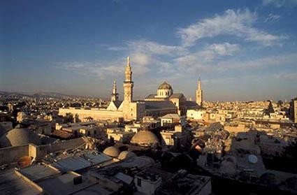
UMAYYAD DYNASTY
BASED IN DAMASCUS
CONQUEST BROUGHT WEALTH

Slide 17
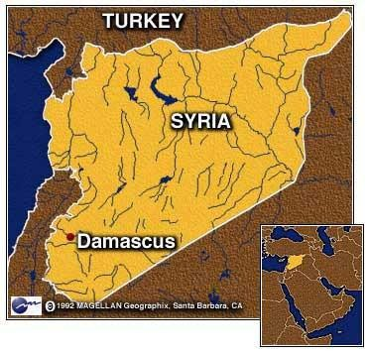

Slide 18
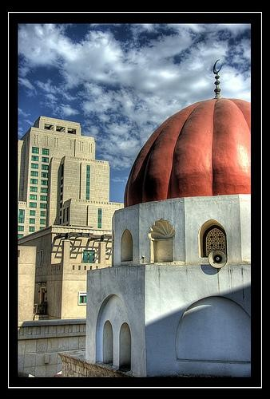

Slide 19
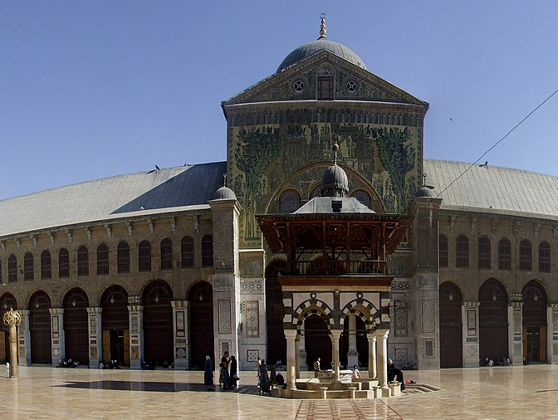

Slide 20


TENSIONS DEVELOPED AS WEALTH FROM CONQUEST INCREASED THE GAP BETWEEN THE RICH AND THE POOR
WHERE HAVE WE SEEN THIS BEFORE . . .

Slide 21
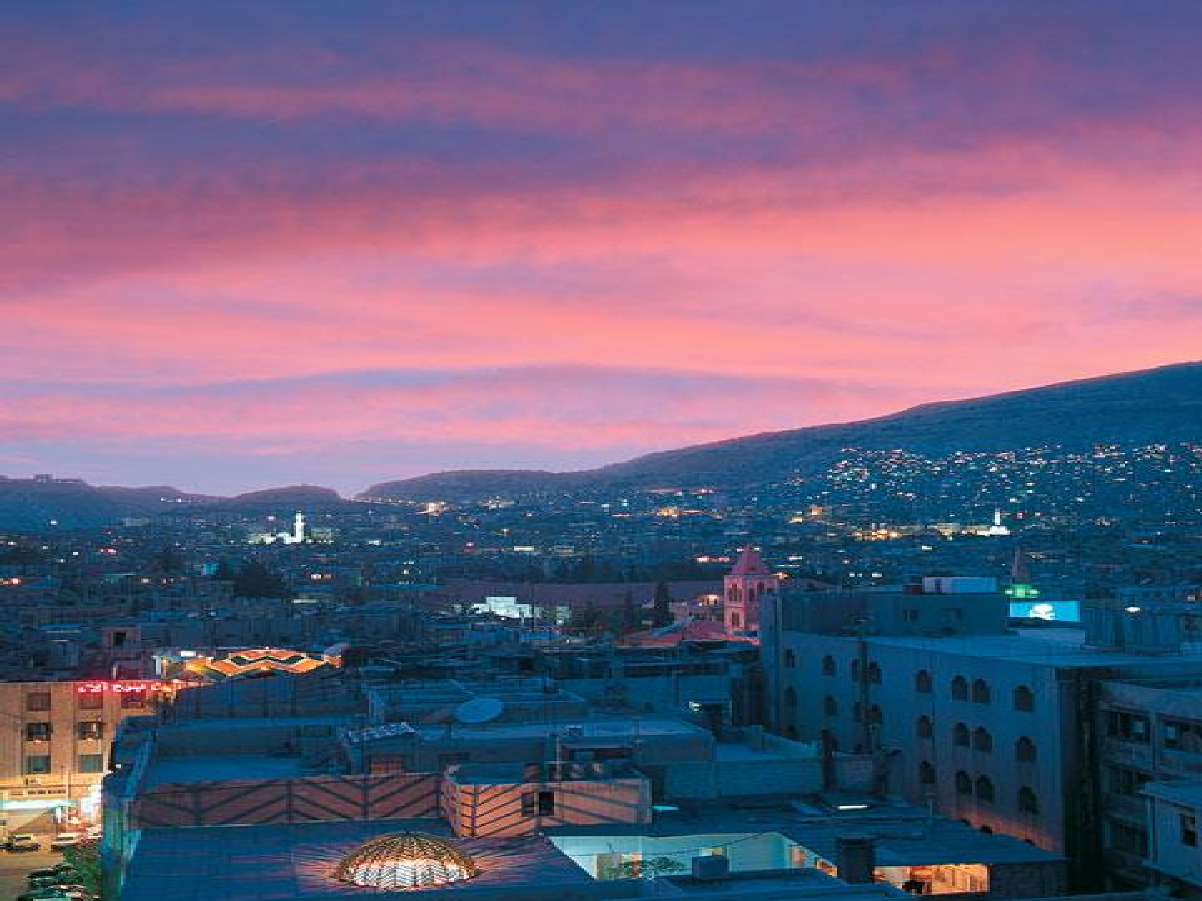
ANSWER: ROME!
And just like Rome, this was the downfall of the Umayyad Dynasty.

Slide 22

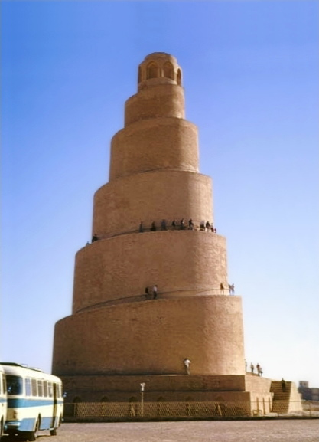
THE ABBASSID DYNASTY
UNHAPPY MUSLIMS REBEL
CAPTURE DAMASCUS IN 750 A.D.
BEGINS THE ABBASSID DYNASTY WHICH RULES UNTIL THE 1200’S (500 YEARS)

Slide 23

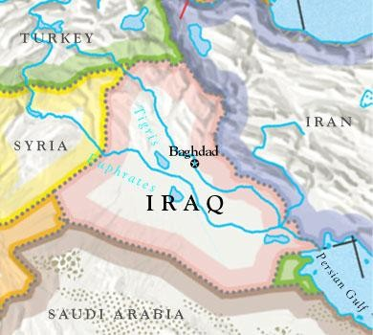
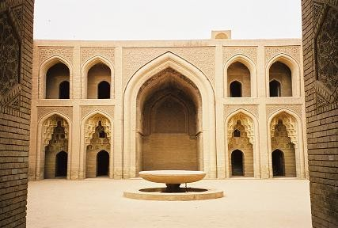
THE ABBASSID DYNASTY (2)
THE ABBASSIDS RULED FROM BAGHDAD
ANCIENT LIBRARY IN → BAGHDAD

Slide 24
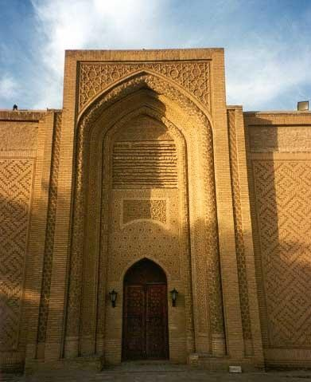
One of the few Abbasid palaces left in Baghdad located near the North Gate overlooking the Tigris. It is believed to have been built by Caliph Al- Naser Ledinillah (1179 - 1225 AD).

Slide 25
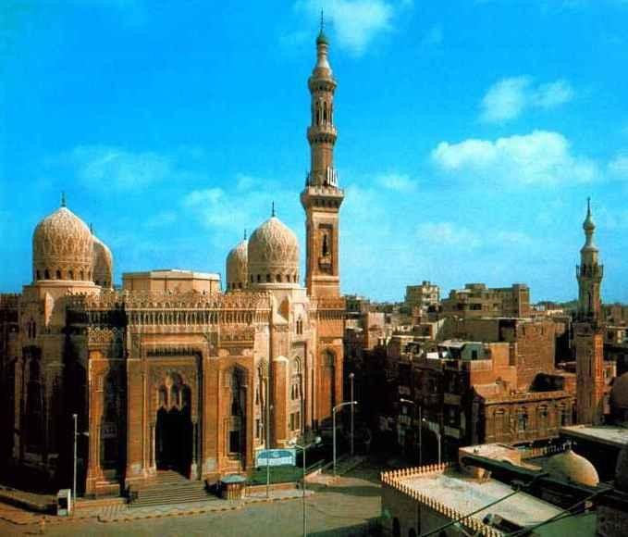
Early Abbassid rulers enjoyed great wealth and power, and the Muslim world experienced a golden age.

Slide 26
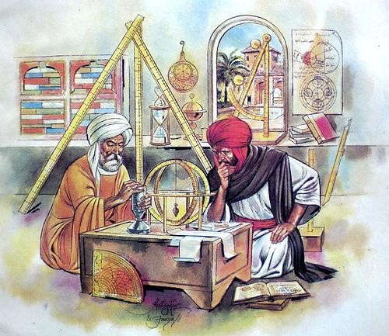
EDUCATION
THE PROPHET MUHAMMAD TAUGHT A RESPECT FOR LEARNING THAT CONTINUED IN MUSLIM CULTURE THROUGHOUT THE AGES

Slide 27

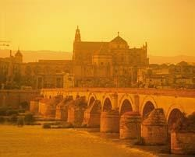
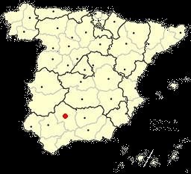

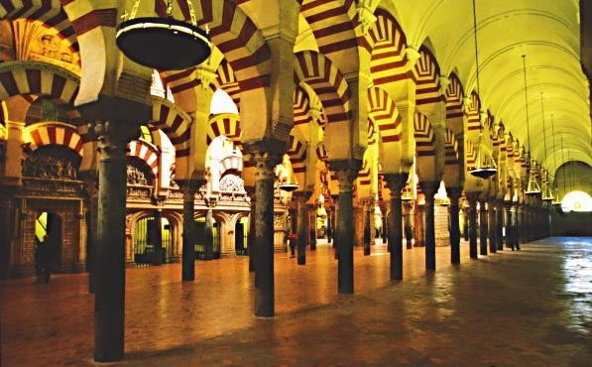
CORDOBA, SPAIN

Slide 28

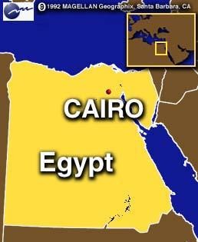
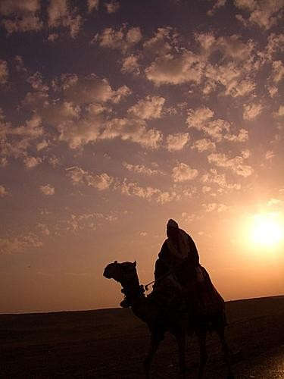
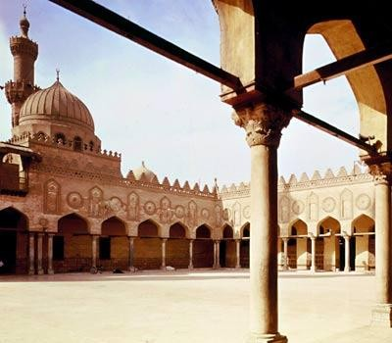
CAIRO, EGYPT

Slide 29

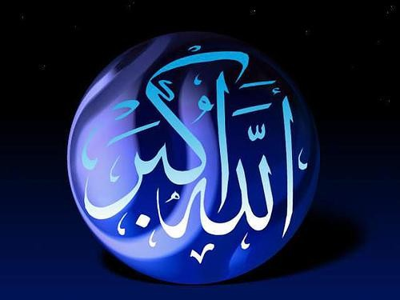
ART
MUSLIM RELIGIOUS LEADERS FORBADE ARTISTS TO PORTRAY GOD OR MOHAMMAD IN RELIGIOUS ART
INSTEAD CALLIGRAPHY WAS POPULAR

Slide 30
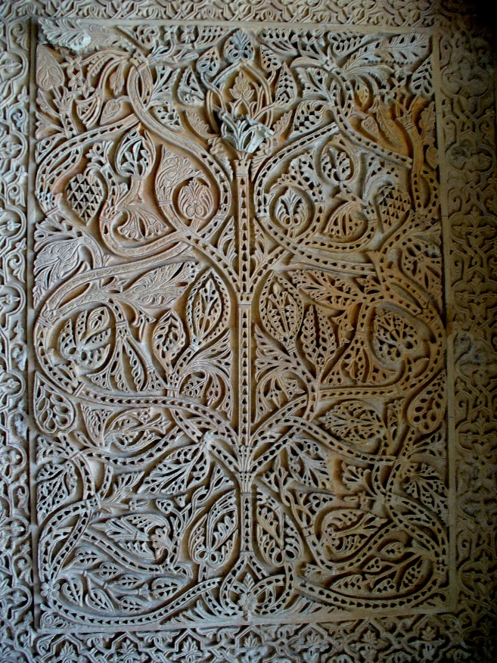
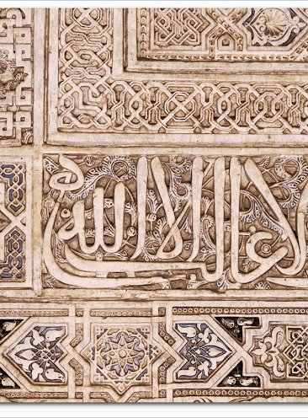
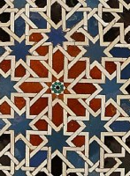
DECORATIONS FOR BUILDINGS

Slide 31


LITERATURE
ONE THOUSAND AND ONE NIGHTS
  INCLUDES FABLES, HUMOR, AND ROMANCE
  “ARABIAN NIGHTS”
*POETRY FAVORED OVER TALES

Slide 32




MATH & SCIENCE
MUSLIMS PIONEERED THE STUDY OF ALGEBRA AND MADE HUGE STRIDES IN ASTRONOMY AND MEDICINE

Slide 33

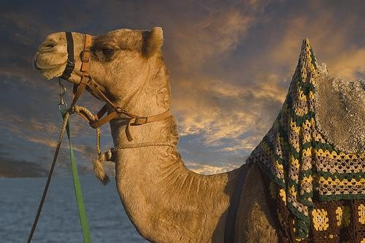
ECONOMIC ACHIEVEMENTS
MUSLIMS HAD AN EXTENSIVE TRADE NETWORk AND ENCOURAGED MANUFACTURING
AGRICULTURE ALSO FLOURISHED

Slide 34

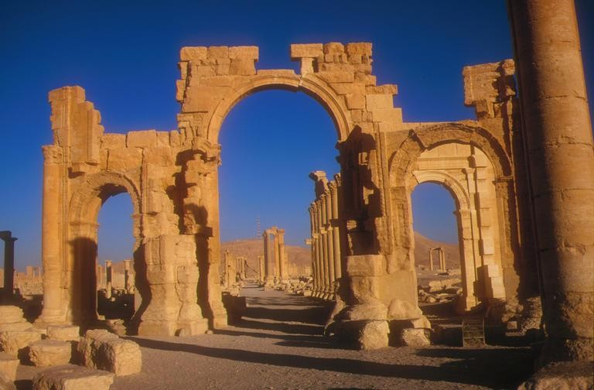
ABBASSID RULE SLOWLY DECLINES AFTER THEIR GOLDEN AGE ( STARTING AROUND 850 A.D.)

Slide 35


THE BIG IDEA
THE MUSLIM WORLD:
  INCLUDED LANDS AND PEOPLES FROM PARTS OF THREE CONTINENTS
  PRESERVED, BLENDED, AND SPREAD VARIOUS SURROUNDING CULTURES
  ENJOYED A PROSPEROUS GOLDEN AGE WITH ADVANCES IN ART, LITERATURE, MATHEMATICS, AND SCIENCE
  SPREAD NEW IDEAS AND INTELLIGENCE TO CHRISTIAN EUROPE

