Slide 1
EARLY MODERN
PERIOD
P

Slide 2
The Early Modern Period
The 200 years between 1400 and 1600 marks a period of transition between Middle Ages and modernism in many areas of the world
This growth is marked by three global movements
  Worldwide exploration and conquest
  Rational and scientific inquiry
  Changes in mentality, religion and art.

Slide 3
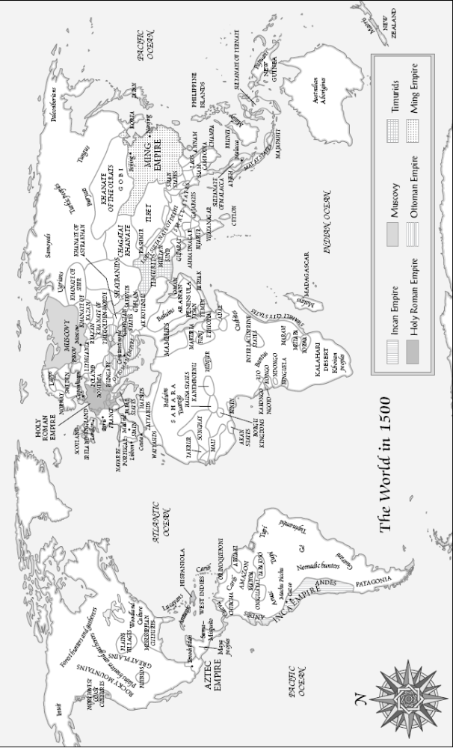
Early Modern Period

Slide 4
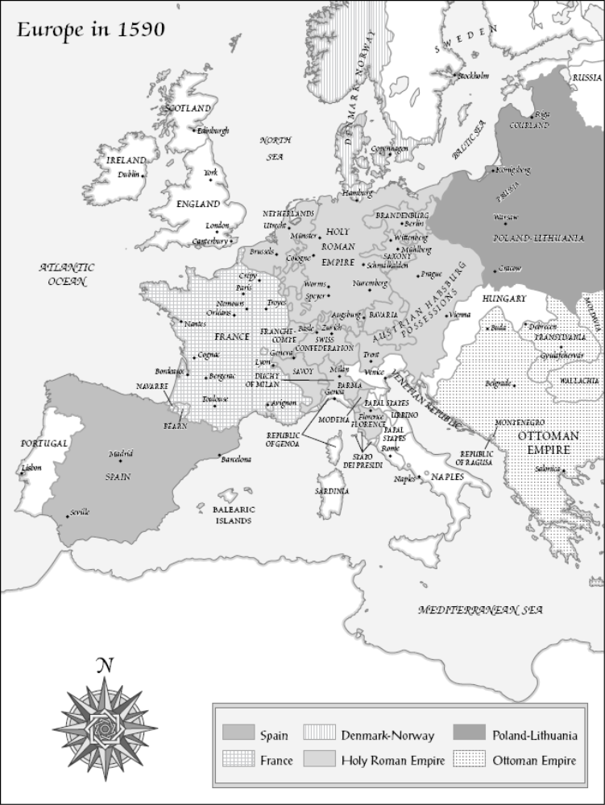
Empires and Nations
Politically, the period is marked by:
  Expansive imperial: Spain and Portugal.
  National consolidation: authoritarian Monarchy, Absolutism and Constitutional Monaarchy.

Slide 5
Empires and Nations
The the establishment of national languages and literatures, was an important aspect of political and cultural self-definition.
  Local languages achieved new status in many parts of the world
    Example: Spanish first Grammar.

Slide 6
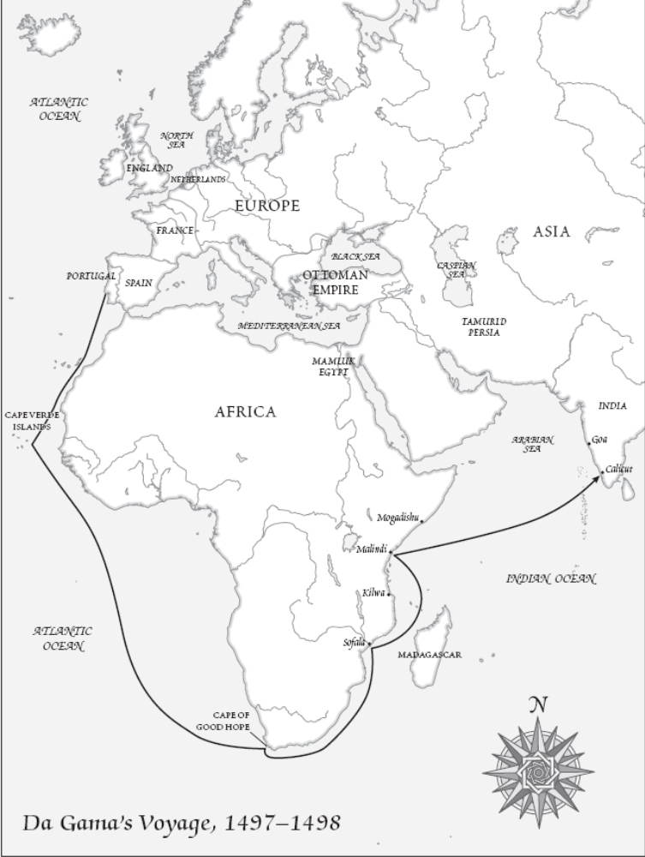
Exploration and Conquest
Long-distance exploration began in earnest in the 1400s
  Vasco de Gama: India 1490s
  Columbus: America 1492
    Followed by a flood of Dutch, British, and French explorations
  Much literature was written about these explorations
    Pantagreul, Lusiads

Slide 7
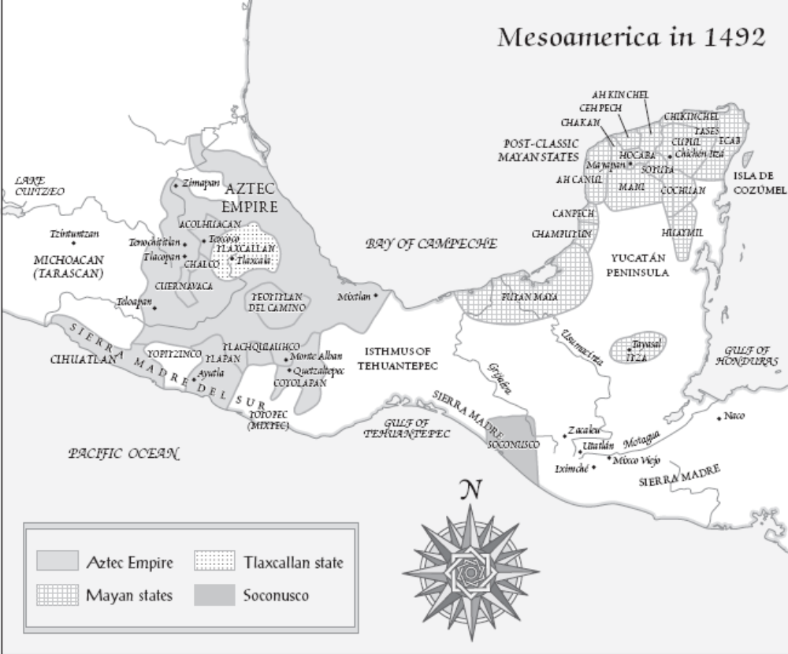
Exploration and Conquest

Slide 8
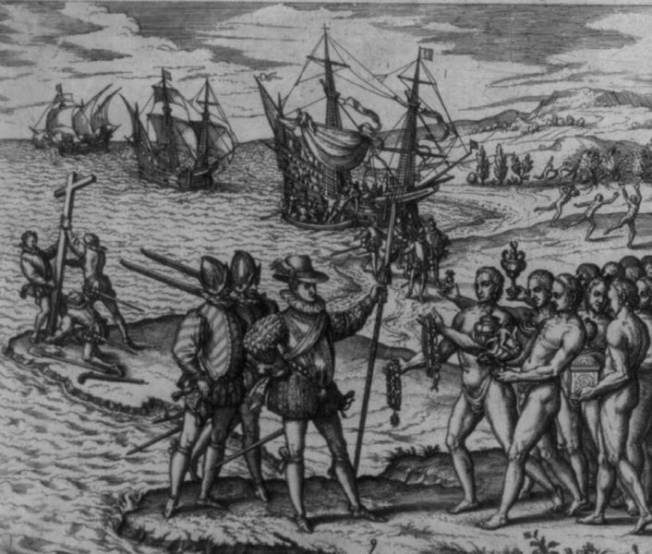
Exploration and Conquest
Christopher Columbus on Hispanolia, Credit: Library of Congress

Slide 9
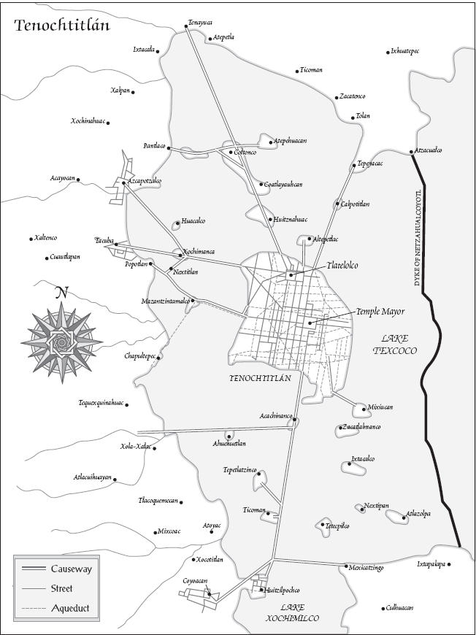
Exploration and Conquest

Slide 10
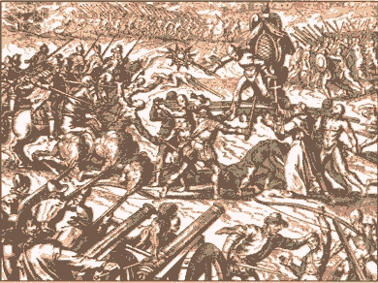
Scientific Conquest and Inquiry
New technologies encouraged exploration and conquest
  Modern armies could easily overwhelm rivals unequipped with guns, canons, and warships
Inca-Spanish confrontation in Cajamarca; there is Emperor Atahuallpa

Slide 11
Scientific Conquest and Inquiry
All phenomenon became subjects for probing, skeptical inquiry.
Advances in Medicine, Geography and other sciences due to the implementing of scientific method

Slide 12
The Rise of Print Culture
The invention of printing was a crucial development
  Enabled texts to be widely circulated and easily affordable
  First movable type invented in China by Pi Sheng around 1000, but impractical due to complex nature of Chinese characters
  In Europe, moveable type revolutionized circulation of texts
    For example, Protestant Reformation

