Slide 1
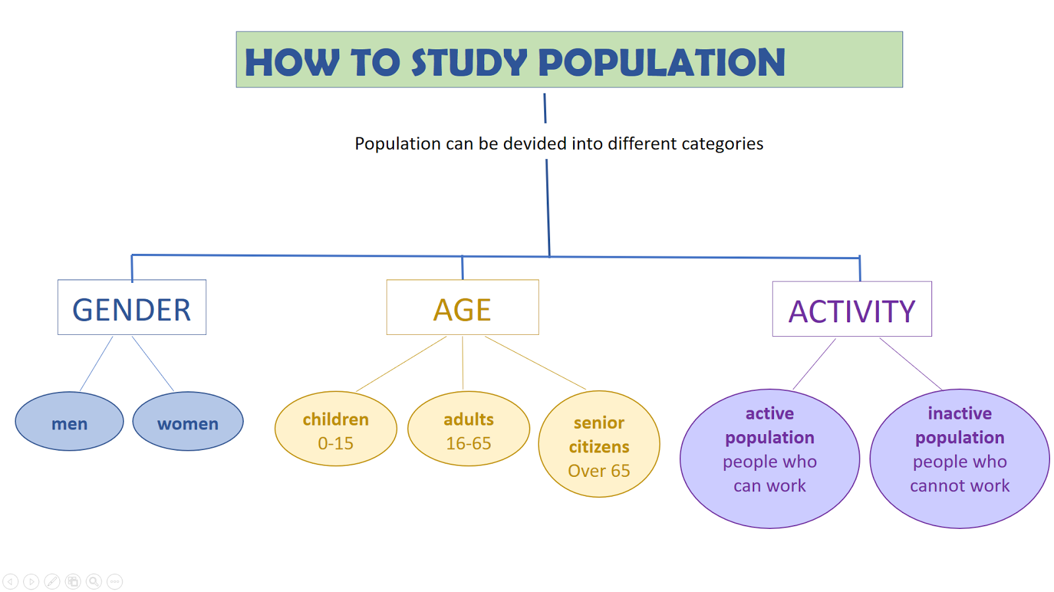

Slide 2
EMPLOYED
ACTIVE POPULATION
UNEMPLOYED
INACTIVE POPULATION
Pensioners, students,
home-makers, etc.

Slide 3
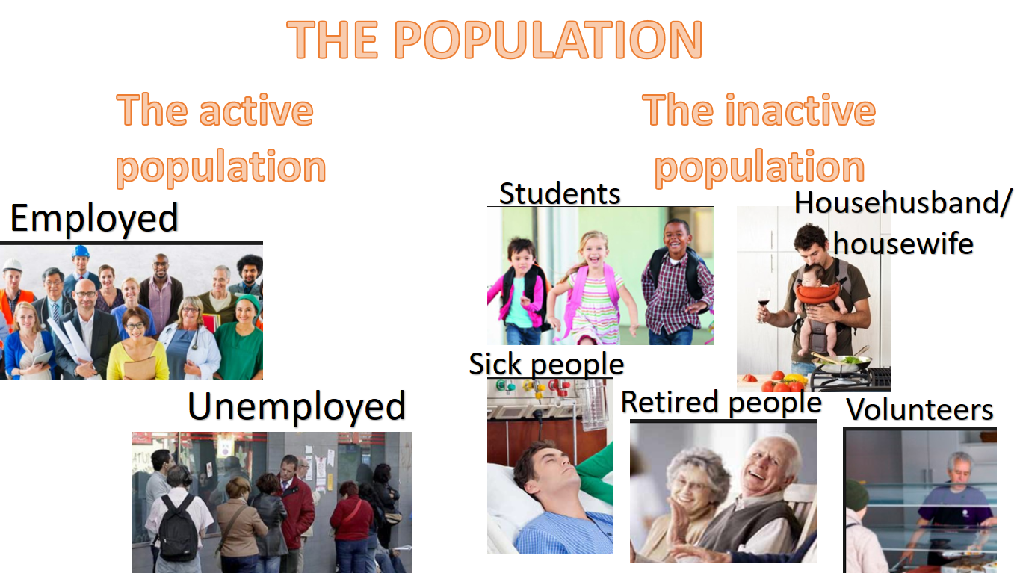

Slide 4


Slide 5
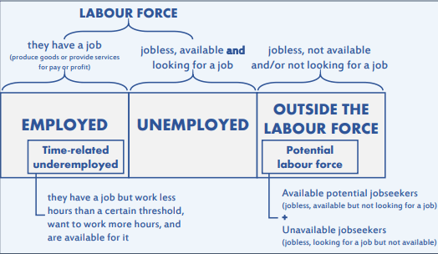

Slide 6
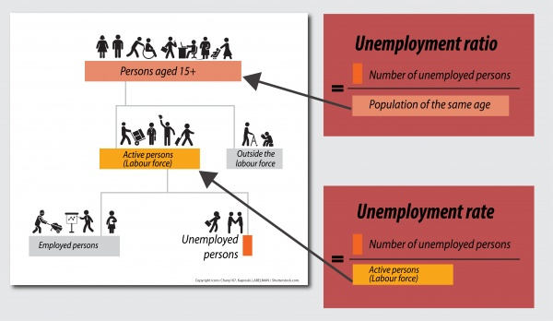

Slide 7
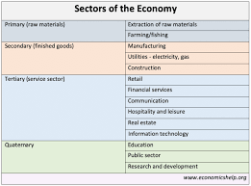
CLASSIFICATION OF ACTIVE POPULATION ACCORDING TO ECONOMIC SECTOR
THEY ARE EMPLOYED

Slide 8
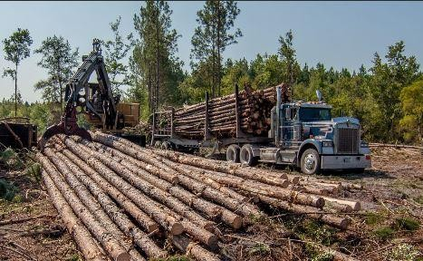
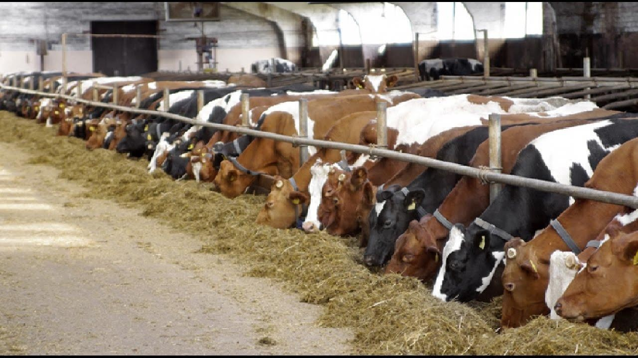

PRIMARY SECTOR

Slide 9
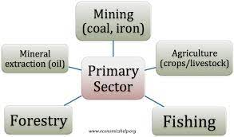

Slide 10

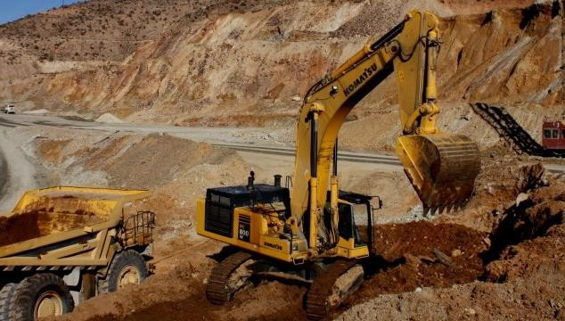
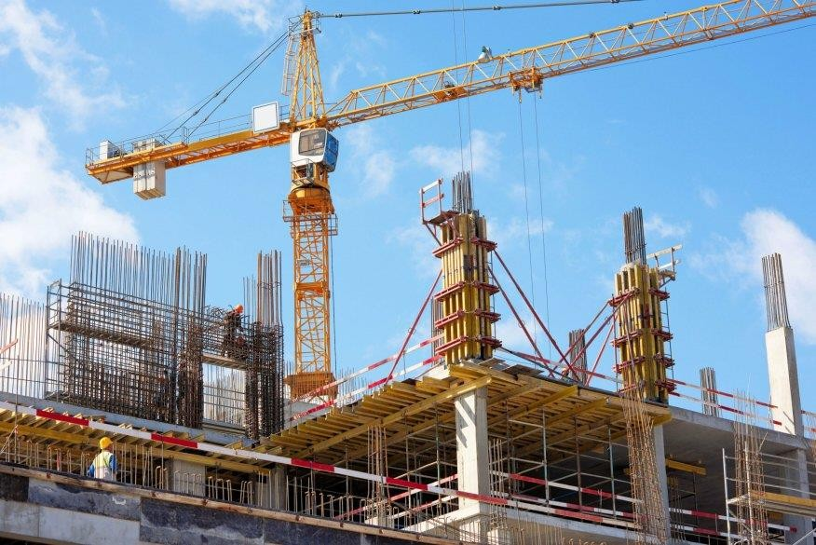
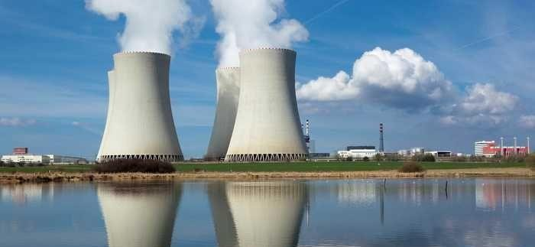
SECONDARY SECTOR

Slide 11
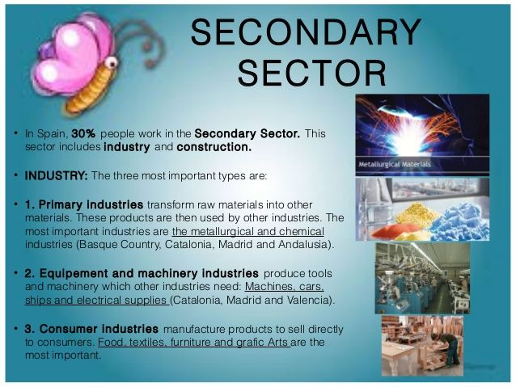

Slide 12


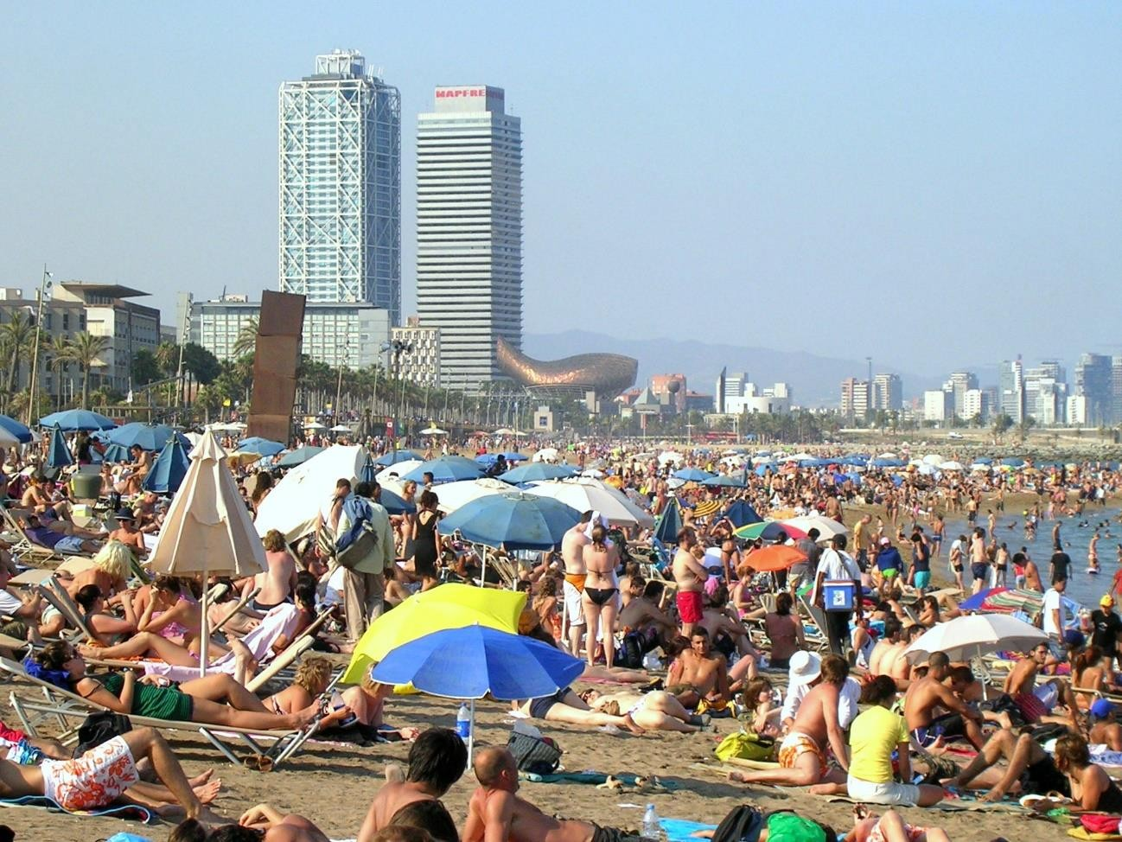

TERTIARY SECTOR

Slide 13
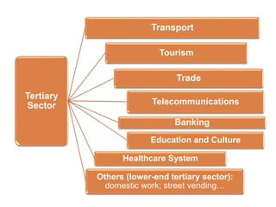

Slide 14
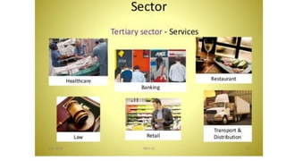

Slide 15
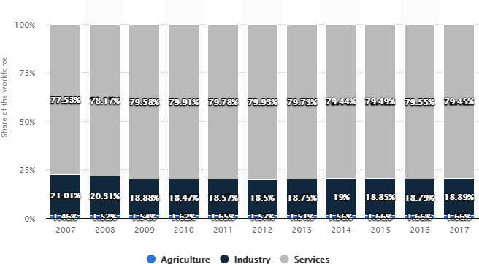
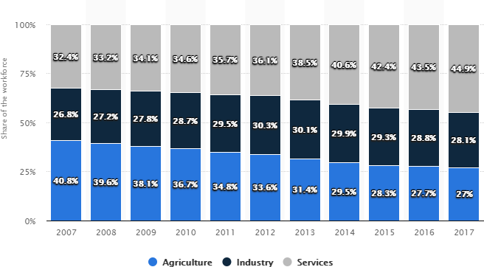
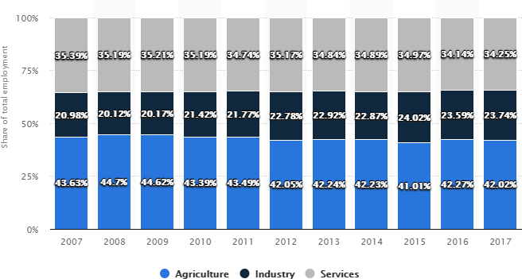
Distribution of employment by economic sector from 2007 to 2017 (USA, China and Paraguay)

Slide 16
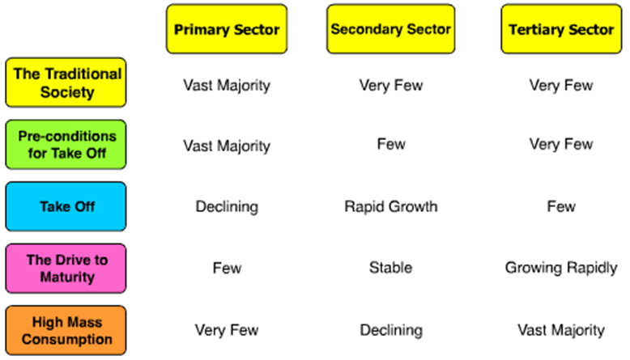
EMPLOYMENT STRUCTURES AND ECONOMIC GROWTH

Slide 17
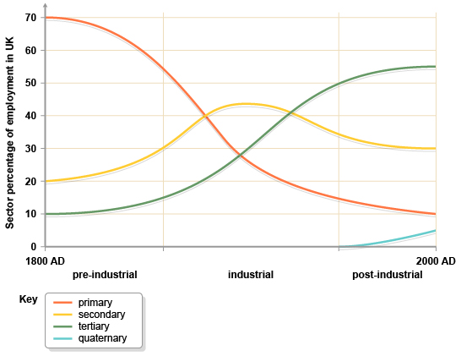

Slide 18
