Slide 1

POPULATION PYRAMIDS

Slide 2
Population Pyramids
AKA age-sex pyramids
area's population by age and sex (gender) for a particular point in time
Males on the left
Females on the right
the bars typically read as percentages of the total population
sometimes the actual number of people is shown
Scaled is preferred by human geographers!
Why?

Slide 3
What Do They Say?
Demographic disasters: War, famine, epidemic
Demographic transition:
  Extreme pyramid= stage 2
  Collumnular= stage 4
Make up of the community
Cultural preferences

Slide 4
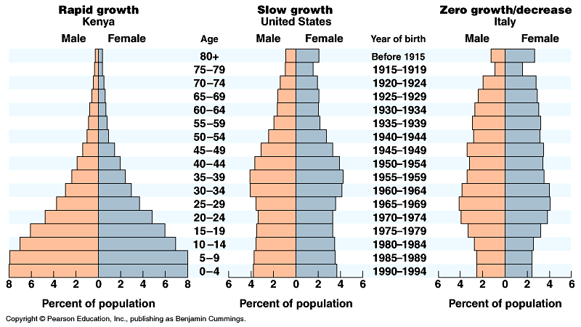

Population Pyramids

Slide 5
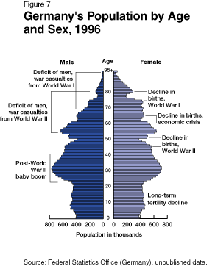
http://ecp3113-01.fa01.fsu.edu/lively_introduction/fig7.gif

Slide 6
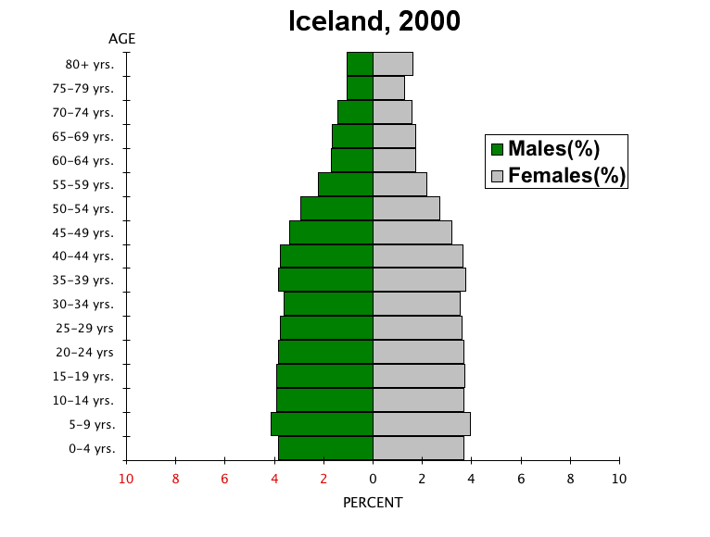
What will the pyramid look like in 2025? 2050?

Slide 7
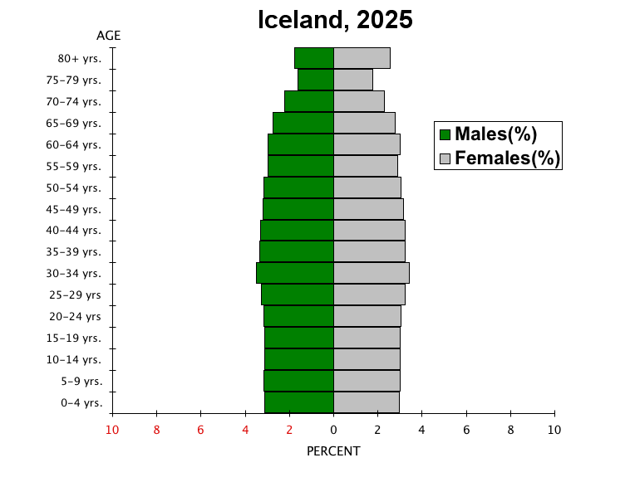

Slide 8
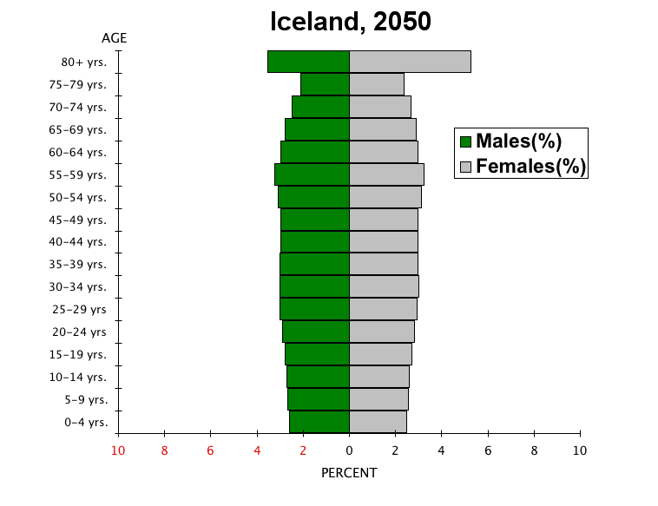
Age Dependency Ratio

Slide 9
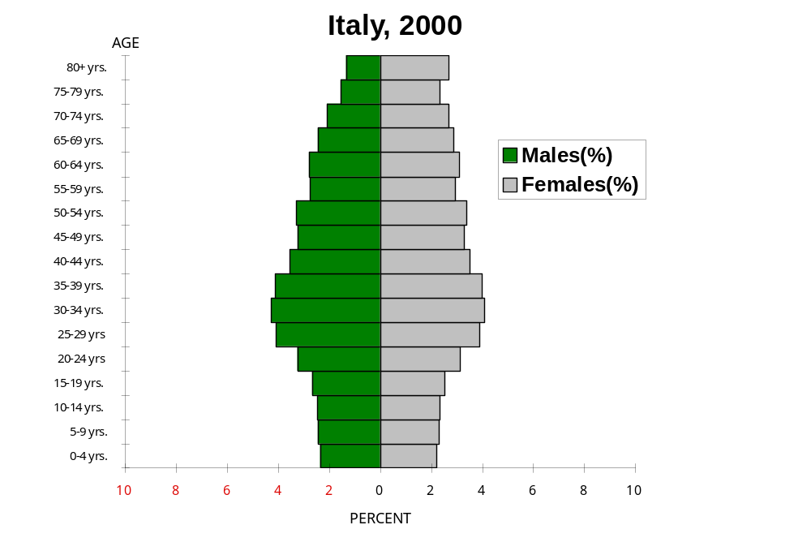
4
3
5
2
1

Slide 10
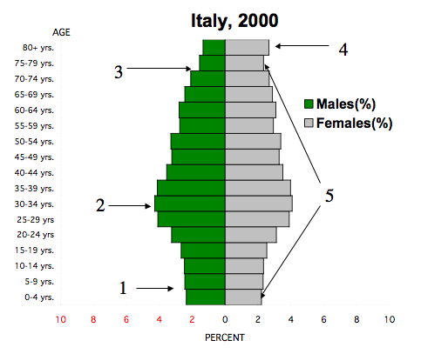
Analysis of Italy’s
Population Pyramid
1. Decline in Birth Rate
2. Baby Boom
3. Fewer men due to World War I and II
4. More women due to: a. longer life expectancy and b. World Wars (I and II)
5. More 75-79 yrs than 0-4 yrs. Signs of a future worker shortage and an overall declining population.

Slide 11

Aging population…
…declining birth rate

Slide 13
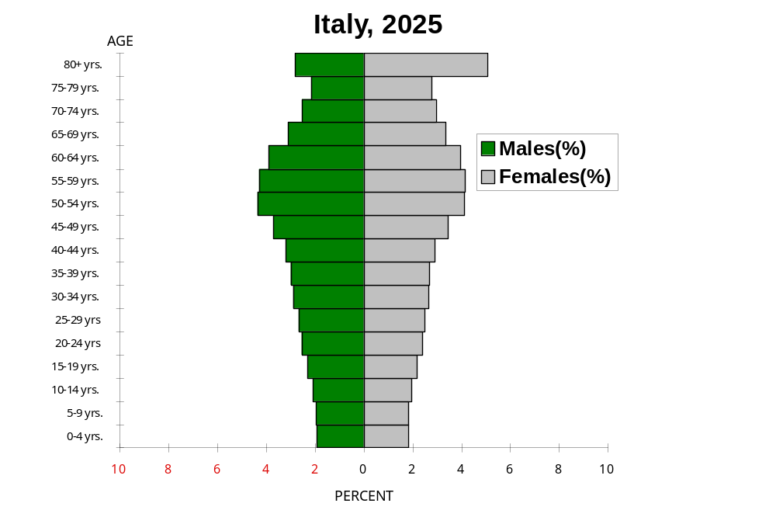

Slide 14
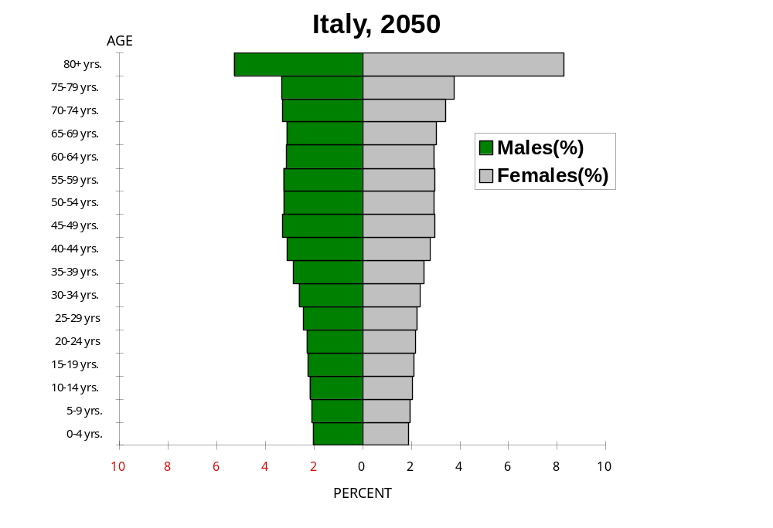

Slide 15
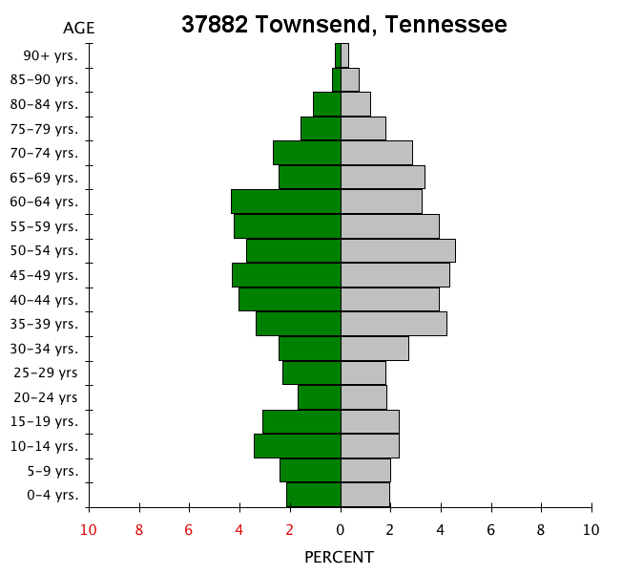

How is this population pyramid different from Italy’s?

Slide 16
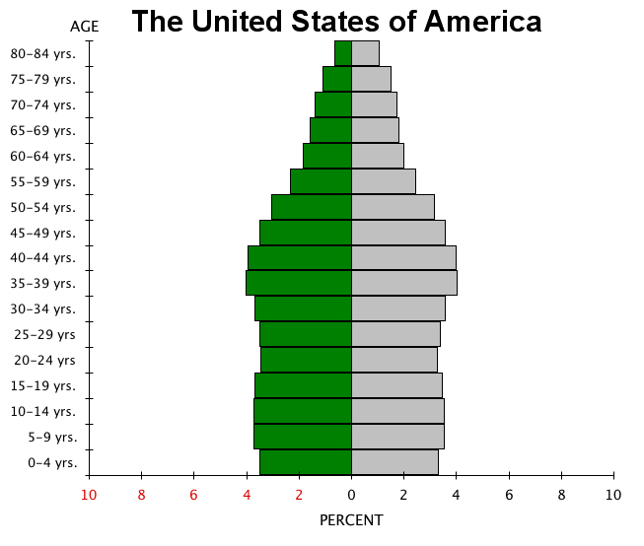


Slide 17
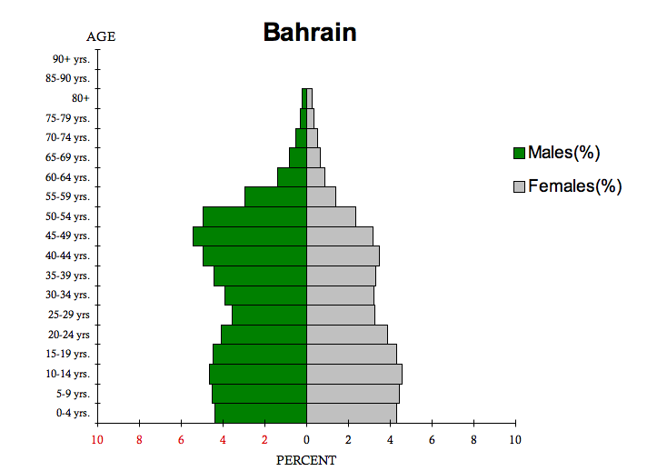
Guest Workers, mainly from South Asia

Slide 18
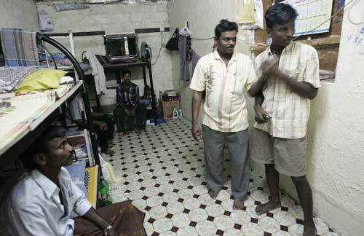

Guest Workers from India in the Persian Gulf Countries
http://fusions.wordpress.com/2007/08/06/migrant-workers-in-dubai

Slide 19
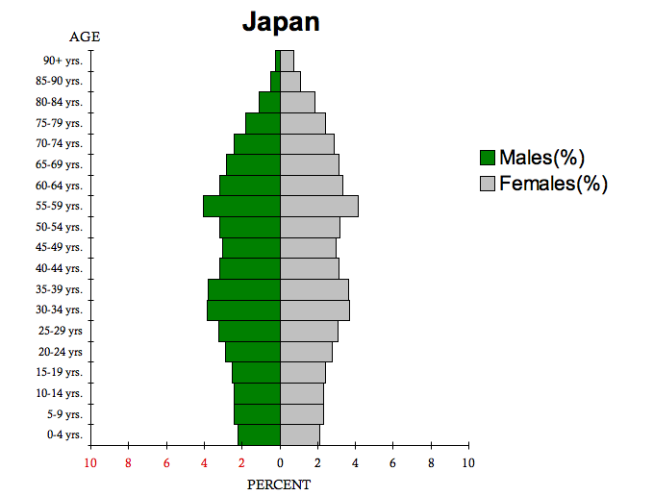
Post War Baby Boom and Declining Birth Rate

Slide 20
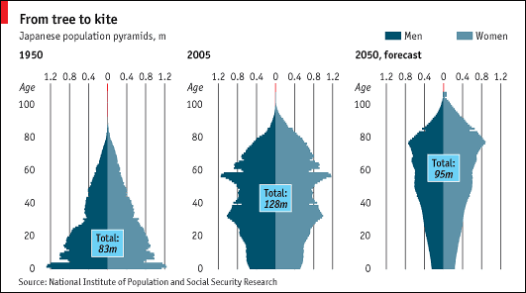

http://kotaku.com/gaming/only-in-japan/strange-japanese-game-center-name-226261.php
http://www.economist.com/world/displaystory.cfm?story_id=9539825

Slide 21
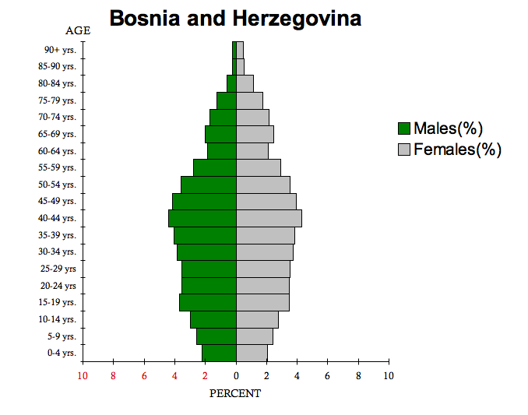
Declining Birth Rate, Emigration, War

Slide 22
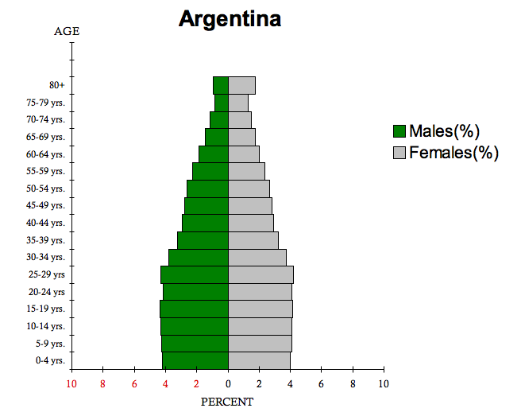
Stable Population Growth

Slide 23
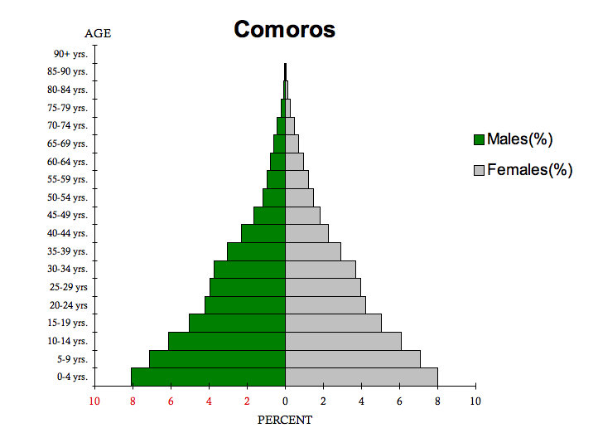
High Birth and Death Rates

Slide 24
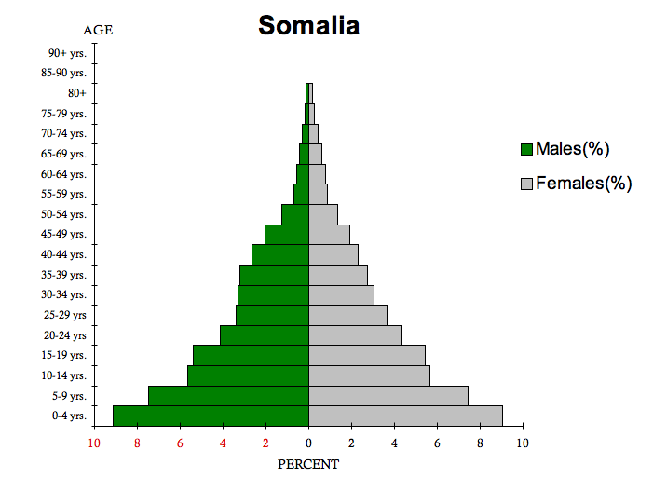
Extremely High Birth and Death Rates

Slide 25
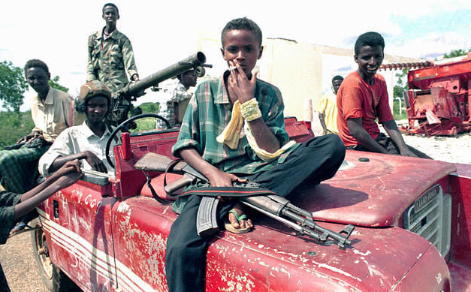
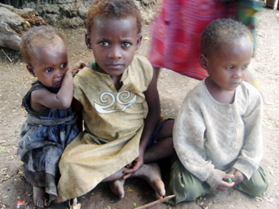
Persistent Poverty and Violence
http://www.islamic-relief.com/submenu/appeal/somalia_crisis.htm
http://www.biyokulule.com/February_%201990s(4).htm

