Slide 1
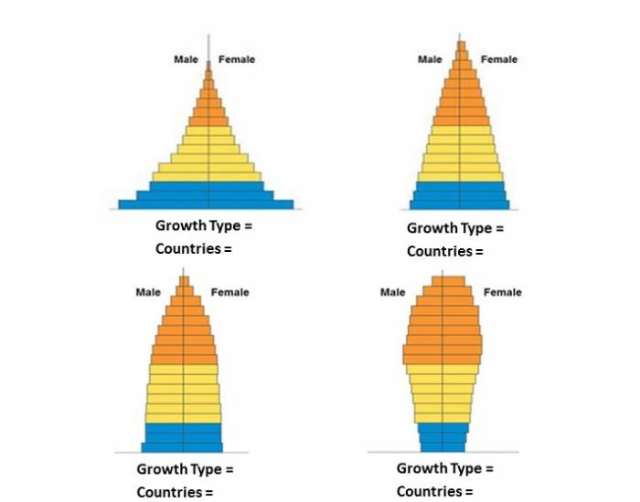
Types of Population Pyramids

Slide 2
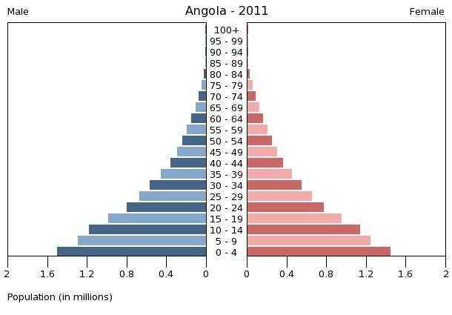
^{𝗈} Expansive population pyramids show larger numbers or percentages of the population in the younger age groups, usually with each age group larger in size or proportion than the one born before it.
^{𝗈} Population growth is rapid.

Slide 3
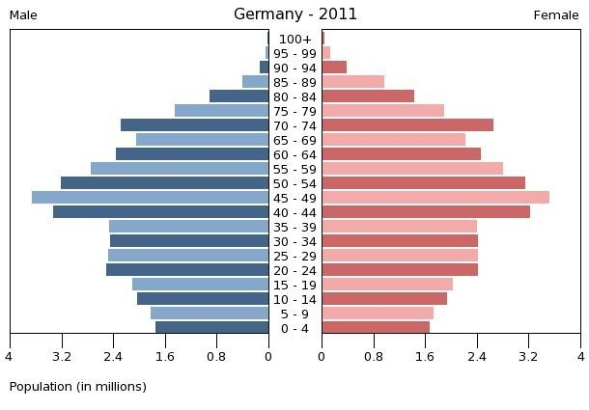
^{𝗈} Constrictive population pyramids display lower numbers or percentages of younger people.
^{𝗈} Population growth is negative.

Slide 4
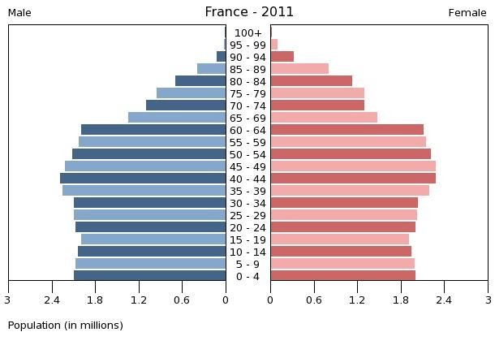
^{𝗈} Stationary or near-stationary population pyramids display somewhat equal numbers or percentages for almost all age groups. Of course, smaller figures are still to be expected at the oldest age groups.
^{𝗈} Population growth is neutral or stable.

Slide 5
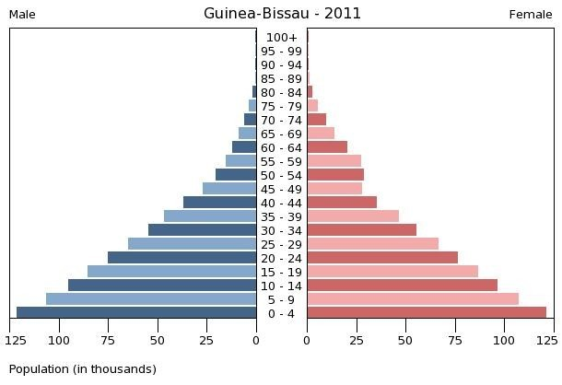
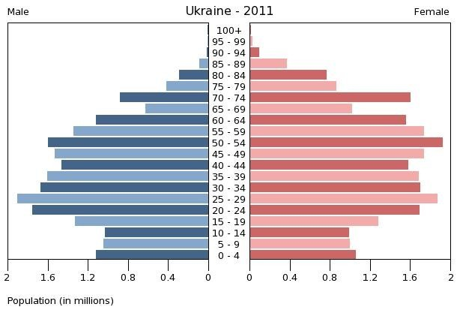
How to Read a Population Pyramid
Wide Base
Birth rate varies with the width of the base.
A wide base indicates a high birth rate.
Narrow Base
Birth rate varies with the width of the base.
A narrow base indicates a low birth rate.

Slide 6
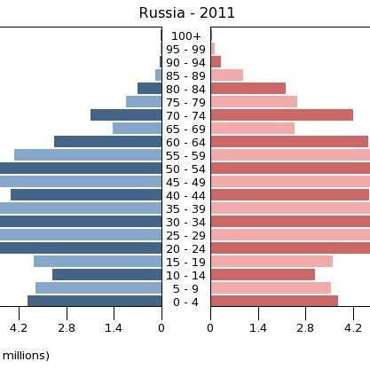
How to Read a Population Pyramid
^{𝗈} Symmetry
𝗈
statistically speaking pyramids should be relatively symmetrical
any asymmetry indicates a difference in the male and female population
this pyramid shows more females at age ranges above 50 which indicates that women are living to older ages than males
𝗈
𝗈

Slide 7
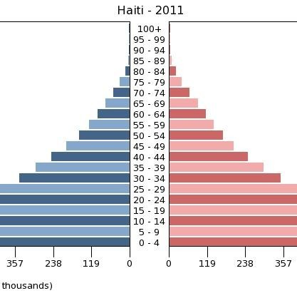
How to Read a Population Pyramid
^{𝗈} Shape of Sides
𝗈
Concave sides indicate a high death rate and convex sides indicate a low death rate
this population pyramid exhibits concave sides indicating a high death rate
𝗈

Slide 8
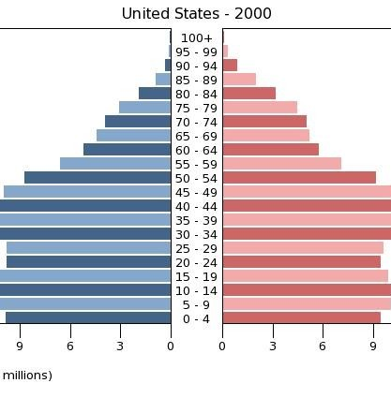
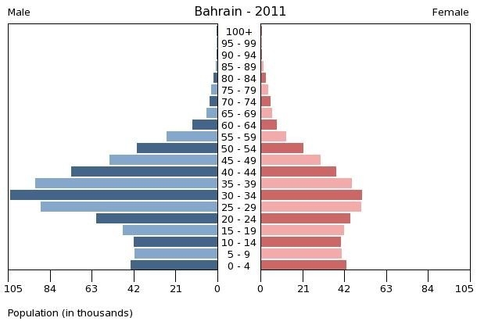
HOW TO READ A POPULATION PYRAMID
𝗈
𝗈
BUMPS IN THE SIDES:
irregularities in the sides indicate a demographic anomaly
the 30 -50 age group in the population pyramid at the right represents the baby boom
this bump will travel upward as the baby boomers age
𝗈
𝗈
Bumps in the sides
– irregularities in the sides indicate a demographic anomaly
the large numbers of working aged men in the pyramid to the left indicates a migrant workforce
–

